Slide 1
Centralized Reporting System
Including Accessing Student Reports and Distribution of Reports to Parents and Guardians

Slide 2
From ORS to CRS
CRS contains the same types of the information previously found in ORS and AIRWays Reporting including:
Test Results from 2014 – 2021 (will include SY 2021-22 as tests are administered);
Score Reports for Summative, Interim, and Checkpoint Tests;
School and Roster Reports;
Summary Statistics (as xls or csv files); and,
Individual Score Reports.
However, the process of “finding your way” through the system is now based on Settings and Filters rather than Radial Buttons.

Slide 3
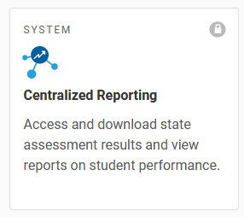
CRS: Opening Screen
Go to alohahsap.org >>> Select Smarter Balanced, Alternate, or Science Assessments
Click on Teacher or Test Coordinator/Administrators
Scroll down the page to After Testing and
The information available in CRS depends upon the user role.
TCs and Principals will see all tests and data for the school.
Teachers will see tests and data related to students they teach.

Slide 4
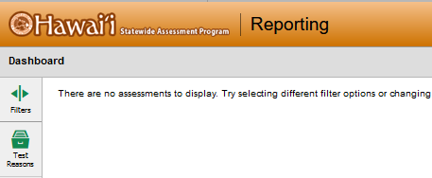
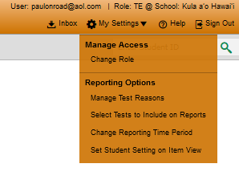
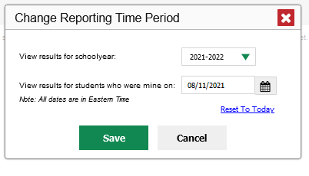
CRS: Don’T Be Surprised UPON Entry
There are no assessments to display. Try selecting different filter options or changing your preferences from the Task Manager menu. If you still do not see any data, your associated students may not have completed any assessments yet.

Slide 5
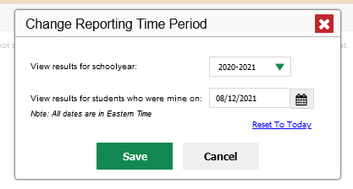
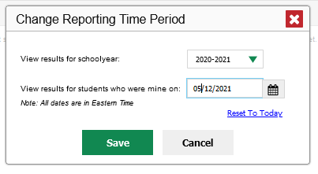
Viewing 2020-2021 Reports For Current Students
Viewing Student Who Were Yours When you tested Last Year

Slide 6
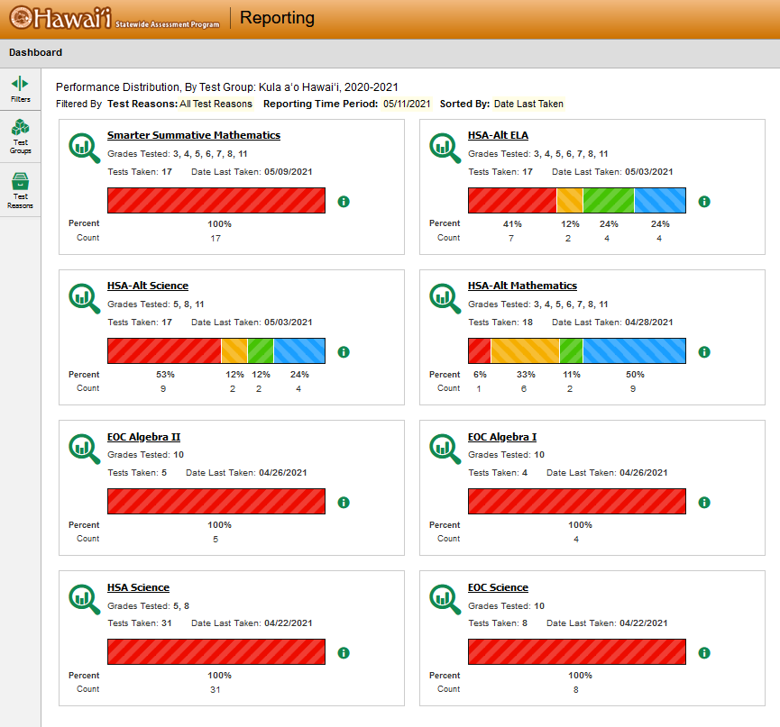
The Test Coordinator’s View
Teachers will see a similar screen but only tests taken by her/his students

Slide 7
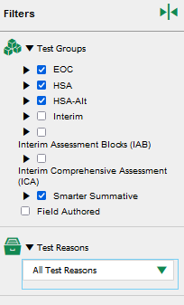
CRS: Using the Filters
Field
Field Authored Tests are those developed by teachers in the Checkpoint System
Criteria such a Fall or Spring, Opportunity number, etc.
To see the results of students in particular classes

Slide 8
Drilling Down

Slide 9
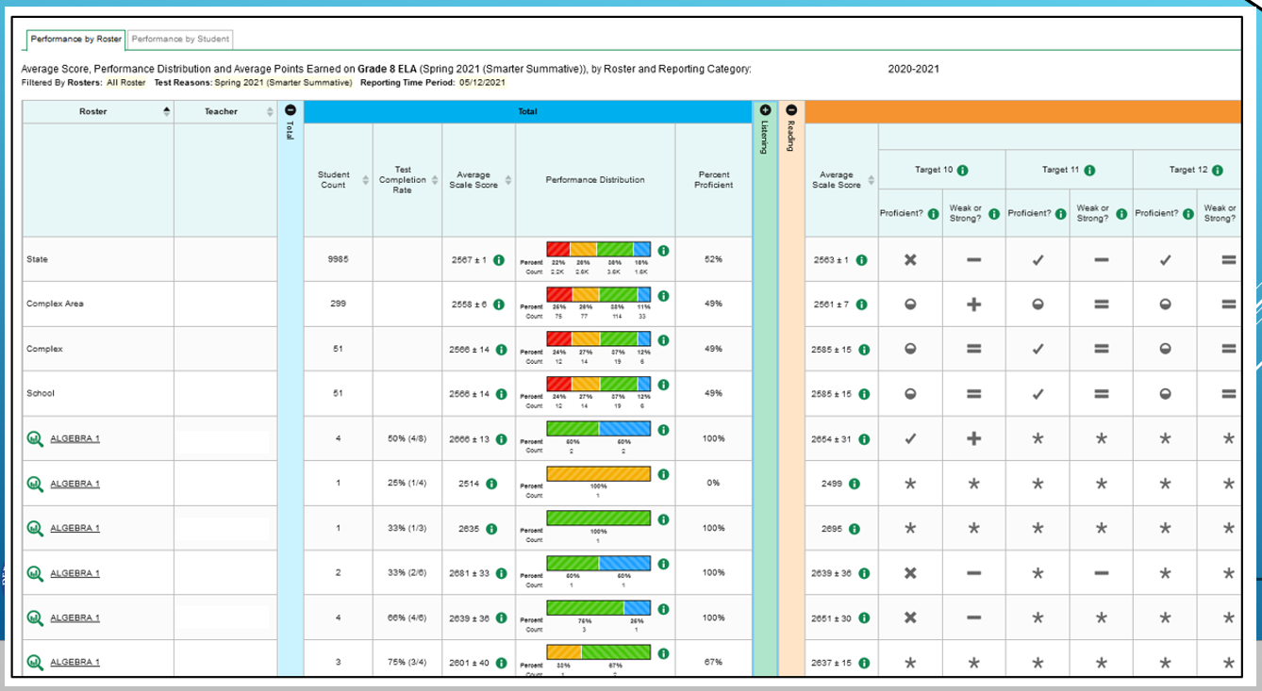
Expanding Claims (Domains in Science)

Slide 10
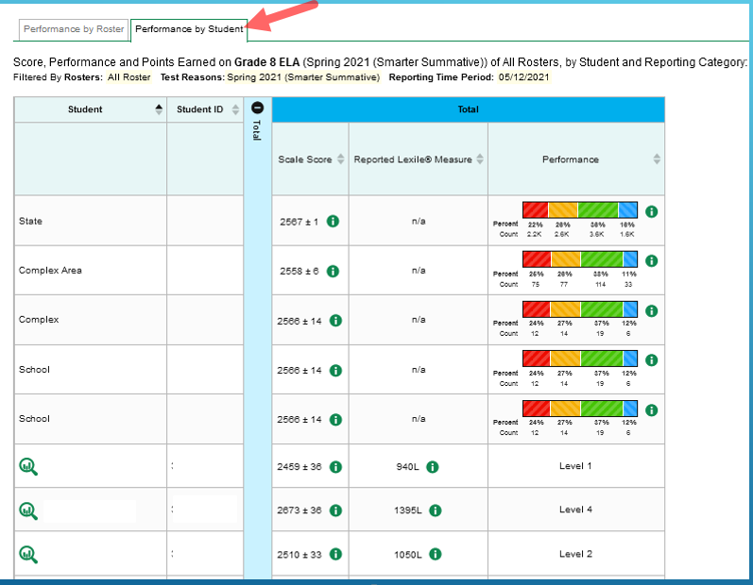
Performance by Student
There are no claim scores for students in ELA or Math due to the shortened SB assessments

Slide 11
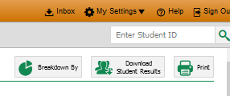
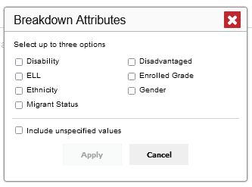
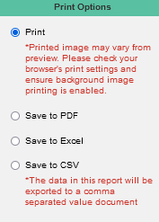
Sorting, Downloading, and Printing
Search for results of a particular student
Prints current view

Slide 12
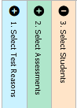
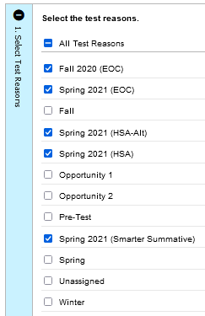
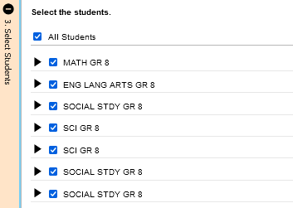
Student Results Generator
Select only the test reasons you are interested in

Slide 13
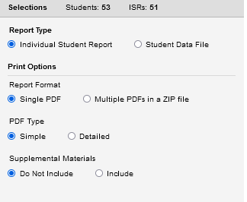
Report Type: ISRs as a pdf or Data File as xls or csv.
Print Options: All selected students reported in one pdf or each student as a separate pdf.
PDF Type: Simple report with scale score only or a detailed report with additional information such as longitudinal trends.
Supplemental Materials: Includes a cover sheet about the assessment being reported. This is the sheet that had included the superintendent’s letter in the past.

Slide 14
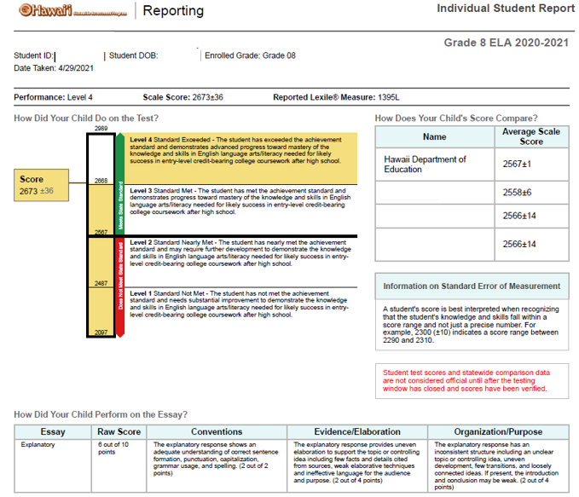
The Simple Report: ELA

Slide 15
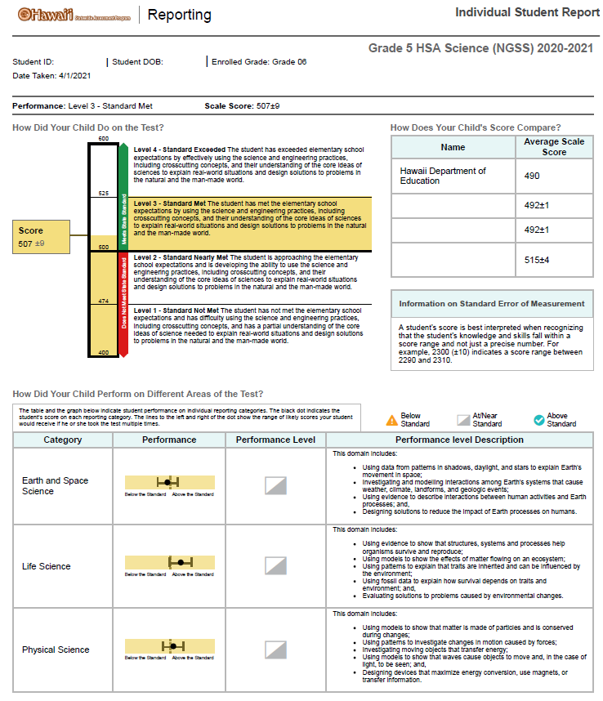
The Simple Report: Science

Slide 16
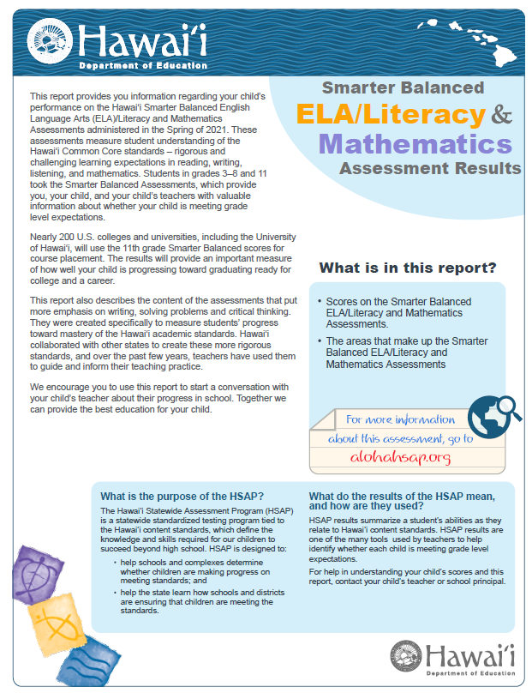
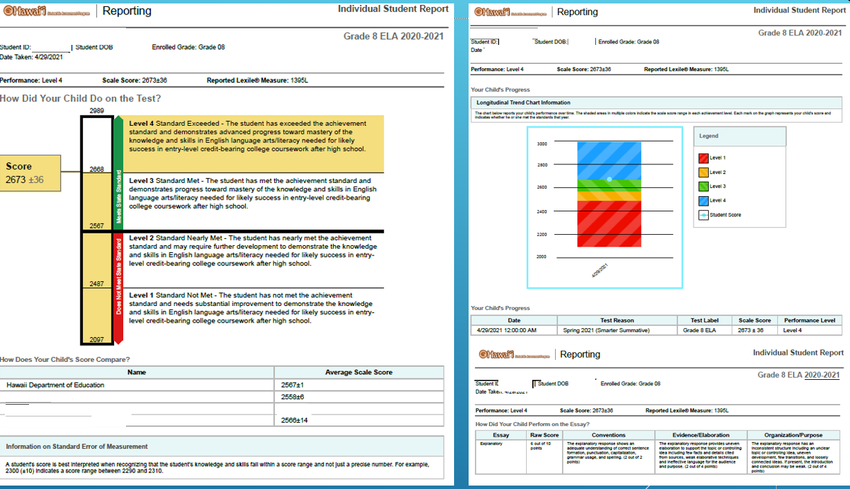
The Detailed Report with Supplemental Materials

Slide 17
CRS Resources
There are a number of excellent CRS resources at: alohahsap.org >>> Resources >>>After Testing >>> Reporting
Centralized Reporting User Guides 2020-2021
CRS Training Modules

Slide 18
Cautions Regarding SY2020-2021 Data and Reports
The Department encourages educators to use the HSAP test results for appropriate purposes that recognizes the impact of the COVID-19 pandemic.
Remember:
Teachers, school leaders, and parents have gone to great lengths to help students learn as much as possible last year despite unprecedented challenges.
End-of-year test scores provide important information and should be interpreted thoughtfully, and always in combination with other information, such as students’ grades, teachers’ observations, and attendance patterns.
Students experienced various learning disruptions this school year, which may have included first-time experiences with remote learning, limited access to internet and technology, reduced instructional time, and varying degrees of supports and resources when learning at home.
Some students were able to take tests this school year while others were not due to safety concerns, challenges with technology, or other barriers. Students had varying access to take state tests. Thus, some student groups will be overrepresented in the results and others may be underrepresented.
Appropriate Use of SY 2020-21 HSAP RESULTS

Slide 19
Accessing and Distributing Last Year’s Reports to Parents and Guardians
Student reports for statewide assessment in SY 2020-2021 need to be shared with parents/guardians of their current students.
This year you will not be receiving a “box of reports” at your school. You will need to download the reports from CRS.
You should download the detailed report with the supplemental materials.
Once the reports are downloaded a school has three options:
If you have a reliable and secure means, you can provide the reports to parents electronically,
You can print the reports at the school and distribute them to parents, or
You can download the report files and sent them to the Reprographics Section who will print them for you at the Assessment Sections Expense.

Slide 20
Downloading the Appropriate File
It is important that you download the appropriate pdf file of the reports.
If you will be sending the reports to parents electronically or printing at the school you will want to select the “Multiple PDFs in a Zip file” option. When the file is “unzipped” there will be a file for each student.
If you will be sending the reports to Reprographics for printing you will want to select the “Single PDF” option which will create on file with all of the students’ reports.
This file can then be emailed to Christine Kaneshiro Christine.Kaneshiro@k12.hi.us and cc. Michelle Kalahiki Michelle.Kalahiki@k12.hi.us. Along with a Reprographic Request form.
There is a prefilled request form available that you should complete and send along with the report pdf file.
Reprographics Request Form Partially Completed.pdf

Slide 21
Questions?
Press *6 to unmute your phone
If you are listening on your computer, click on Participants list then click on the microphone next to your name and ask your question
Type in questions in Chat (address to “Everyone”)

