Slide 1
How to Publish Tests in Checkpoint
Checkpoint System Training Module
2021–2022
Copyright © 2021 Cambium Assessment, Inc. All rights reserved.
Notes:
Welcome to the How to Publish Tests in Checkpoint training module. This module is part of a series of training modules on the Checkpoint System and its features. This module explains how to publish teacher-authored tests so that other educators can administer them as well.
Consult your Checkpoint User Guide on the Smarter Balanced, HSA Science, and EOC page of AlohaHSAP.org for information about additional features in Checkpoint.

Slide 2
Objectives
This presentation will show you how to do the following:
Log in to the Checkpoint System
Validate a test
Publish a test
Share a test with other educators
Notes:
This presentation will show you how to do the following:
Log into the Checkpoint System
Validate a test
Publish a test
Share a test with other educators

Slide 3
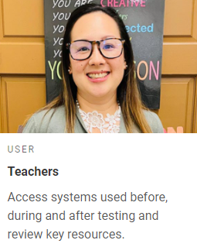
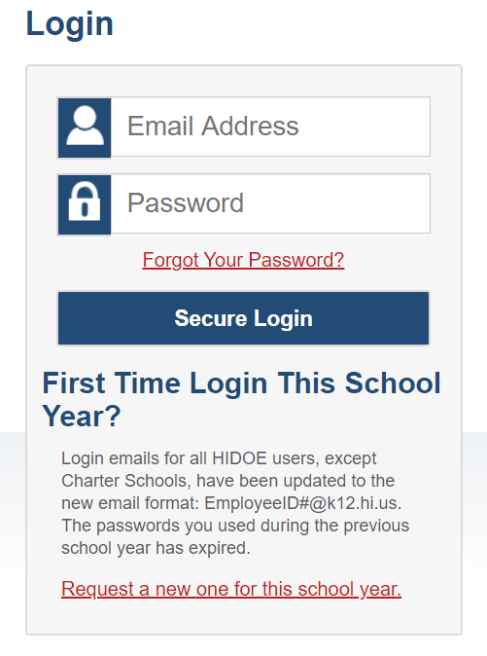
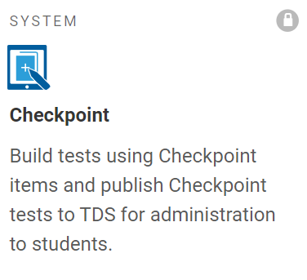
Logging in to the Checkpoint System
Notes:
To log in to Checkpoint, go to your state portal. From the portal, select your user role card. On the next page, click the Checkpoint system card. Enter your username and password, and then click Secure Login to continue.

Slide 4
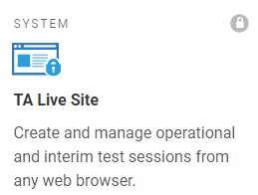
Overview of Publishing Tests
Teacher authors a test
Student takes the test
Test is published in Checkpoint
Notes:
Tests created in the Checkpoint system can be administered to students in the Test Delivery System. However, in order to administer your test to students, you must first publish it to the Test Administration System. Once you publish a test, you can administer the test to your students. You can also share the test with other Checkpoint users so they can administer the test as well. The following slides will walk you through each of these steps.

Slide 5
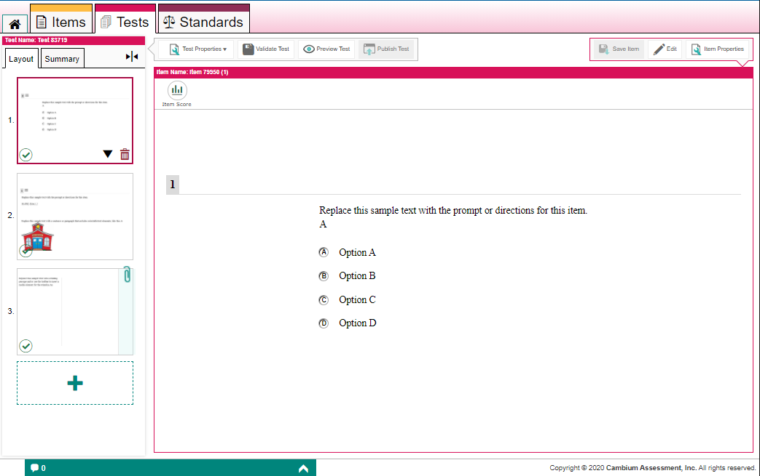
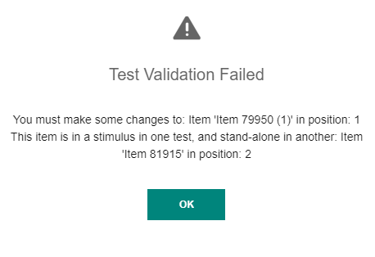
Validating a Test
1
2
Notes:
Once you have created a test in Checkpoint, you need to publish the test to the Test Delivery System so that you can administer it to students.
Before you can publish an authored test, you must first validate it to make sure there are no test errors. First, make sure each item on the test has been saved. Next, to validate the test, click Validate Test (1) in the test toolbar. If the test is already valid, this button turns gray and displays “Test is Valid”. If the test is invalid, a pop-up window will appear indicating why the test is not valid (2). You cannot validate a test with unsaved changes to any of its items.

Slide 6
Validation Errors
Validation Error | How to Fix This Error
You must make some changes to this item | This error occurs when you insert the copy of an item from an item library but you do not make any edits to the item’s content. To fix this, click Edit in the item toolbar for the copied item and update the content so that it is not exactly identical to that of the original item in the library.
A test must have at least one item | This error occurs when the test does not contain any items. To fix this, add at least one item to the test.
This item is in a stimulus in one test, and standalone in another | This error may occur when you add a library item to a stimulus. Stimuli cannot be linked to items that already exist in an item library. To fix this, remove the item and add it to a new test page instead of the stimulus. This error may also occur when you add a library item to a test without its linked stimulus. To fix this, remove the item from the test and add its linked stimulus instead. The linked item should be added automatically when you add its stimulus.
This stimulus contains no items | This error occurs when a stimulus is added to the test but no items are linked to the stimulus. To fix this, click the stimulus thumbnail, then click the add button directly below it to create a linked item.
This item is under review and can't be published | This error occurs when you add an item that has been submitted to a shared item library but has not been approved. To fix this, you must remove the item from the test. If you still wish to add an item like this to this test, you should create a copy of the item undergoing review.
You do not have permission to publish this item | This error occurs when you have added a shared item that you do not have permission to publish. To fix this, you must remove the item from the test. If you still wish to add an item like this to this test, you should create a copy of the shared item.
Notes:
You cannot validate a test if it generates any of the validation errors shown here.
Once a test is valid, it can be published.

Slide 7
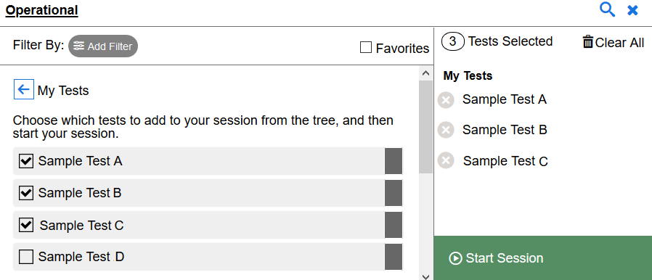
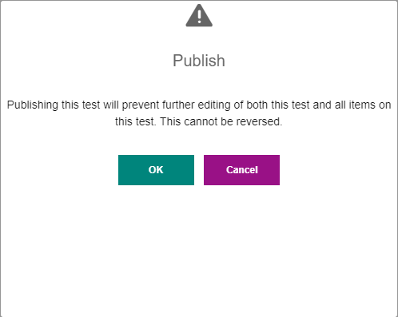
Publishing a Test
1
2
Test Administration System:
Test Selection Window
Toolbar Buttons
3
4
Notes:
To see what your test will look like to students, click Preview Test (1) in the test toolbar. You can enter sample responses to items and click Item Score to make sure the items are being scored correctly.
To publish the test, click Publish Test (2). If this button is not clickable, make sure you have validated the test.
In the confirmation message (3) that appears, click OK.
Before or after publishing a test, you can share that test with other educators for administration purposes. School-level users can also set administration dates when they share a Published test with educators in their schools. These dates determine when the test will be available in the Test Administration System.
After publishing a test, you can add it to your test sessions by selecting it from the Test Selection window (4) in the Test Administration System. You can administer your own tests, shared tests, and tests from a shared test library.

Slide 8
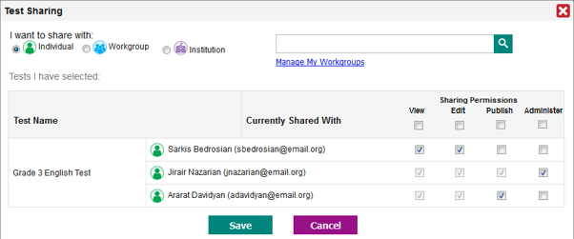
Sharing Tests
Notes:
When sharing a test, you can choose to let recipients view it, edit it, publish it, and/or administer it in the Test Administration System. Note that recipients can only edit the items themselves if they’ve been shared with them separately.
To share tests, open the Tests tab and mark the checkbox for each test you wish to share. Click the Share button above the table. The Test Sharing window opens. Select the recipients you want to share with. You can select multiple recipients.
To share with an individual educator, mark the Individual radio button and search for that educator's name or email address. School-level users may first need to select the educator’s institution from the available dropdowns.
To share the content with a custom-made group of educators, mark the Workgroup radio button and search for the name of an existing workgroup.
To share the content with an institution, such as a school, mark the Institution radio button and search for that institution's name.

Slide 9
Setting Permissions
Notes:
Once you’ve selected the recipients, select the specific permissions you’d like to give to each recipient. All recipients will be able to create copies of your shared tests by default.
To allow a recipient to view the tests, mark the View checkbox.
To allow a recipient to make edits to the tests, mark the Edit checkbox. When you’ve shared a test, recipients can change the order of items and can add and remove items, but cannot edit the content of items already on it, unless you also share those items with editing permission.
To allow a recipient to publish the test, mark the Publish checkbox.
To allow a recipient to administer the test to students, mark the Administer checkbox. This option may be checked before or after publishing.

Slide 10
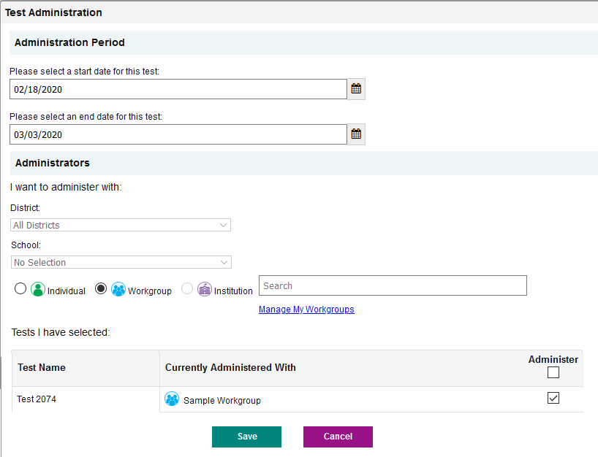
Admin Users: Sharing Tests with Administration Dates
1
2
3
4
Notes:
School-level users can set administration dates that specify exactly when their shared tests will be available in the recipients’ Test Administration System. Recipients will be able to access these shared tests in the Test Administration System, but they cannot view or edit them in the Checkpoint Tests tab.
To share a test with educators and set its administration dates, open the Tests tab. Then mark the checkbox for each Published test you wish to share and click Administer above the table. The Test Administration window appears.
To specify the date range in which the test will be available in the Test Administration System, select start and end dates from the fields in the Administration Period section (1).
In the I want to administer with section, select who will be able to administer the test in the Test Administration System (2). To share the test with an individual educator, mark the Individual radio button and search for that educator’s name or email address. You may need to select the user’s school from the available dropdowns first. To share the test with a workgroup, mark the Workgroup radio button and search for that workgroup’s name. To share the test with an entire school, mark the Institution radio button and search for that institution’s name.
Select the intended administrator (3). You can repeat this step to add more administrators.
Finally, click Save (4). The test will be available in the Test Administration System for the selected administrators on the specified start date. You can repeat these steps to update the administration rules at any time.

Slide 11
For More Help
You can contact the Helpdesk for assistance with any technical issues you encounter. When contacting the Helpdesk, please be ready to provide:
Any error messages that are appearing (including codes)
Your operating system and browser information
Your network configuration information
Your contact information for follow-up by phone or email
Any other relevant information, such as test names or content areas, student IDs, session IDs, and search criteria
For test administration or policy issues, please contact your school test coordinator.
Further Information
HSAP Portal: https://alohahsap.org/
HSAP Help Desk
Phone: 1-866-648-3712
Email:
hsaphelpdesk@cambiumassessment.com
Thank you!
Notes:
You can find the 2021–2022 Checkpoint User Guide and other helpful resources on the AlohaHSAP.org portal on the Smarter Balanced, HSA Science, and EOC pages. However, if you still require assistance with troubleshooting a technical issue, you may also contact your the HSAP Help Desk. When contacting your Helpdesk, please be ready to provide the following information:
Any error messages that are appearing (including codes)
Your operating system and browser information
Your network configuration information
Your contact information for follow-up by phone or email
Any other relevant information, such as test names or content areas, student IDs, session IDs, and search criteria
For questions about test administration or policy issues, please contact your school test coordinator.
Thank you for taking the time to view this training module. For detailed information, consult your Checkpoint User Guide located on the AlohaHSAP.org Smarter Balanced, HSA Science, and EOC portal or contact the HSAP Help Desk.

