Slide 1
How to Add Checkpoint Users to Review Groups
Checkpoint System Training Module
2021–2022
Copyright © 2021 Cambium Assessment, Inc. All rights reserved.
Notes:
Welcome to the How to Add Checkpoint Users to Review Groups training module. This module is part of a series of training modules on the Checkpoint System and its features. In this module we explain how administrator users can add other Checkpoint users to review groups. Each review group consists of multiple review levels that determine which group members can submit items to the library and which members can review them at each stage of the process.
Consult your Checkpoint User Guide on the Smarter Balanced, HSA Science, and EOC portals for information about additional features in Checkpoint.

Slide 2
Objectives
This presentation will show you how to do the following:
Log in to the Checkpoint System
Understand review levels and review groups
Create or modify a review group
Name the new group or choose which group to modify, then select a review level
Add members to the group and save
Notes:
This presentation will show you how to do the following:
Log in to the Checkpoint System
Understand review levels and review groups
Create or modify a review group
Name the new group or choose which group to modify, then select a review level
Add members to the group and save

Slide 3
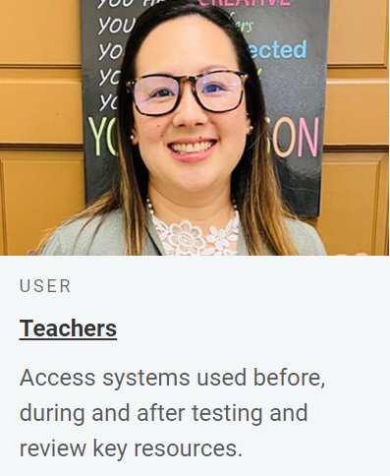
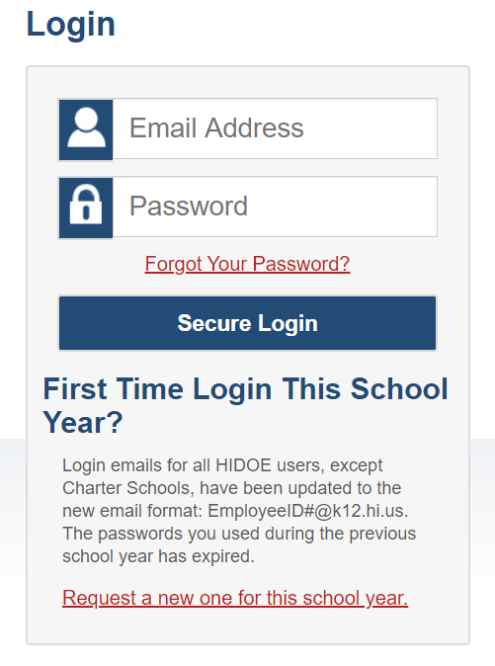
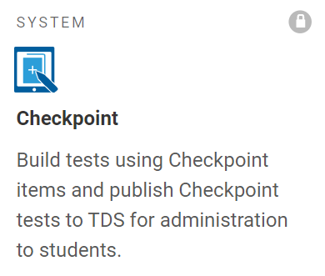
Logging in to the Authoring System
Notes:
To log in to Checkpoint, go to the Smarter Balanced, HSA Science, or EOC page of the HSAP portal. From the portal, select your user role card. On the next page, click the Checkpoint system card. Enter your username and password, and then click Secure Login to continue.

Slide 4
Understanding Review Levels and Review Groups
Review Level | Description
Draft | Members with this review level can create items and submit them to the Initial Review stage of the review workflow.
Initial Review | Members with this review level can review items in the Initial Review stage and approve them to be sent to Content Review. They can also edit submitted items and send them back to original author for revision.
Content Review | Members with this review level can review items in the Content Review stage and approve them to be sent to the Final Approval stage. They can also edit submitted items and send them back to original author for revision.
Final Approval | Members with this review level can review items in the Final Approval stage and approve them to be added to the shared items library. They can also edit submitted items and send them back to the original author for revision.
Notes:
Before Checkpoint users can submit or approve items for a shared library, a user with administrator privileges must add them to a review group and assign their review level permissions within the group. Each review group consists of multiple review levels that determine which group members can submit items to the library and which members can review them at each stage of the process.
You can create multiple review groups, but when users submit an item to the library, they can choose only one group to review it. Since a review group includes multiple review levels, a review group must include at least one member assigned at each review level in order for items to complete the review workflow. For example, if a review group does not have any members with Content Review permission, nobody can approve an item once it reaches the Content Review level.

Slide 5
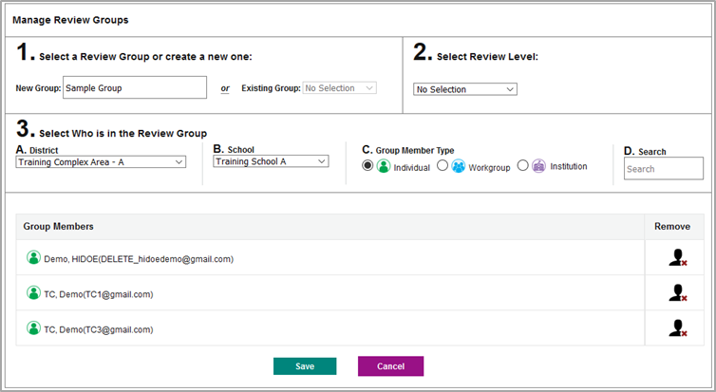
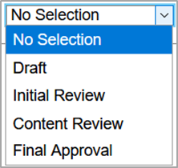
Creating or Modifying a Review Group (Part 1)
Notes:
To add Checkpoint users to a review group, select Review Groups from the My Settings menu in the banner. The Manage Review Groups window appears.
1. If you wish to create a new review group, enter a name for the group in the New Group field.
If you wish to update the membership of an existing group, select the desired group from the Existing Group drop-down.
2. To assign a review level permission to the group members you are adding, select an option from the Select Review Level dropdown. This review level permission applies only to the group members you select in the next few steps. You can assign only one review level at a time. However, you will later be able to assign additional review levels for the same review group as necessary.

Slide 6
Creating or Modifying a Review Group (Part 2)
Notes:
3. Next, select who should be added to the review group.
To add an individual educator, mark the Individual radio button and search for that educator's name or email address. You may first need to select the educator’s institution from the available District and School dropdowns on the left.
To add the members of a workgroup, mark the Workgroup radio button and search for that workgroup's name. A workgroup is a custom group of educators created for sharing purposes. Checkpoint users can create workgroups from the My Settings menu in the banner. More information about creating and joining workgroups is provided in the full-length Checkpoint training module.
To add the members of an entire institution, such as a school or district, mark the Institution radio button and search for that institution's name.
The selected group members will be added to the list at the bottom of the window.
To remove a member from the group, click the remove user from group button beside that member. The button looks like a human silhouette with a red X on it.
To save your changes, click Save. The selected educators may begin submitting or reviewing items immediately, depending on which permissions were given to them.
When setting up a new review group, you must repeat some of these steps until you have added members to the group at each review level. If you do not assign a particular review level to any members of the group, such as Final Approval, submitted items can never be added to the library. To add members for another review level, select another option from the Select Review Level dropdown and add more members as previously explained.
Note: Educators are limited to who they can add to Review Groups based on their role in TIDE. Please see Appendix F of the Checkpoint User Guide on the Smarter Balanced, HSA Science, and EOC pages of the HSAP portal for more information.

Slide 7
For More Help
You can contact the Helpdesk for assistance with any technical issues you encounter. When contacting the Helpdesk, please be ready to provide:
Any error messages that are appearing (including codes)
Your operating system and browser information
Your network configuration information
Your contact information for follow-up by phone or email
Any other relevant information, such as test names or content areas, student IDs, session IDs, and search criteria
For test administration or policy issues, please contact your district test coordinator.
Further Information
HSAP Portal: https://alohahsap.org/
HSAP Help Desk
Phone: 1-866-648-3712
Email:
hsaphelpdesk@cambiumassessment.com
Thank you!
Notes:
You can find additional Checkpoint resources on the Smarter Balanced, HSA-Science, or EOC portal. However, if you still require assistance with troubleshooting a technical issue, you may also contact the HSAP Helpdesk. When contacting the HSAP Helpdesk, please be ready to provide the following information:
Any error messages that are appearing (including codes)
Your operating system and browser information
Your network configuration information
Your contact information for follow-up by phone or email
Any other relevant information, such as test names or content areas, student IDs, session IDs, and search criteria
For questions about test administration or policy issues, please contact your district test coordinator.
Thank you for taking the time to view this training module. For detailed information, consult your Checkpoint User Guide located on the Smarter Balanced, HSA-Science, and EOC portal or contact the HSAP Help Desk.

