Slide 1
Managing Reasons For Non-Participation
Please mute on entry
Enter any questions in the Chat
There will be a chance for anyone who would like to voice their questions at the end of the presentation

Slide 2
Data Management
There are circumstances in which a student did not participate in an expected test (e.g., student or parent refusal) or participated in a test but in a non-standard way (e.g., student inadvertently takes an incorrect test, a parent opt-out, or the student not receiving appropriate instruction prior to the test).
In such instances, you need to assign a special code to the student’s test so that TIDE can accurately explain the reason for non-participation.
Only one reason for non-participation can be selected for each test for which a student is eligible.
All students in the school needs to be accounted for.

Slide 3
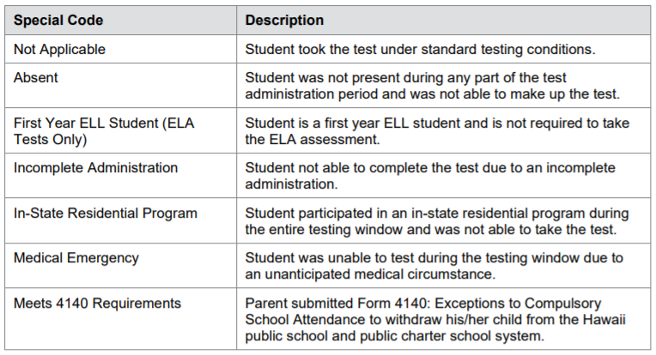
Special Codes

Slide 4
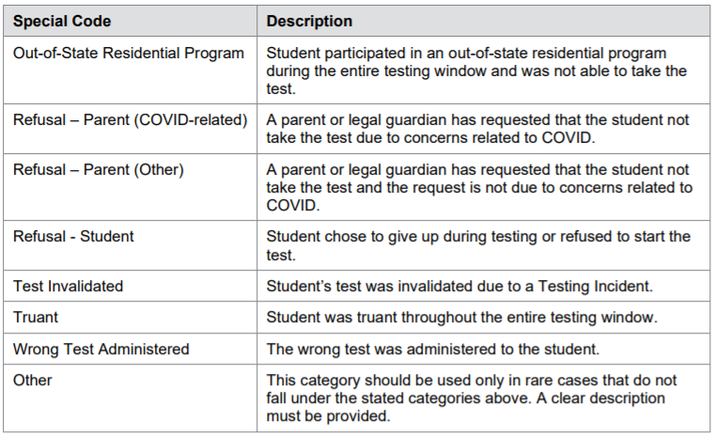
Special Codes

Slide 5
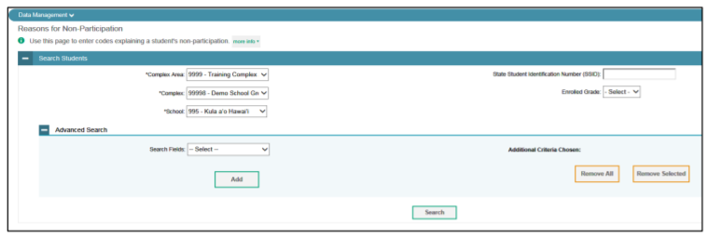
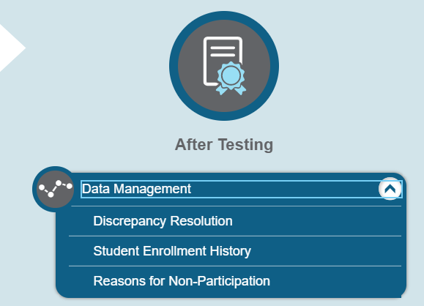
Viewing and Editing a Student’s Reason
From the Data Management task menu on the TIDE dashboard, select Reasons for Non-Participation. The Reasons for Non-Participation page appears
Retrieve the record for the student whose non-participation codes you want to view or edit by following the procedure in the section

Slide 6
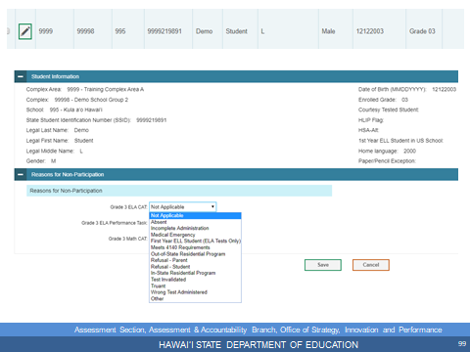
In the list of retrieved students, click for the student whose non-participation codes you want to edit. The Edit Non-Participation form appears, listing the student’s demographic information in the Student Information panel, and the student’s available tests and reasons for non-participation in the Reasons for Non-Participation panel
From the drop-down lists in the Reasons for Non-Participation panel, select the reason for non-participation for each available test, as required. For a listing of reasons for nonparticipation.
Click SAVE.

Slide 7
Resolving Discrepancies
The Discrepancy Resolution System (DRS) only reports tests for which non-participation codes have not yet been established. For example, if a teacher finds out that a student will not take a test because of a medical reason and a non-participation code is set up for the student’s test through TIDE’s Non-Participation Code page before the DRS opens, then that test will not be displayed as a discrepancy in the DRS.

Slide 8
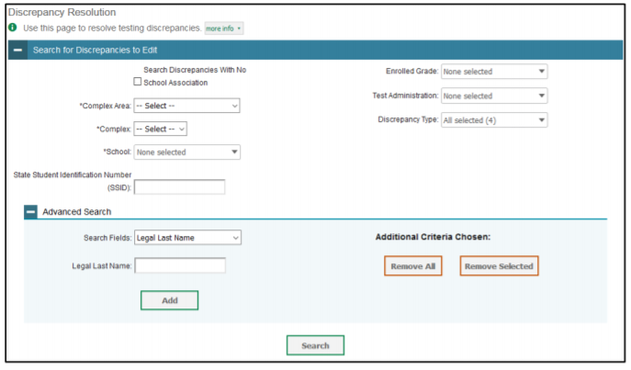
Discrepancy Resolution
From the Data Management task menu on the TIDE dashboard, select Discrepancy Resolution.
Schools should select "Untested Student" from the "Discrepancy Type" menu when searching for discrepancies.
Select for the non-participated student discrepancy you want to resolve.
The Resolve Discrepancy: Non-participated Students window appears for the test that was not started

Slide 9
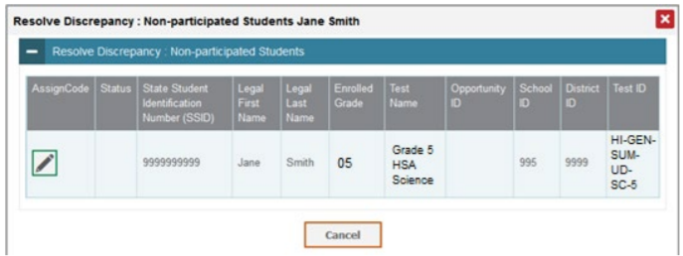
To assign a non-participation code to the discrepant test, click in the Assign Code column.

Slide 10
From the Non-Participation Code drop-down list, select the appropriate non-participation code. 6. Click Save. A confirmation message appears to notify you that the discrepancy has been successfully resolved. 7. Click Continue to close the confirmation message and return to the discrepancy listing.

Slide 11
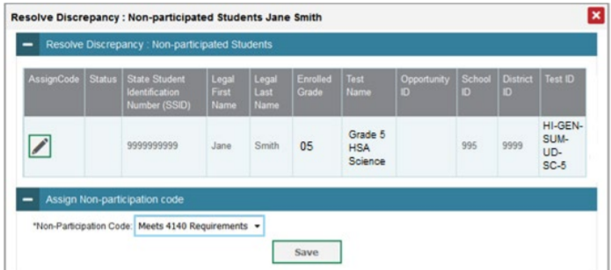
Once each student discrepancy has been saved and successfully resolved (some students may have more than one test that will need to be resolved), the student’s name is removed from the list in the DRS. Therefore, when all students’ non-participation status has been resolved, there should be no students listed so you will know all discrepancies have been resolved.

Slide 13
CONTACT
Assessment Section
PH: 808-305-3636
Karen Tohinaka- karen.tohinaka@k12.hi.us
Paul Dumas- paul.dumas@k12.hi.us
HSAP Help Desk
ph: 1-866-648-3712
Email: hsaphelpdesk@cambiumassessment.com

