Slide 1
2020 – 2021 Assessments Ensuring Successful Administration
Test Coordinators Training Winter 2021 PowerPoint Download: http://bit.ly/3otfBaI
Notes:
Welcome! Folder contents: agenda, PPT notes, handouts, UAAG
Housekeeping: coffee, tea, water, lunch, parking, restrooms, WIFI, download files
Parking Lot: We will have chart paper and post its for you to post questions during breaks and lunch.

Slide 2
Office of Strategy, Innovation and Performance
Assessment and Accountability Branch
Keith Kameoka– Acting Director, Assessment and Accountability Branch
Assessment Section Contacts
Brian Reiter – Administrator, Assessment Section
Paul Dumas– Test Development Specialist- Science/NGSS
Sue Forbes– Test Development Specialist-ALT
Bruce Hirotsu– Test Development Specialist-ACT
Elaine Lee– Test Development Specialist-Accommodations
Dianne Morada– Test Development Specialist-Item Dev/Math
Kelsie Pualoa – Test Development Specialist-Item Dev/ELA
Karen Tohinaka – Test Development Specialist/SBA/WIDA ACCESS
Dewey Gottleib– NAEP Testing Specialist
Cambium Assessment Inc.
Emily MacGillivray – Cambium Project Manager
Notes:
Introduce the OSIP Team
Thank all of the participants for taking the time to participate in the training.
We all hope to have a successful “testing season” this year with the few problems and minimal stress

Slide 3
The Goal:
Our students will be fully prepared for the Smarter Balanced Assessments which will be appropriately administered such that our young people have a fair and reliable opportunity to demonstrate their knowledge and skills.
Test Coordinators (TCs) will understand and be able to fulfill the important role they have so that their school successfully carries out this year’s statewide assessments.
Success means:
schedules are developed and shared and supported across the school.
technology resources, including school networks and computers, are ready for testing.
student supports are appropriately set in TIDE based on individual needs and IEPs.
test administrators are trained and prepared to create an appropriate test environment and to administer the tests following the guidelines in the test administration manuals.
students have become familiar with the online testing by completing the training and practice tests.
school personnel are aware of what constitutes testing incidents, take steps to ensure that they do not occur, and know how to respond when issues arise.
the school’s participation rate is 95% or higher.
appropriate school personnel know how to access and use the assessment results.
Notes:
Overall and session goals and objectives.
The Assessment Section would love to have every student demonstrate proficiency and have made every effort to develop the tools, resources, and procedures to make this possible.
Assuming students have had a “high quality” opportunity to learn, the “testing system” allows students to train and practice prior to the assessment, have the appropriate supports during the tests, and provide schools and teachers with data to inform decision making.

Slide 4
Agenda: Day 1
Overview of the Statewide Assessments
General Information on Statewide Assessment
The Systems and Tools Related to Smarter Balanced and HSA Science Assessments and End of Course Exams
Alohahsap portal navigation
Dealing with COVID in assessments
Navigating TIDE
Agenda: http://bit.ly/3iZuKze

Slide 5
Agenda: Day 2
Accessibility and Accommodations
Administering the Tests
Test Security
The Centralized Reporting System
Interim Assessment and Tool for Teachers (formerly the Digital Library) Updates

Slide 6
Changes This Year…..
COVID-19
Working with Parents and Students: Hybrid, FOL, In-School
Reporting: Centralized Reporting System
Requesting Accommodations
Digital Library Redesigned and is now Tools of Teachers
SB ELA and Math Test Times

Slide 7
Things That are the Same:
TA Live Site
TIDE
Test Security

Slide 8
The Assessments: An Overview

Slide 9
Smarter Balanced Assessments
These assessments measure college and career readiness (or progress towards readiness) as described in the Hawaii Common Core State Standards.
The Smarter Balanced summative assessments are available in ELA/literacy and mathematics to students in grades 3–8 and 11.
The ELA/literacy summative assessment consists of a computer adaptive test (CAT) as well as a performance task (PT). For ELA/Literacy, a student must complete both the CAT and PT in order to receive a score.
The Math summative assessment consists of a computer adaptive test (CAT) only.

Slide 10
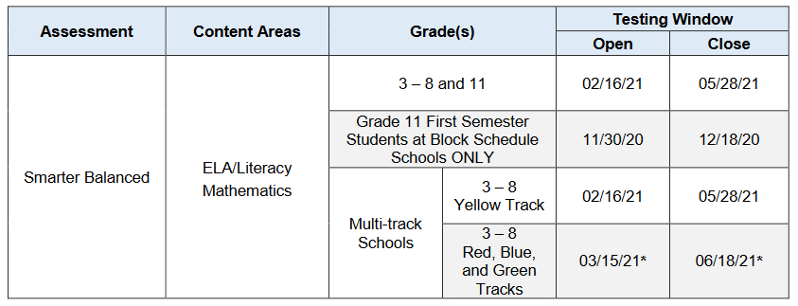
SB Test Windows and Estimated Test Times/Shortened CAT
Content Area | Grades | Computer Adaptive Test (CAT) items hrs : mins | Performance Task (PT) hrs : mins | Total hrs : mins
English Language Arts/Literacy | 3–5 | 45-60 min | 1:45 | 2:45
 | 6–8 | 45-60 min | 1:20 | 2:20
 | HS | 45-50 min | 0:55 | 1:45
Mathematics | 3–5 | 45-60 min | N/A | 1:00
 | 6–8 | 45-60 min | N/A | 1:00
 | HS | 45-60 min | N/A | 1:00
Both | 3–5 | 2:00 | 1:45 | 3:45
 | 6–8 | 2:00 | 1:20 | 3:20
 | HS | 1:40 | 0:55 | 2:45
01/29/21
When developing a testing schedule, use the estimated testing times to calculate the amount of time it will take to complete an assessment in each content area and grade level. The shortened CATs have been designed to be completed in one test session lasting 45-60 minutes.

Slide 11
HSA Science (NGSS) and Biology 1 EOC
Beginning last school year, the HSA Science Assessments, Biology End-of- Course Exam and HSA-Alt Science assessments are based upon the NGSS and no longer aligned with the HCPS III for Science.
The NGSS calls for science teaching and learning to begin in kindergarten and continue so that by the end of the 12th grade all students have gained the knowledge and skills knowledge necessary to:
engage in public discussions,
to be critical consumers of scientific information related to their everyday lives, and
to continue to learn about science throughout their lives.
The Performance Expectations (PEs) that make up the NGSS integrate the core ideas of science (DCIs) with the science and engineering practices (SEPs) used in science, and the crosscutting concepts (CCCs) that link the sciences.

Slide 12
NGSS (cont.)
The new science assessments will be quite different from the past assessments.
The NGSS assessments at each grade include item clusters and stand-alone items. Item clusters include a stimulus and a series of questions that generally take students about 6 to 12 minutes to complete. Stand-alone items are shorter and generally take students 2 to 3 minutes to complete.
Science (NGSS) assessments is administered in Grade 5 covering the NGSS PEs for grades 3 through 5 and Grade 8 covering NGSS PEs for grades 6 through 8. Students are required to take this test once but will have an optional second opportunity.
The Biology EOC will cover the NGSS high school NGSS Life Science PEs as well as Earth Space Science PEs HS-ESS 2-6, HS-ESS2-7, and HS-ESS3-3. Students will have 1 opportunity to take the Biology EOC.

Slide 13
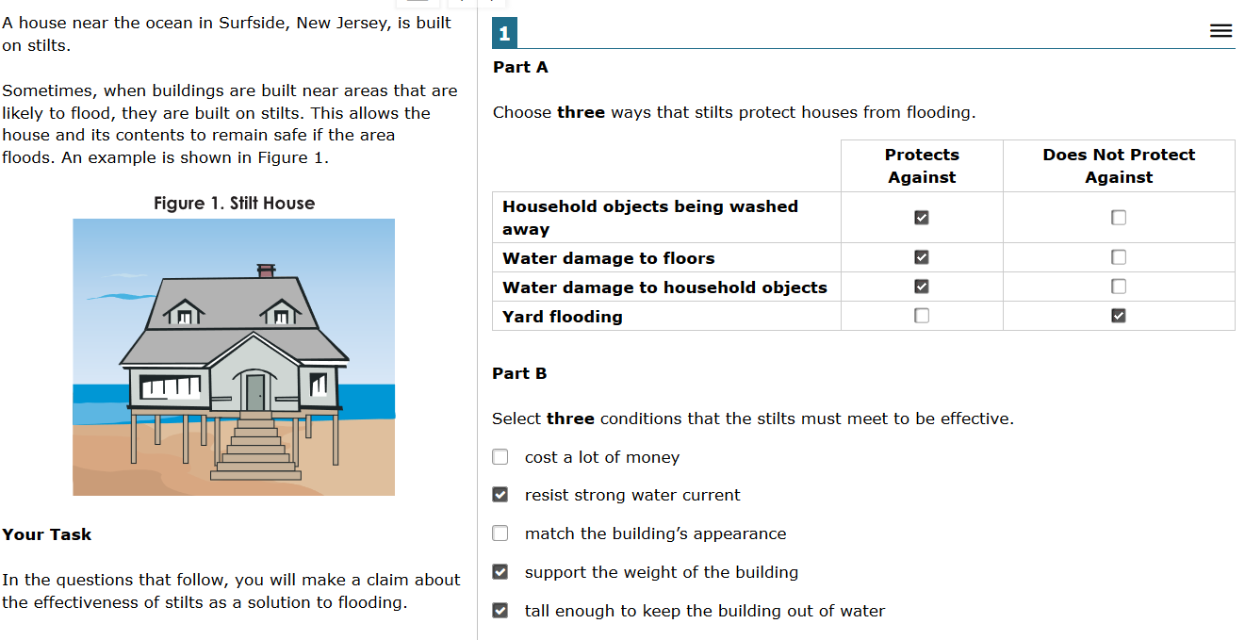
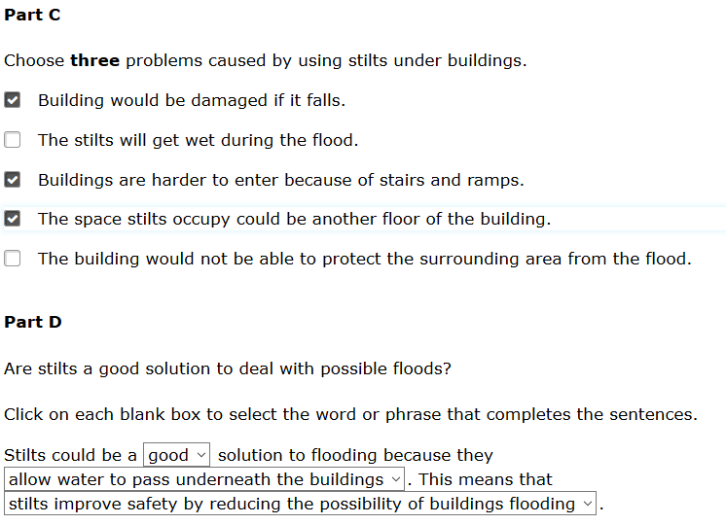
A Cluster Item

Slide 14
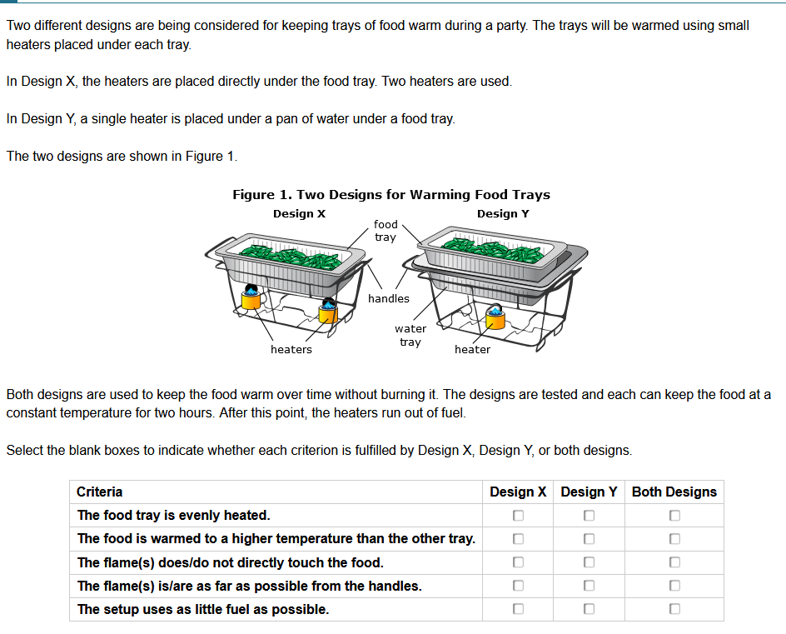
A Stand-Alone Item

Slide 15
Science Assessment Design: A Student’s Test
Each student’s test will consist of:
6 clusters (two each from physical, life, and Earth science for grades 5 and 8)
12 stand alone items (4 from each domain of science but addressing different sub-areas than addressed by the clusters)
Embedded field test items (either 1 cluster or 4 to 6 stand alone items)

Slide 16
Science continued…...
Test Time: The target is that 80% of the students will complete the test in 90 minutes.
Grades 5 and 8 have 2 opportunities but are only need to complete one.
All students enrolled in the school, including fully online students, should be tested. Home Schooled students can be offered an opportunity to be tested.
All testing should be carried out following state, county, and school COVID-19 guidelines and procedures.
Results will not be available until after achievement standard setting during Summer 2021.
The Training/Practice Test

Slide 17
HSA Science (NGSS) and Biology 1 EOC
01/29/2021
The Biology EOC is required of all students enrolled in Biology.
The Algebra EOCs are optional.

Slide 18
https://hsa.alohahsap.org/resources/ngss-resources/
Resource | Description
Guide to Remotely Administering Interim Assessments | This document outlines considerations regarding the remote administration of the NGSS Interim Assessments.
Hawaii NGSS Assessments Overview | This document provides information on the NGSS assessments including: scheduling; test design; item types including practice items; information regarding practice and training tests and NGSS Interim Assessments; and reporting.
NGSS Elementary School Cluster Specs NGSS Middle School Cluster Specs NGSS Biology EOC Cluster Specs | The item cluster specifications guide the work of item writers and the review of item clusters. They can also be helpful to teachers as they implement the NGSS and prepare students for the upcoming NGSS assessments.
HIDOE NGSS Fact Sheet | This document provides information on the NGSS.
HIDOE Science Assessment Interpretation and Action Guide | The purpose of this guide is to provide schools and complex areas with support to make meaning from assessment results and to translate data into practice for science teaching and learning.
NGSS Family Guide: Grades 3-5 NGSS Family Guide: Grades 6-8 NGSS Family Guide: High School | The Parent Guides describe the NGSS and illustrate how they help students build an understanding of science.
NGSS Assessments Test Design, Test Blueprints, and Sample Items | This document provides information on the NGSS test design including test blueprints and sample items.
NGSS Interim Assessments Fact Sheet | This document contains an overview of the NGSS Interim Assessments that will be administered.
NGSS Interim Assessments Test Administration Guide | This guide provides an overview of how to prepare for and administer the NGSS Interim Assessments.
The Assessment Section staff, OCID Science staff and the Communications Office have been working together to develop/adapt NGSS-related resources for science teachers, school leaders and parents and families. These are now available at:
NGSS Main Page: http://bit.ly/HIDOE-NGSS-2019
NGSS Toolkit for Staff: http://bit.ly/HIDOE-NGSS-Toolkit
NGSS Resource for Families: http://bit.ly/HIDOE-NGSS-Families

Slide 19
HSA-Alternate Assessments
The HSA-Alt is a system of assessments based on alternate academic achievement standards and is designed for students with the most significant cognitive disabilities. Typically, this student population consists of less than 1% of the total student population.
Students are tested in ELA and Math in grades 3-8 and 11. They are assessed in science in grades 5, 8, and 11. The 11th grade science assessment is based upon the NGSS high school life science PEs which have been appropriately reduced in complexity.
The HSA-Alt Range Performance Level Descriptors and other resources can be found at https://hsa-alt.alohahsap.org/resources/
Procedures for administering the HSA-Alt are significantly different from those used for the other assessments.

Slide 20
WIDA ACCESS for ELLs: ACCESS is a secure large-scale English language proficiency assessment administered to Kindergarten through 12th grade students who have been identified as English language learners (ELLs).
Window: 01/12/2021 - 02/24/2021
KĀʻEO: The University of Hawai’i Mānoa and Ka Papahana Loiloi Kaiapuni of the Office of Hawaiian Education developed and administer the Kaiapuni Assessment of Educational Outcomes (KĀʻEO) in Language Arts, Mathematics and Science in the Hawaiian language.
Window: 04/01/2021 - 05/28/2021

Slide 21
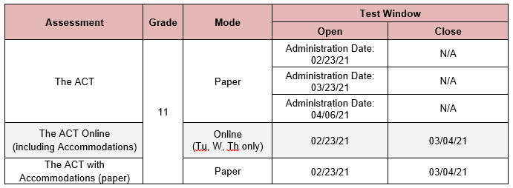
This college admissions assessment is to be administered to all students enrolled in grade 11 (as defined by credit count in the Student Information System) who have not been administered the test in a prior year.

Slide 22
Seal of Biliteracy: The Seal to be awarded to students who demonstrate a high proficiency in either of the State’s two official languages and at least one additional language, including American Sign Language; or to a student who demonstrates a high proficiency in both of the State’s official language The purposes of the Seal of Biliteracy are:
to recognize the importance of enabling students to be college, career, and community ready in today’s global society and
to support opportunities for study of and increasing proficiency in ‘Ōlelo Hawai‘i.
NAEP: Postponed

Slide 23
Developing Testing Schedules

Slide 24
Developing Testing Schedules
Computer Adaptive Test for ELA/L and Math. It is recommended that students have one but not more than two 45 to 60 minute sessions.
Performance Task for ELA/L It is recommended that students have one but not more than two 40 to 60 minute sessions. Segment 1 will only have one question so students should not be told to stop at the end of that segment.
Most students can be expected to finish within these times.
While “limiting” testing time should be approached with caution, particularly for students with special needs who may require more time. Students do not need to be scheduled for additional sessions if they are not “productively engaged” in completing the test.
For students who are off–task or not actively engaged in testing may be read the statement verbatim:
Breaking the tests into numerous short sessions can be counterproductive - leading to “test burn out” and increased scheduling challenges.

Slide 25
Things To Keep In Mind When Scheduling
Bandwidth (work with school administration)
Remember teachers are also using school bandwidth with Google Classroom. Work with you school leadership and other staff at your school to ensure there will ample bandwidth for testing.
Be creative (may not be feasible)
Test after schools hours for Distance Learning students (i.e. 2:30-4:00pm)
Saturdays (check with Assessment to insure there will be no updates or maintenance going on that weekend)
Test any student that is on campus
Have hot spots used exclusively for testing

Slide 26
Addressing COVID-19
Create backup plans for staff shortages, student absences, school closures, and possible test day cancellations (training additional staff as test administrators - particularly for SBA and ACCESS, alternative test days, alternate testing site).
Create a plan for students or staff members in case of illness.
Consider a check-in process and waiting area (if they arrive early) for students who are coming in only for testing, whether your format is virtual or hybrid.
Create alternate plans to complete testing that align with different schooling scenarios including:
The school switches to an all distance learning format prior to or during testing.
The school switches to a hybrid (distance learning/in-person) format prior to or during testing.

Slide 27
Know what each assessment’s test window is and utilize the entire test window to your advantage. Do not wait to test your students as staff and student absences may make it very difficult to ensure testing of all students.
Break the testing population into smaller groups, over multiple testing rooms, over multiple days (if applicable).
Consider staggering the start time for groups for students by just a few minutes to spread out that higher need for network bandwidth.
Plan a flexible testing schedule with makeup dates and consider starting earlier in the testing windows in anticipation of student and staff illness.

Slide 28
Allow sufficient time for handwashing, sanitization, moving students in and out, doing health assessments, socially distanced bathroom breaks, and other safety procedures.
Allow time to maintain social distancing during breaks.
Assemble a team of staff to assist the test coordinator plan and implement in-person testing.
Be creative in creating small student pods. (Example: grouping families together, keeping student cohorts or classrooms together as much as possible, etc.

Slide 29
Everyone wears a mask at all times. The number of students in test session may vary but students must be at least 6 feet apart with masks
Each student have their own 3' x 6' table or desk . All of their belongings placed under their table only
Temperature taken and hand sanitizer given before they enter the room*
Use gloves to distribute and collect the tests
*Dependent upon school policies and procedures

Slide 30
Students not allowed on campus more than 30 minutes before their test and must leave immediately after testing*
Allow at least 30 minutes between each group for tables, chairs, handles, headsets, keyboards, mice and anything else that a student may have touched to be sanitized*
Stagger their location and times*
At the end of the day, teachers wipe all the areas of the testing room including tables, computers, headset, etc.*
*Subject to school policies and procedures

Slide 31
Parent Refusal
Here is some info regarding those parents who do not want to bring their student on campus:
The State is obligated to assess ACCESS, ELA, Math and Science progress annually.
A parent/legal guardian must annually refuse, in writing, their child's participation in the SBA Assessment.
Principals should review the Opt Out Guidance before communicating with the parent(s).
Principals can either send the talking points or make a phone call to the parent/legal guardian explaining the importance the student’s participation in testing.

Slide 32
Parent Refusal (cont.)
Principal can designate others to perform responsibilities as the principal sees fit.
If a parent/legal guardian does not want their child to be tested even after school administrators have followed the Opt-Out Guidance procedures, they will need to send in a letter indicating the reason for the Opt-Out, then a copy of the parent refusal of testing letter, handwritten or via email, shall be filed in a folder at the school and entered in a spreadsheet. Consider creating a spreadsheet that includes student last name, first name, grade level, school contact, letter received Y/N .
A copy of the Opt Out Guidance document can be found on the HIDOE Intranet

Slide 33
SOME USEFUL LINKS
COVID-19 Related Guidelines
Hawaii DOE Assessments Considerations for Spring 2021
Hawaii DOE Suggested Guidelines for Spring 2021 In-Person Test Administration
Communicating with Parents
Parent Letter Template for In-Person Test Administration
Opt-Out Guidance (DOE Login Required)

Slide 34
The Test Coordinator and Assessment Team

Slide 36
Preparing for Testing
Getting the Team on the same page
Developing a Testing Schedule
Ensuring the “technology” is ready
Setting up Users in TIDE
Preparing and Training Test Administrators
Identifying Designated Supports and Accommodations for Students
Adjusting Student Settings in TIDE

Slide 37
Key Tasks for the Test Coordinator
Key Responsibilities:
General oversight of all test administration activities in their schools and for all TAs.
Complete the online TA Certification Course and review all relevant manuals and guides.
Identify Test Administrators, Teachers, and Proctors, and ensure that they are all properly trained and certified.
Work with the School Assessment Team to create testing schedules and procedures.
Work with Technology Coordinator to ensure that all computers to be used for testing are ready and any other technical issues are resolved.
Work with the Student Services Coordinator to ensure that the appropriate designated supports and accommodations are set in TIDE for all students.
Monitor testing sessions and progress and ensure that all students participate as appropriate.
Collaborate with the Curriculum Coordinator to arrange for training and practice tests as well as the Interim Assessments.
Disseminate information about testing to families, including Parent Information Booklets and appropriate parent letters. This may be “electronic communication”.

Slide 38
Get the Team on Board
Test Coordinator
Principal or Vice Principal
Technology Coordinator
Test Administrators
Student Services Coordinator
Curriculum Coordinator/ Data Team
Also:
Assessment Section staff
HSAP Help Desk
See Overview of Roles in TAM pg 6-9
Smarter Balanced Summative Test Administration Manual

Slide 39
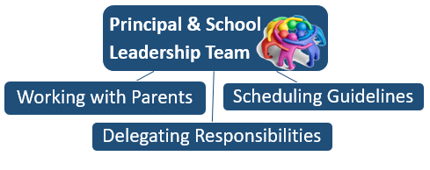
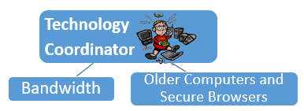
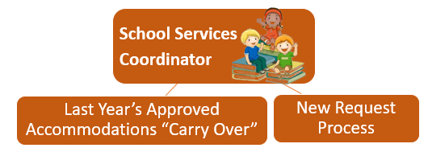
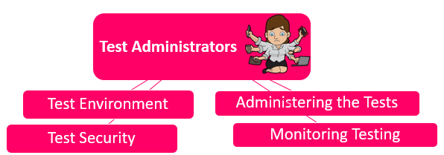
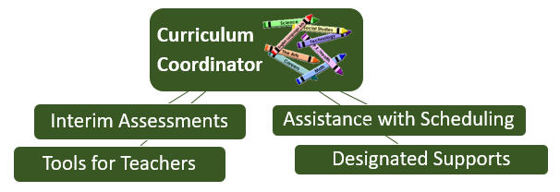
Technology Coordinator Resources
Accessibility and Accommodations Resources
Smarter Balanced Test Administration Manual
HSA Science /EOC Test Administration Manual
Guide to Navigating Online HSAP Administration
Interim Assessments / Tools for Teachers

Slide 40
Personnel Who May Serve as Test Administrators

Slide 41
TA Training Packet
Assessment Section will also be monitoring training of TA’s held at school sites.
Document where, when and who attended the trainings with sign in sheets and file at the school.
All TA’s need to be certified and complete the TA Certification course in TIDE or they cannot administer the Assessments.
Assessment Section will make available TA training packets on alohasp.org site under Trainings and Webinars to assist in your trainings.
Test Administrator Training Packet
2020-2021 Smarter Balanced Assessments Procedures HSAP Test Administrator Training PowerPoint (Part 1) HSAP Test Administrator Training PowerPoint (Part 2) Test Sessions ID Log 2020-2021 Testing Incident Report Form | These materials are available for schools to provide TA trainings at their schools. They can be modified to meet to your school's policies and procedures so long as they are consistent with the Test Administration Manual (TAM).

Slide 42
Adding Accommodations/Designated Supports
Get together with your SSC and review students and enter IEP/504 Student Designated Supports in TIDE and submit the request forms for Accommodations to the Assessment Section – hopefully submitted ASAP.
Remember that a student’s teachers can meet and, based upon student needs, identify appropriate supports and “set” them in TIDE
For SPED and EL Students accommodations and designated supports will also need to be entered in eCSSS.
Supports will be discussed in depth during Day 2

Slide 43
Breakout Room Discussions
We will be going into “Breakout Rooms” several times during today’s session so that there can be small group discussions.
You will be in the Breakout Room for about 10 minutes.
While in the Breakout Room you can unmute yourself and turn on your video (camera).
There will be several discussion questions for each breakout.
While in the group you will be asked to select a scribe to take a few notes and report out when the group comes back together.

Slide 44
Activity #1: Breakouts Discussion
The challenges are many but we can pull it off !!
How are we doing with getting your team together and planning for the tasks that need to be completed?
In addition to what has been discussed, talk within your group and see what additional administration tips or advice do you use at your school during testing.

Slide 45
General Facts About the Test Administration

Slide 46
Procedures Prior to Administration of Assessments
Assessments are to be administered at a secure testing site such as a school computer lab, library, or classroom.
Students who are distance learning are required to be assessed in-person and school-level staff are expected to communicate the requirement to the parents/guardians of distance learning students and address concerns to ensure needs are met.

Slide 47
Assessment Implementation
Students are to work at their own pace.
Test Administrators may not specify the number of questions a student must answer during a test session.
The ELA/Literacy Performance Task should be completed in one or two sessions with students transitioning from segment 1 to at least beginning segment 2 in the 1st session.
There will monitoring of Test Security and provision of Accommodations with site visits (More detail to follow)

Slide 48
Smarter Balanced Summative ELA/Literacy and Mathematics Participation
All students enrolled in grades 3–8 and 11 are required to participate in the Smarter Balanced ELA/Literacy and Mathematics Assessments except:
Students with the most significant cognitive disabilities who meet the criteria for the HSA-Alternate Assessments.
ELL program students who first enrolled in a U.S. school this school year are not required to take the ELA/Literacy Assessment if they complete the WIDA Access. This only applies to ELA.
Home-schooled students may take the Smarter Balanced and HSA Science Assessments at least once at the request of their parents.
NOTE: Schools must send a letter to parents/guardians informing them of the testing and inviting them to have their child(ren) tested. The family is responsible for responding if they would like their child(ren) “courtesy tested”.
Students who have a significant medical emergency, are receiving services at an out-of-state residential program or meet the requirements of Regulation 4140, Exceptions to Compulsory School Attendance, are exempt for testing. Submit the Medical Emergency form to the Assessment Section.

Slide 49
Administration Tips
Schools may test students at any time during school hours.
Students may take the interim assessments multiple times but can take the summative assessments only once!
(Students in grades 5 and 8 have 2 opportunities)
Interim and Summative results will only be found in Centralized Reporting System (CRS). Past results are in the ORS.
Ensure that each student receives their own test ticket and verify prior to the student logging in.
Assessments are not timed, however students who are not making an effort to complete the test do not need to be offered additional testing sessions.

Slide 50
More Administration Tips
Students can be tested in any room that provides a quiet environment free of distractions where other students are not participating in learning activities including not doing homework or accessing the internet.
Remember that the script must be followed exactly and used each time a test is administered except when students are designated for the Simplified Directions.
Collect or ensure that all electronic devices are put away in backpacks and placed under their desk.
Remember to write the Test Session ID on a spreadsheet daily in case you need to refer to it.
No food or drink allowed in the testing environment.

Slide 51
Test Expiration
Computer Adaptive Test (CAT) (including Science and EOCs)
A student’s CAT remains active until the student completes and submits the test or 45 calendar days after the student has begun the test.
ELA Performance Task (PT)
The PT is a separate test that remains active only for 10 calendar days after the student has begun the PT.
If a student was absent and exceeded the 10 day window, you can request a reopen. The 10 day countdown will start again from the day it is reopened. Only one reopen per student is allowed, so it is important to let the Assessment Section know what day you want to have the test reopened.

Slide 52
Pause Rules
CAT (including Science and EOCs)
During the CAT portion of the test if a test is paused for more than 20 minutes, when the student logs back in he/she is:
Presented with the page containing the item(s) he or she was working on;
NOT permitted to review or change any previously answered items,
Any highlighted text will be saved but notes on the digital notepad will not be saved when a test is paused.
Performance Task (SB ELA only)
There are no pause restrictions. If a test is paused for 20 minutes or more, the student can return to the section and continue entering his or her responses.
Any highlighted text will be saved but notes on the digital notepad which is an embedded universal tool will not be saved when a test is paused.

Slide 53
Major Disruptions Grace Period Extension
A Grace Period Extension “overrides” the Pause Rule.
A Grace Period extension (GPE) is granted due to a major disruption, such as a fire drill, earthquake, a school-wide power or Internet outage.
Test Coordinators may submit a request for a grace period extension (GPE) in TIDE (Administering Tests / Testing Incidents) for the student’s test. This GPE will allow the student to go back and review his or her answers.
Note: The student(s) should also not be allowed to resume the test or proceed to the next test opportunity (in the case of an Interim assessment or HSA Science) until the Test Coordinator has been notified of the Assessment Section’s decision regarding the GPE request.

Slide 54
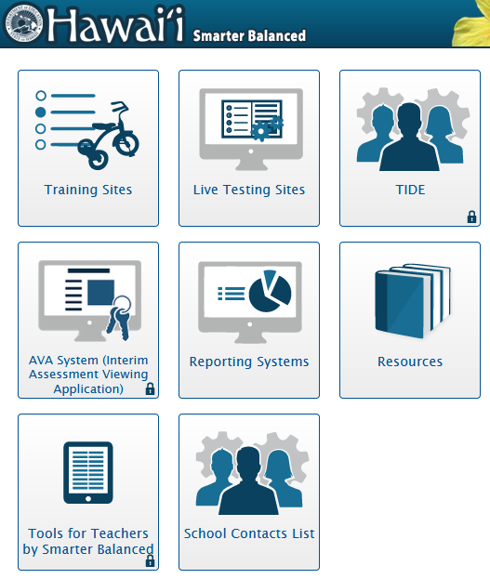
The Systems and Tools Supporting the HSAP

Slide 55
Hawai`i Statewide Assessment Portal
alohahsap.org
The Hawaiʻi Statewide Assessment Program Portal has all of the information, documents, training resources, and test administration tools needed to successfully administer the state assessments.
Notes:
alohahsap.org is your “one stop shop” for Hawaii statewide assessments ---- resources and training, test delivery, and results and reporting.

Slide 56
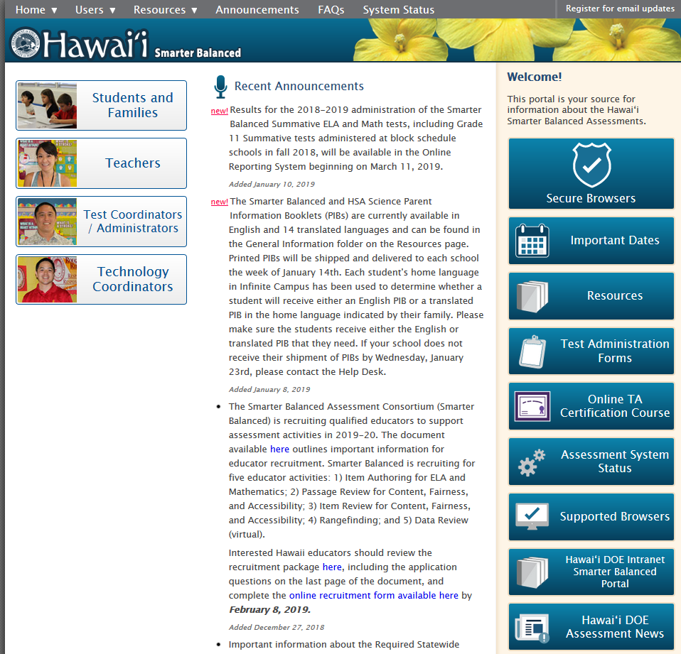

Slide 57
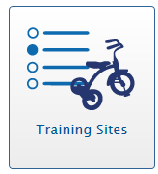
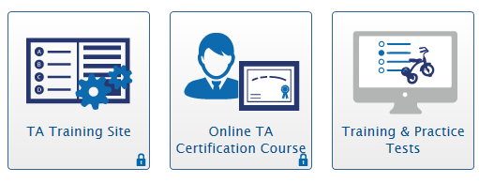
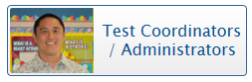
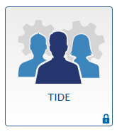
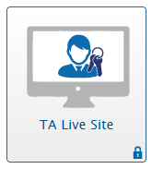
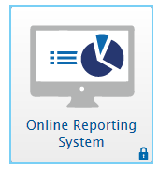
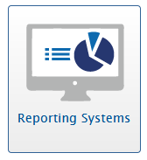
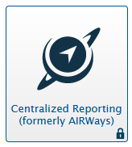
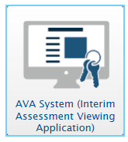
TIDE includes features to manage users and student information, monitor test progress, execute administrative functions, and data management after testing.
The TA Live Site is used by certified TAs to launch Interim and Summative assessment test sessions.
ORS provides performance data for past HSAP tests including individual student reports as well as school, complex, complex area, or overall state average scores.
The Centralized Reporting System (CRS) will have all results from this year forward. CRS allows authorized users to view and score individual student responses on the Interim Assessments and this year’s Summative Assessments.
AVA is a component of the Online Testing System that allows authorized users to view the Interim Assessments.

Slide 58
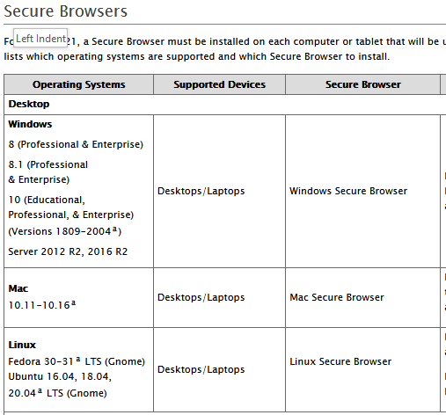
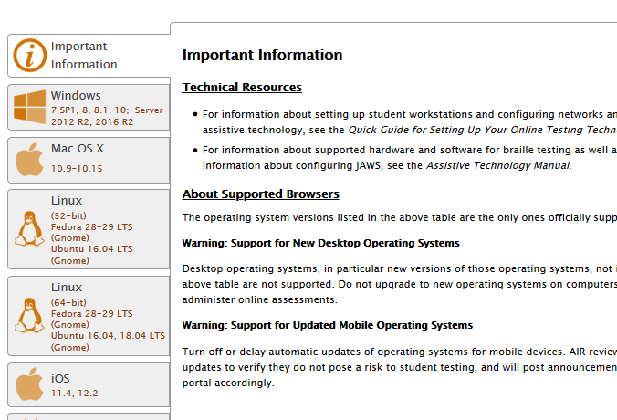
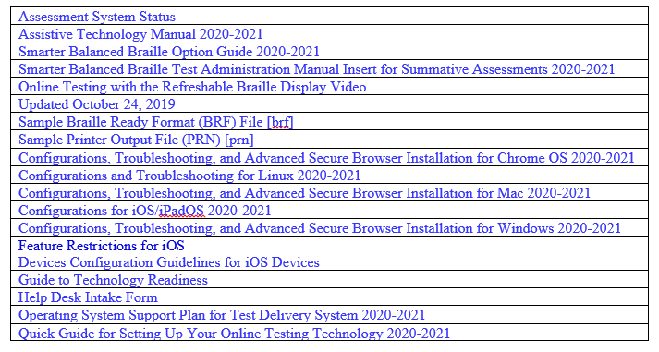

Slide 59
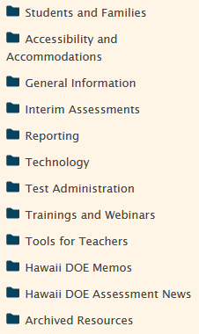
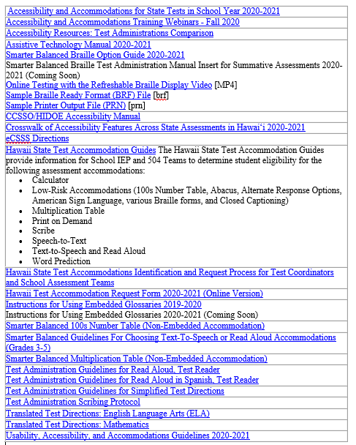
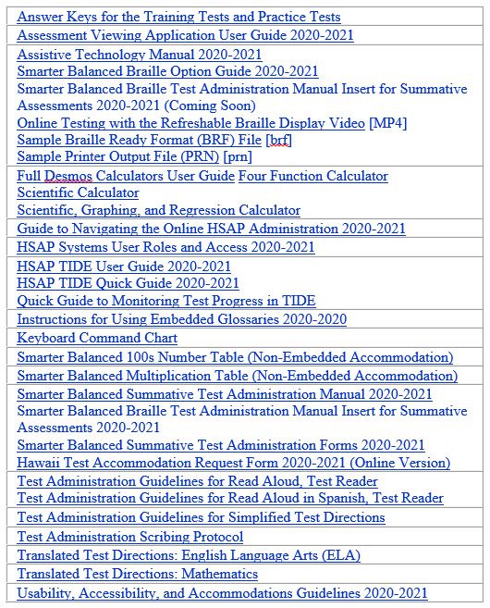
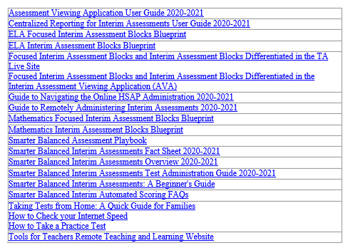
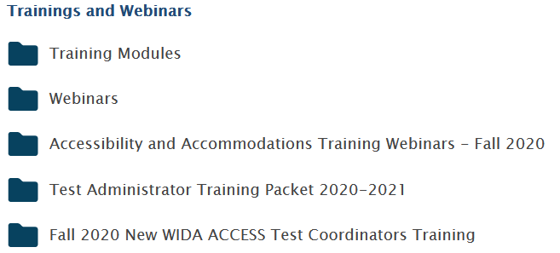
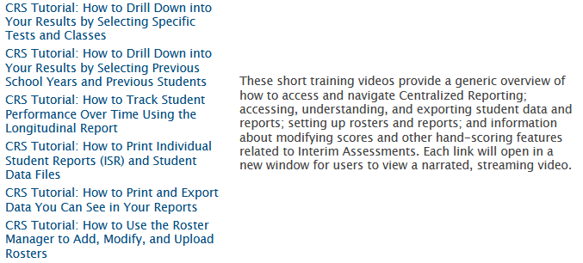
https://smarterbalanced.alohahsap.org/resources/

Slide 60
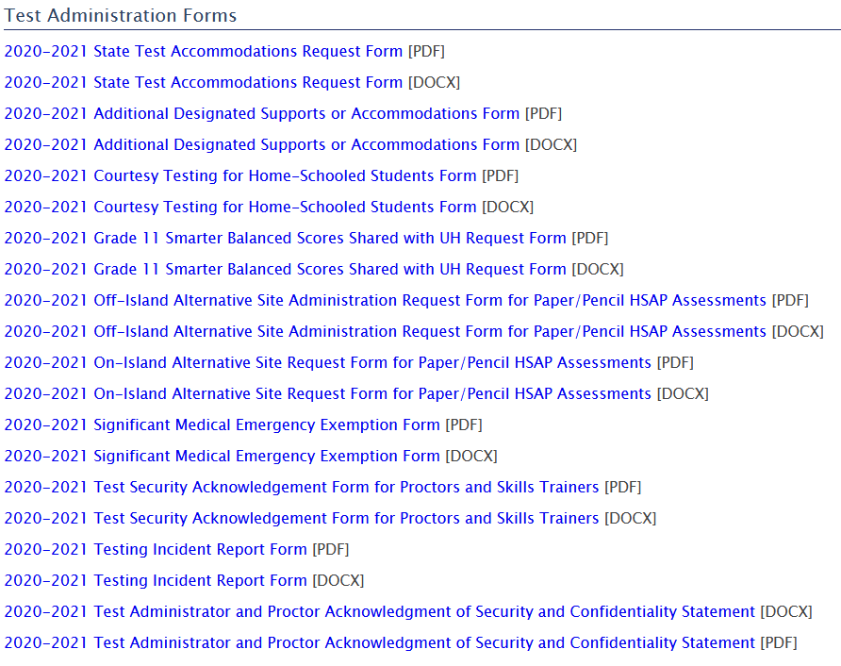

Slide 61
Overview of Online HSAP Process
Before
During
View Student Responses in CRS
View Score Reports and Performance Data in CRS
After
Document Non-Participation in TIDE

Slide 62
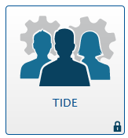
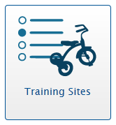
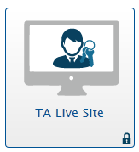
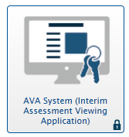
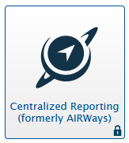
Online HSAP Systems
TIDE
Register users and update student info
Training/Practice Site
Prepare for assessments or exams
Training and Practice Tests
Online TA Certification Course
Test Administrator Training Site
Live Online HSAP
Administer online the Smarter Balanced Interim and Summative Assessments, HSA Science, EOC Exams and Alternate assessments
Test Administrator Live Site
Student Testing Site
ICAs
AVA (Assessment Viewing Application)
Interim Comprehensive Assessment (ICA) and Interim Assessment Blocks (IAB)
IABs
Centralized Reporting
TIDE
Monitoring Test Progress
Non-Participation
Tools for Teachers
Centralized Reporting
Score Reports

Slide 63
Into the Weeds
Preparing for Testing
The Team
Users in TIDE
Preparing Test Administrators
Student Needs
Designated Supports and Accommodations
Student Settings in TIDE
Training and Practice Tests
Administering the Tests
The Testing Environment
Administration Guidelines
Test Security
The TA Live Site and Secure Browser
Monitoring Test Progress
After Testing
Student Results in the Centralized Reporting System
Documenting None Participation in TIDE
Debriefing the School’s Testing Experience

Slide 64
Critical Resources
TIDE: The TIDE system supports Test Coordinators and Test Administrators throughout the testing process, from test preparation, to test administration, to post-administration. TIDE includes features to manage user and student information, monitor test progress, execute administrative functions such as test resets or reopens and, after testing, documenting reasons for non-participation.
CRS: Centralized Reporting system will have all test results data from SY 2020-21 forward including reports with student score information. Centralized Reporting is also a component of the Smarter Balanced Interim Assessments that allows authorized users to view and score individual student responses on both the Interim Comprehensive Assessments and the Interim Assessment Blocks.

Slide 65
UAAG: The Usability, Accessibility, and Accommodations Guidelines are intended for school-level personnel and decision-making teams, particularly Individualized Education Program (IEP) teams, as they prepare for and implement the HSAP assessments. The Guidelines provide information for use in selecting and administering universal tools, designated supports, and accommodations for those students who need them.
TAM: The Smarter Balanced Summative and HSA Science and EOC Exams Test Administration Manuals contain information about policies and procedures for Test Administrators, Test Coordinators, and others involved in test administration.
Test Administrator Training Packet: These materials are available for schools to provide customized Test Administrator (TA) trainings at their schools in preparation for and administration of HSAP testing. These materials can be adjusted to adhere to your school's policies and procedures so long as they are consistent with the Test Administration Manuals.
Test Coordinators need to conduct and document an on-site training for all test administrators.

Slide 66
PIBs and Parent Letters
A Parent Information Booklet (PIB) is available in English and in 14 languages on the Resources page. The PIB includes information for the grades 3-8 and 11 Smarter Balanced Assessments and the grades 5 and 8 Hawaii State Science (NGSS) Assessments.
<<PIBs are no longer being printed. You can provide parents with a link to them and they can select the language of their choice: PIBs >>
Parent Letters are also available in English and 14 languages on the Smarter Balanced Resources page. The Parent Letters will include information for the grades 3-8 and 11 Smarter Balanced Assessments and the grades 5 and 8 Hawaii State Science (NGSS) Assessments.
<<Parent Letters can also be shared electronically>>
The Parent Fact Sheet provides information on how Smarter Balanced Assessments are preparing students for success.
Notes:
Printed copies of one English PIB per student and one translated PIB for identified ELL students whose parents have indicated their home language is a language other than English have been shipped to each school. If you need additional copies you can print them from alohahsap/HSA/ParentInformationBooklets

Slide 67
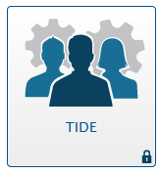
Getting to Know TIDE (Test Information Distribution Engine)

Slide 68
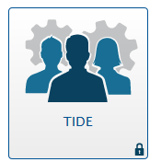
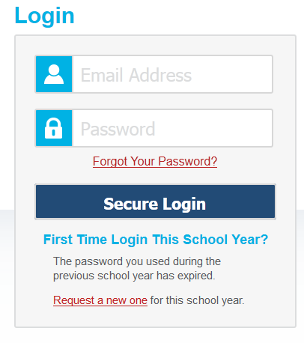
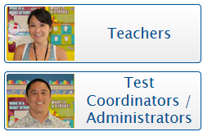
alohahsap.org
Upon clicking Secure Login the TIDE dashboard will appear.
A user’s privileges within TIDE vary by role group (test coordinator, test administrator, teachers, etc.) so the dashboards may vary.
Some users have multiple roles, in those cases TIDE may prompt you to select a specific user role to complete the login process.
Notes:
To log in to TIDE:
1. Open your web browser and navigate to the HSAP portal at alohahsap.org.
2. Click on the assessment or exam you will be administering.
3. Click the Teachers or Test Coordinators / Administrators card .
4. Click the TIDE card. The Login page appears.
5. Enter your email address and password.

Slide 69
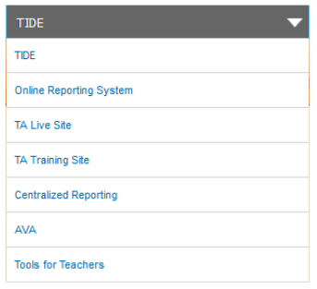
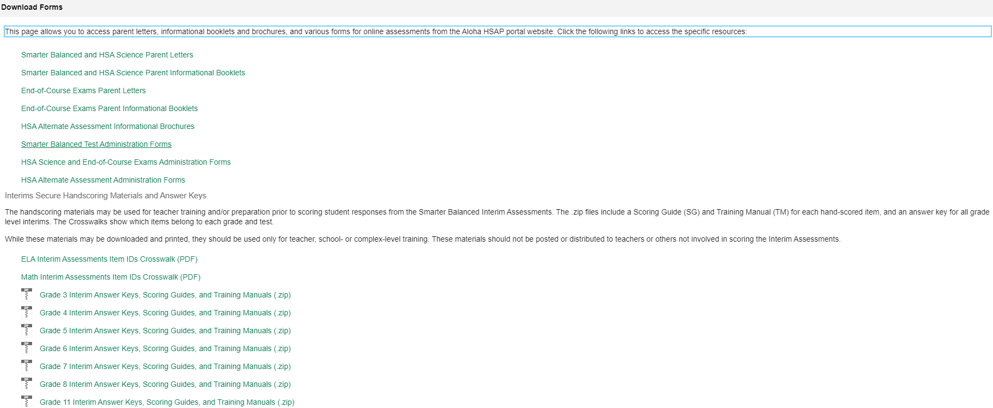
Navigating TIDE
Once you log into the TIDE, a banner appears at the top of every page:
Also available through TIDE: access to informational booklets & brochures, parent letters, online forms, Interim Scoring Guides and Answer Keys
alohahsap.org
Notes:
General Resources: This drop-down list allows you to access various resources needed for testing and hand-scoring materials.
Help: This button opens the online TIDE User Guide
Inbox: This is where you get your files that were downloaded
Manage Account: This drop-down list allows you to change your user role and set up your contact information.
Log out: This button logs you out of TIDE and related AIR systems.

Slide 70
Test Administration Resources
TIDE-Related Resources
HSAP TIDE Quick Guide 2020-2021
HSAP TIDE User Guide 2020-2021
Smarter Balanced Interim Assessments Test Administration Guide 2020-2021
Smarter Balanced Summative Assessments Test Administration Manual 2020-2021

Slide 71
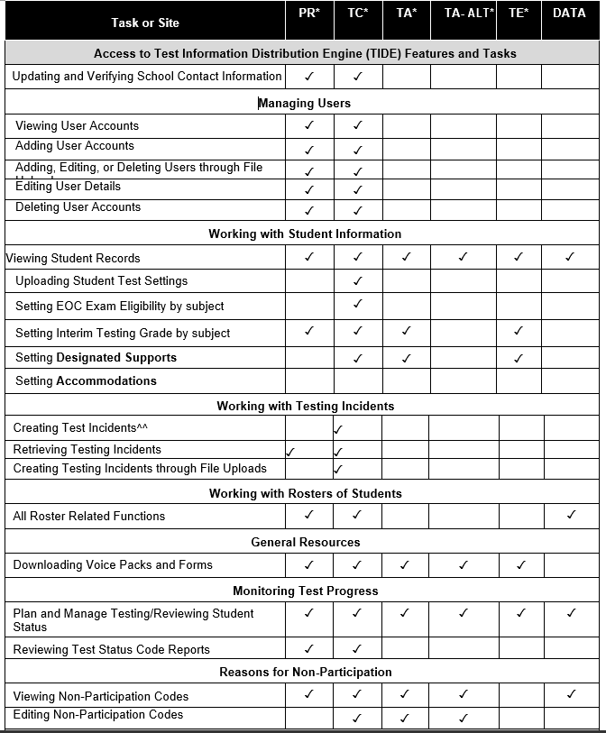
TIDE Roles
Access to information varies by role group.
Link to Updated Version
HSAP Systems User Roles and Access 2020-2021
A Test Coordinator (TC) must submit a student’s Accommodations Request Form for accommodations

Slide 72
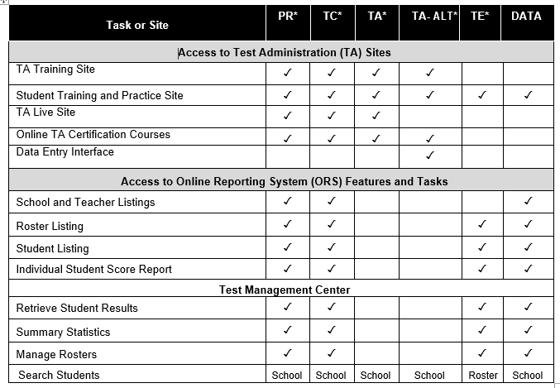

Slide 73
When you navigate away from the TIDE dashboard, a navigation toolbar appears at the top of the page:
To access the dashboard, click in the upper-left corner.
To view the task menus for a particular TIDE category, click the icon for that category above the toolbar.
To access a particular task, click that task menu in the toolbar (such as Users) and select the required task from the list of options that appears.
There is a Find Student by ID field where you can type in the student SSID # in the upper-right corner of every page in TIDE. You can use this field to navigate to the View/Edit Student page filtered to a specified student’s record.
To search for a student:
1. In the Find Student by ID field, enter a student’s SSID.
2. Click the magnifying glass. The View and Edit Student form for that student appears.

Slide 74
TIDE: Preparing for Testing (Users)

Slide 75
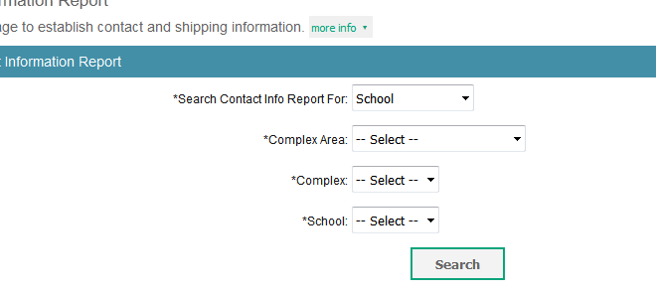
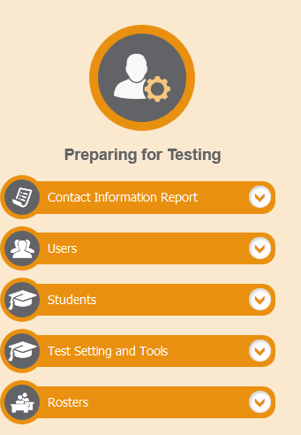
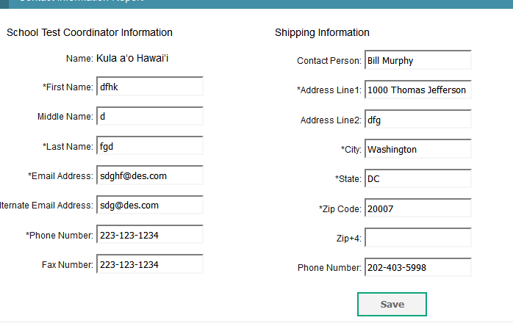
School Contact Information

Slide 76
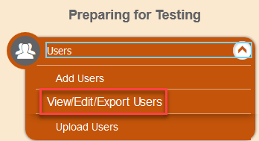
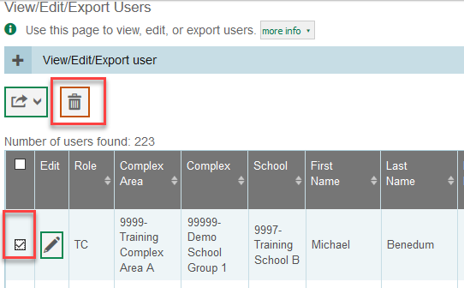
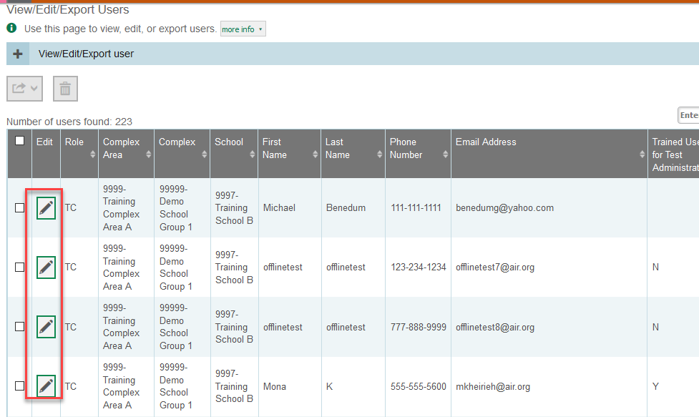
Clean Up Users In TIDE
In alohahsap.org/Smarter Balanced/TIDE
To Clean up Users (important to do this at the start of each year)

Slide 77
Add New Users In TIDE
To Add New Users Enter their new Gmail e.g. 2345676@k12.hi.us or an email that they will be using as school email/charter school, then click Add user or add roles to user with this email
Then choose the role they will be in/add more roles if that person has multiple roles, Then click SAVE

Slide 78
TA: Dual Authentication
The security of online systems, including Cambium systems, is a growing concern worldwide. As a result, CAI has implemented dual authentication when users login into any of the password protected applications from a “new computer” for the first time. This includes the TA live site.
A “new computer” is :
a computer that they have not used to log into one or more CAI system in the past; or,
a computer they they have used in the past but has had the history or cache cleared since they last logged in.
Dual authentication means that when a user logs in to a new computer, the user will be receive an access code via the email associated with their TIDE account and will need to enter that code on the Login Screen to complete log in.
Implications: If TAs are using a “new computer” they will need access to their email while signing in. The message with the code may take several minutes to arrive. So TAs should either start their sign-in process 15 minutes before student arrive OR sign in “for the first time” the afternoon before then log out and sign-in again right before the test session.

Slide 79
Identifying and Certifying TAs
TAs must be identified in TIDE.
Checking to see your current cadre of TAs
Adding new TAs
TA Certification
The certification course
Checking to see who has successfully completed the TA certification course.

Slide 80
TIDE: Preparing for Testing Student Setting

Slide 81
Student “Data” in TIDE
Student Information
Demographic from Infinite Campus cannot be edited
Test Eligibility
Preset based upon information from Infinite Campus
Only Interim Testing grade and EOC eligibility can be adjusted
Assessment section can set Courtesy Testing for you
Embedded Accessibility Features
Universal Tools can be “turned off”
Designated Supports can be made available to students with identified needs as determined by a team of teachers.
Accommodations can be made available to IDEA and 504 Plan students when consistent with the IEP, PLEP, services in the classroom, and the summative assessment use guidelines (These must be verified and set by the Assessment Section)
Non-Embedded Accessibility Features
As with the embedded features

Slide 82
Working with Student Information
Task or Site |  | PR* | TC* | TA* | TA- ALT* | TE* | DATA** | IS*
Viewing Student Records | ▪ | ✔ | ✔ | ✔ | ✔ | ✔ | ✔
Uploading Student Test Settings |  |  | ✔
Setting EOC Exam Eligibility by subject |  |  | ✔
Setting Interim Testing Grade by subject | ▪ | ✔ | ✔ | ✔ |  | ✔
Setting Designated Supports and adjusting Universal Tools |  |  | ✔ | ✔ |  | ✔
Setting Accommodations for Smarter Balanced ELA and Math as well as HSA Science and EOCs |  | Principal or TC submits request form to the Assessment Section for activation in TIDE
You can also search by SSID# located at the top right of the TIDE screen

Slide 83
Student Demographics and Designated Supports/Accommodations

Slide 84
TIDE: Preparing for Testing (Test Setting and Tools)

Slide 85
Print Test Tickets/Test Settings and Tools

Slide 86
TIDE- Administering Tests Monitoring Test Progress

Slide 87
How to Monitor Test Progress in TIDE
Click on the TIDE icon:
Once in TIDE, under Administering Tests click Testing Incident:
Then click on Plan and Manage Testing:
Notes:
Once a Test Incident is identified, you will need to input it into TIDE.
This is how you enter a Test Security Incident in TIDE.
*Read steps to input Test Incident into TIDE.

Slide 88
Plan and Manage Testing
TIDE includes a Plan and Manage Testing report that details all of a student’s test opportunities and the status of those test opportunities.
To generate a Plan and Manage Testing Report:
click on Monitor Test Progress
Then Plan and Manage Testing
Step 1: Choose What panel, select parameters

Slide 89
Step 2: Choose Search Students panel, select the parameters for whose information to include.
Step 3: Get Specific panel, select radio button for one of the options and then set the parameters for the option. Then click “Generate Report.”

Slide 90
Test Session Monitoring Report
School Principals and Test Coordinators can view status reports of active and inactive test sessions happening in their school. These reports show each active and inactive session ID for a school, along with information like proctor name, test name, the start time of the test session, the total number of students taking the test, and the number of students who have started, paused, and completed the test.
Note: A test session will only appear in this real-time report once the first student has been approved by the TA into that session for testing.

Slide 91
TIDE
After Testing

Slide 93
Activity #2 Breakout Open Discussion
Based on what you’ve just heard….
How is Your School’s TIDE? Cleaned up, TA set, and good to go?
Share ideas regarding the necessary tasks you need to do to prepare for testing?
What general questions do you still have?

