Slide 1
How to Analyze Item-Level Reports
Centralized Reporting System Training Module Series #4
Copyright © 2020 Cambium Assessment, Inc. All rights reserved.
Notes:
Welcome to training module #4 in the Centralized Reporting System series, How to Analyze Item-Level Reports. In this training module we show you the unique reporting characteristics of non-summative tests that include item-level data. We also show you how to drill down into your reports using filters and settings so that you see precisely the data you need.

Slide 2
Interim Assessments
Interim Assessment Blocks (IABs) and Focused Interim Assessment Blocks (FIABs)
—fixed-form tests with 6-16 items within a specific topic or skill area
—users can compare item-level scores across all students
Interim Comprehensive Assessments (ICAs)
—fixed-form tests that cover some or all of the targets students are required to learn
—users can see item-level scores for individual students
VARIOUS TYPES OF INTERIM TESTS THAT REPORT ITEM-LEVEL DATA
Notes:
The focus of this training module will be on interim test reports that contain item-level data, access to the items themselves and access to student responses to the items. This chart shows how tests in Centralized Reporting can be categorized.
Interim Assessment Blocks (IABs) and Focused Interim Assessment Blocks (FIABs) are small, single-skill-area tests with non-secure items. Users can compare item-level scores and the items themselves, for all their students.
Interims Comprehensive Assessments are larger than IABs and address more standards within them. Many ICAs will report item-level data, depending on the type of test and state policies.
We’ll show you how to analyze the item-level data on these reports. Then, we will show you how to trim your reports by using settings and filter options that apply specifically to item-level data.

Slide 3
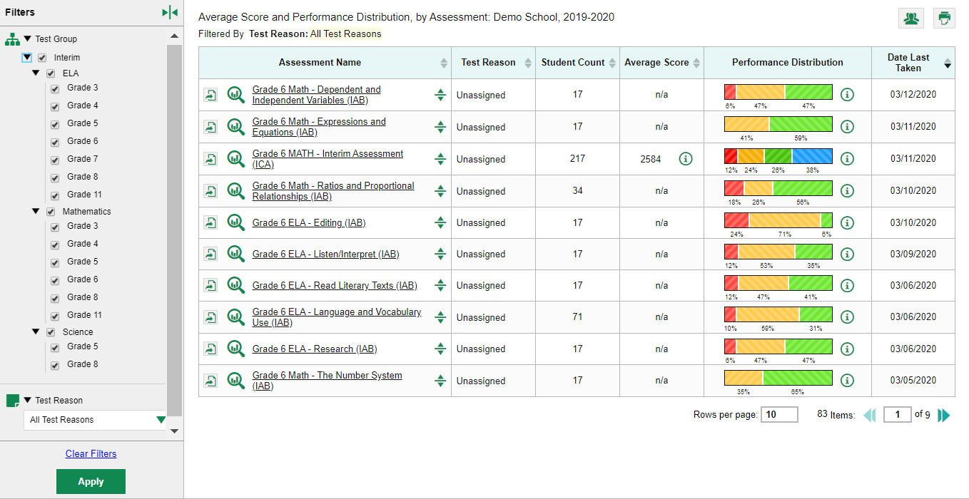
2
1
Notes:
We start by showing you an unfiltered dashboard for a school-level user in Centralized Reporting. You see ten (1) interim tests listed on the school user dashboard, shown here.
You also see the (2) filters panel expanded on the left. The test groups are listed by type of test, subject, and grade. You can use this filter to trim the number of reports listed on your dashboard.
Test items can be analyzed to provide a clear view of the student’s reasoning and subsequent performance on the test.
The first report we show you is a report for an interim assessment that tests a single standard with more than ten items on the test.

Slide 4
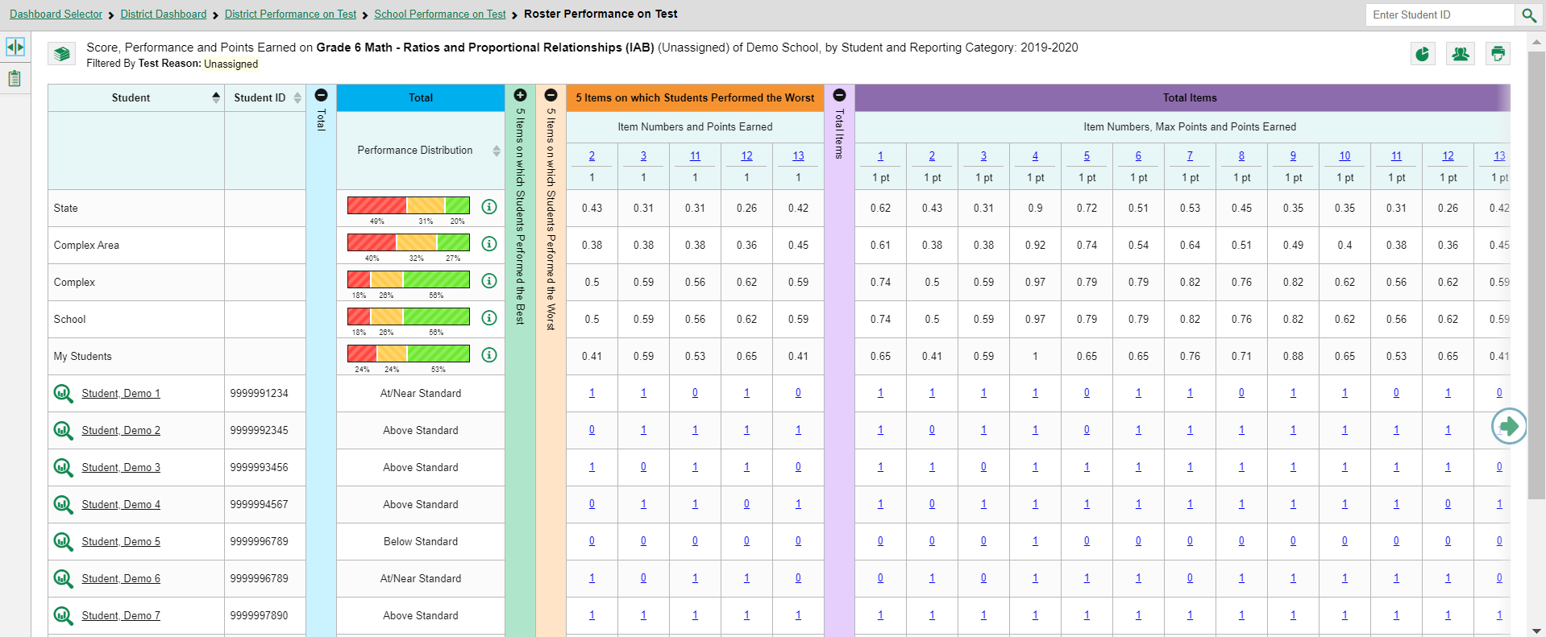
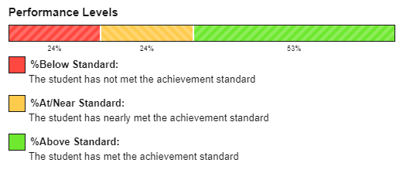
5
1
2
3
4
7
8
6
9
Notes:
Here is a roster report for seven demo students who took the Grade 6 Math IAB on Ratios and Proportional Relationships. This is a benchmark test assessing a single skill, also called a topic area or reporting category.
The colored sections in the table include a (1) Total performance measurement section in blue, a green section for the (2) 5 Items on which Students Performed the Best, an orange section for the (3) 5 Items on which Students Performed the Worst, and a purple section for (4) Total Items. You can expand or collapse the columns by clicking on the (5) + and – signs at the top of the column.
To advance further into the purple section, click the green, (6) circled arrow at the right side of the slide. You can see the state, complex area, complex, and school (7) aggregates displayed above the list of student results. You can click on the (8) information button to display the (9) legend for the performance levels.
To show you how to analyze your results, we will focus first on the orange section, showing the 5 items on which students performed the worst.

Slide 5
Notes:
The first two rows under the section header, 5 Items on which Students Performed the Worst, list the item number and the number of points assigned to the item. The students on this roster performed the worst on items #2, 3, 11, 12, and 13.
For example, the results for item #11 show that students at the aggregate state level earned an average of .31 of a point. The complex area average is .38 of a point, the complex average is .56 of a point, and the students in the school averaged .56 of a point. Students in this demo class scored an average of .53 of a point. Of the seven demo students in the table, students 2, 3, 4, 6 and 7 answered that item correctly and earned 1 point.
Now we show you a report with fewer than ten items on it.

Slide 6
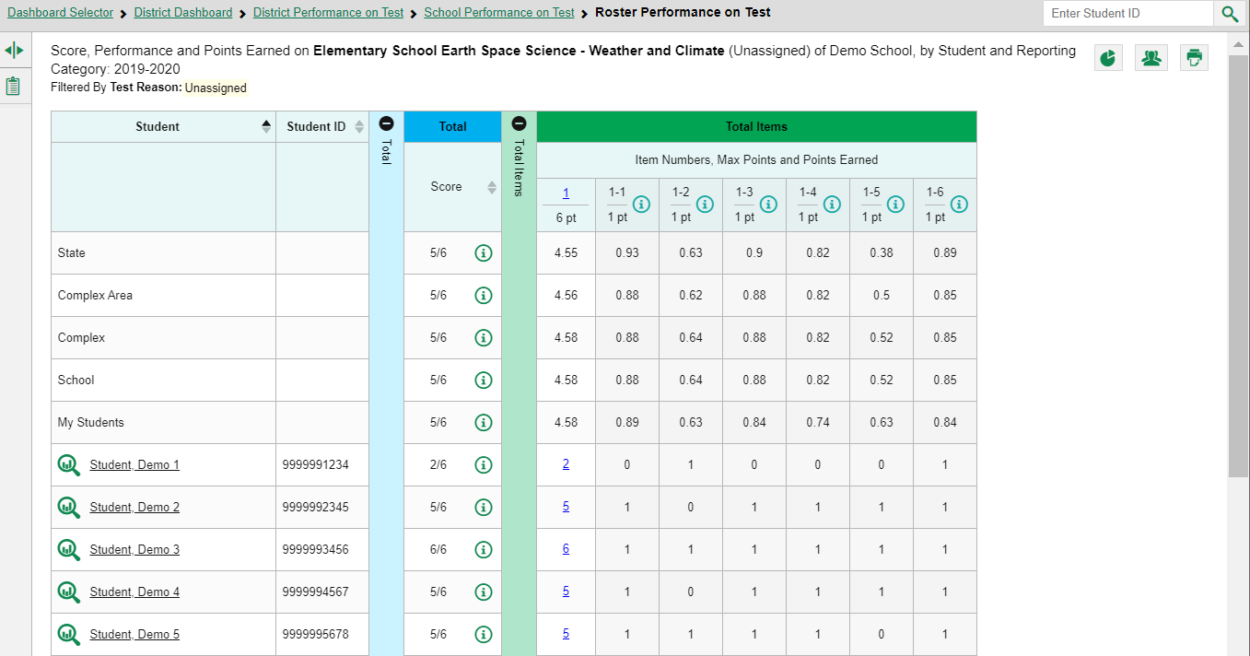
Notes:
Item-level reports with fewer than ten items do not display with the 5 Best and 5 Worst sections. You see a Total Items section, as shown here in green on the Elementary School Earth Space Science – Weather and Climate Interim Assessment.
Now we show you how to access the item and the student’s response to it.

Slide 7
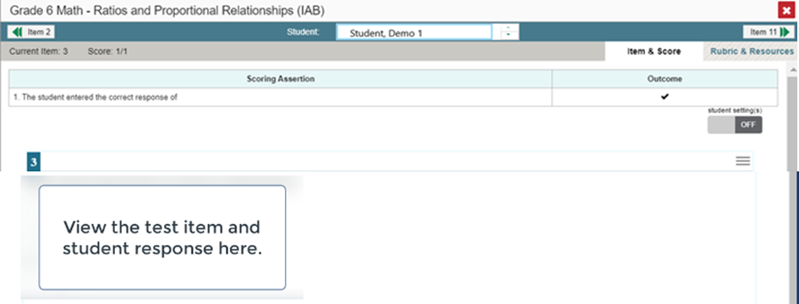
Item
Number Link
1
2
Item Number Link
Student
Score Link
3
Student Score Link
4
Notes:
To view a test item in the blank state, click the (1) item number link in the first row of the report table. The (2) item-view window displays the test question as it appeared on the assessment in the Student Testing Site.
To view the student’s response to the item, find that student’s name in the Student column on the left. Then click the (3) blue student score link under the numbered item. In this example we look at item #3 for Demo Student 1.
The (4) item-view window displays the question along with the answer provided by Demo Student 1.
We will explain the features of the item-view window on the next slide.

Slide 8
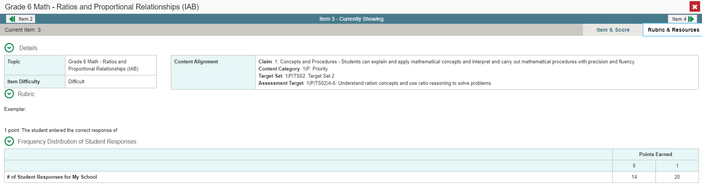
7
5
6
8
3
1
2
4
Item & Score Tab
Rubric & Resources Tab
Notes:
You can see the (1) current item number and the (2) score for that item in the gray bar in the banner. The student answered correctly with a score of 1 out of 1 point on item #3.
Moving to the right in the gray bar you see two tabs, (3) Item & Score and (4) Rubric & Resources. You can toggle between these tabs to display associated content. The Item & Score tab is open in the top image and the Rubric & Resources tab is open in the bottom image.
In the teal-colored bar at the top of the window are three navigation tools to help you move between students and items without returning to the report. The name of the (5) selected student displays in the middle box. You can click the (6) arrows to navigate to different students and their responses to that item. Clicking the down arrow takes you to the next student listed in the report table. Clicking the up arrow takes you to the previous student. The (7) navigation tool on the left moves you to the previous item. The (8) navigation tool on the right takes you to the next item. Because we opened Item #3 from the 5 Worst section on the report, Item 11 displays as the next item listed under the 5 Worst column.
Underneath the teal and gray banners, the Scoring Assertion and the Outcome for the test item are displayed.
The Scoring Assertion states exactly what the student must do to earn the point value for the item. The Outcome box shows a checkmark for a correct answer, or an X for each incorrect answer. Some windows display “Scoring Criteria” instead of “Scoring Assertion.”
The test item is displayed below along with the student’s response to it. Reviewing a student’s response in this window provides important clues into the struggles experienced by the student.
You can show or hide a student’s visual settings, like large fonts, different color contrasts, or Spanish, on a per-item basis. To do so, click the toggle labeled student settings at the upper right of the item you are viewing to ON.
We explain the Rubric & Resources tab on the next slide.

Slide 9
1
2
4
3
Notes:
Underneath the teal and gray banners, the (1) Scoring Assertion and the (2) Outcome for the test item are displayed.
The Scoring Assertion states exactly what the student must do to earn the point value for the item. The Outcome box shows a checkmark for a correct answer, or an X for each incorrect answer. Some windows display “Scoring Criteria” instead of “Scoring Assertion.”
The (3) test item is displayed below along with the student’s response to it. Reviewing a student’s response in this window provides important clues into the struggles experienced by the student.
You can show or hide a student’s visual settings, like large fonts, different color contrasts, or Spanish, on a per-item basis. To do so, click the toggle labeled (4) student settings at the upper right of the item you are viewing to ON.
We explain the Rubric & Resources tab on the next slide.

Slide 10
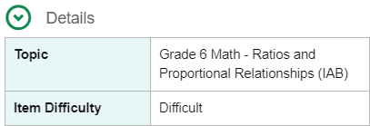
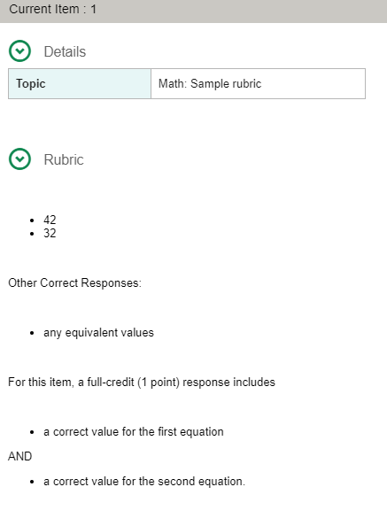
1
5
2
3
6
4
Notes:
The Rubric & Resources window has the same teal and gray banner features and is divided into three sections: (1) Details, (2) Rubric, and (3) Frequency Distribution of Student Responses. The sections are expanded and collapsed using the circled arrows to the left. The information included in each section varies, depending on the test item.
The (4) Topic lists the skill area to which the item belongs. The (5) Content Alignment section describes, in detail, the learning claim and target to which the item is aligned. The (2) Rubric displays the criteria used to score the item.
A simple correct answer may be listed, or this section may include a score breakdown, a human-readable rubric, or an exemplar, which provides an example of a response for each point value. An (6) example is shown here in the image on the right side of the slide (for a different item number and test.)
The (3) Frequency Distribution of Student Responses provides a breakdown of how many students earned each possible point value available for the item. In this example, 34 students in the school responded to item #3 on this Math interim assessment. Twenty of them answered correctly and earned one point for the item.
Now we show you a test report for a Comprehensive Interim Test with reporting categories for each skill area.

Slide 11
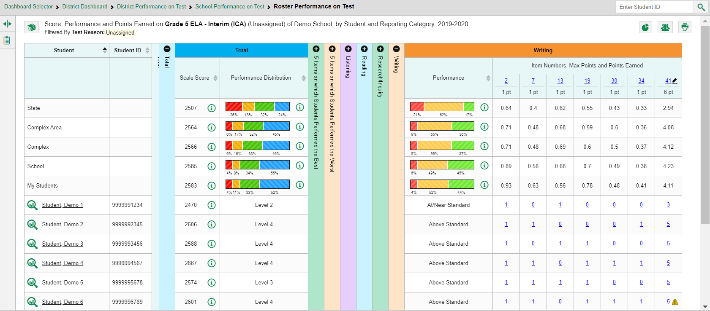
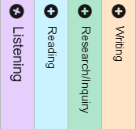
2
Item Link
4
5
1
Four Reporting Categories
3
6
Student Score Link
Notes:
Here is a Roster Performance on Test report for the Grade 5 ELA Interim Comprehensive Assessment (ICA).
Notice that the table includes (1) four reporting categories in addition to the blue Total section and the 5 Best and 5 Worst sections. The items included in each of the reporting categories are the ones that assess those skill areas.
Under each reporting category the item number displays as a (2) blue item link and the maximum points for the item displays under the link.
The student responses display as blue (3) student score links. The number reflects the points earned for that item. For example, you can see that item #41 under Writing Standards is worth 6 points. Demo Student 6 earned 5 points for her answer to that item.
Every topic section in this report includes a performance column that can be sorted. Click the (4) up or down arrow next to the column header to sort in ascending or descending order. When you sort your students this way you can quickly see who needs more support in each topic area.
The (5) pencil icon next to an item number means that the score may be modified. This is covered in training module #5 of the series, How to Hand-Score Unscored Items and Modify Machine Scores. If you see a (6) yellow triangle with an exclamation point in it, that item should be reviewed by a teacher.
You may sometimes see “n/a” instead of a score for an item. It means that the student did not respond to the item, or the item was not included in that form of the test.
Now we show you a report for a test that features multiple scoring assertions.

Slide 12
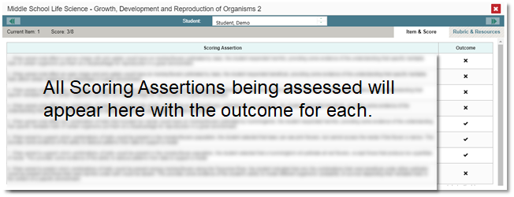
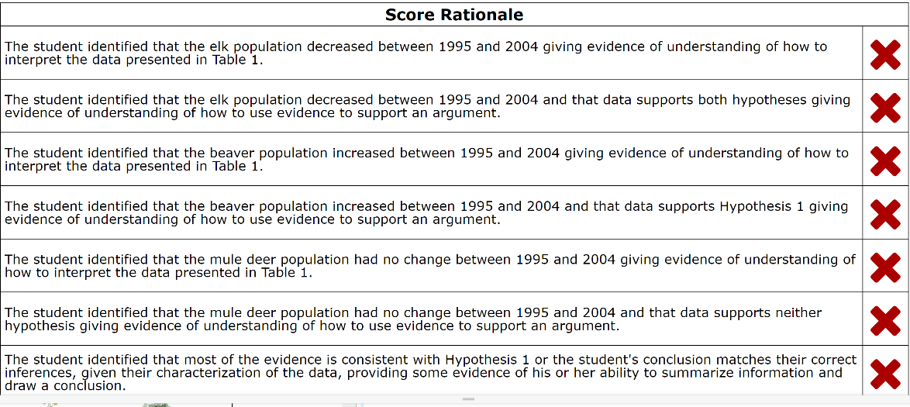
1
Information Button
2
3
4
Student Score Link
5
Notes:
The report shown here is for a Middle School Life Science Interim Assessment.
The test items are designed as clusters with multiple scoring assertions. For example, item #1 is worth eight points. Each point is associated with a sub-item, listed as 1-1, 1-2, 1-3, and so on. Cluster items usually feature a reading passage, along with graphic images like maps, tables, and illustrations. Several test items are associated with the passage and images. Students are instructed to use what they have learned from the stimuli to perform the associated sub-item tasks. You can see that Demo Student 2, answered 1-5, 1-6, and 1-7 correctly. She earned three of the possible eight points.
The (1) information button displays the (2) scoring assertions associated with each of the sub-items. The legend displayed here is from item 1-5.
When you click on the (3) student’s score link, the (4) Item & Score tab of the item-view window shows all eight scoring assertions listed in that section of the page. The student outcomes for each sub-item are indicated.
On the bottom left, you will see a screenshot of (5) actual scoring assertions from an NGSS Training Test.
We now show you how to filter your item-level data by standard and how to assign test reasons to your item-level tests and how to filter by test reason.

Slide 13
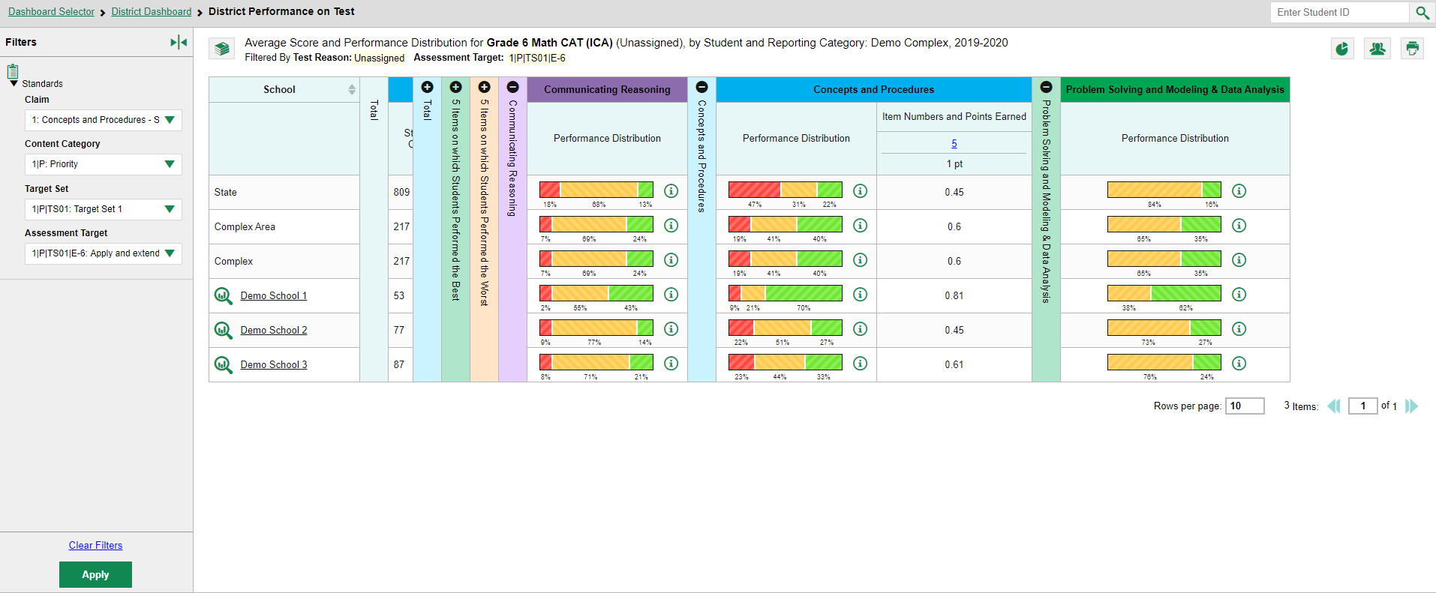
1
4
5
2
3
Notes:
Sometimes it is helpful to use the Standards filter to trim an Interim Comprehensive Assessment so that you can focus on the students’ performance in a single claim or assessment target.
There are 30 items on this Interim Comprehensive Assessment (ICA) in Grade 6 math. The items are associated with three topic areas, also known as domains or reporting categories: Communicating Reasoning in purple; Concepts and Procedures in blue; and Problem Solving and Modeling & Data Analysis in green.
Open the Filters panel by clicking the (1) expansion arrow or on the standards icon. Use the drop-down list under Standards to (2) select a claim. Here we have selected Concepts and Procedures.
Keep making selections from the drop-down lists as they appear. In this example, we chose the content category “1P: Priority.” Then, we selected “Target Set 1.” Then, we selected “Apply and extend previous understandings of arithmetic to algebraic expressions” as our assessment target. Click (3) Apply to update the report.
The (4) table header updates to show the assessment target selected.
The filtered report shows only the items associated with the standard selected. You can see that (5) Item #5 was the only item on the test to assess this target. You can see that there are no items listed under the first or third topic areas, Communicating Reasoning and Problem Solving and Modeling & Data Analysis, meaning that the items belonging to that category tested other targets, not the one we filtered for.
You can compare the results of the schools in your complex from this District Performance on Test Report. Please note that the Centralized system will refer to districts throughout some of this process, while the actual report breaks the scores down by complex area and complex. The average points earned for Item 5 is listed for each of the schools in the complex.
You can look at another claim and target by changing the selections in the drop-down filter options, or you can clear filters and click Apply.
On the next slide we show you the Roster Performance on Test report, which displays each student’s score link to the item.

Slide 14
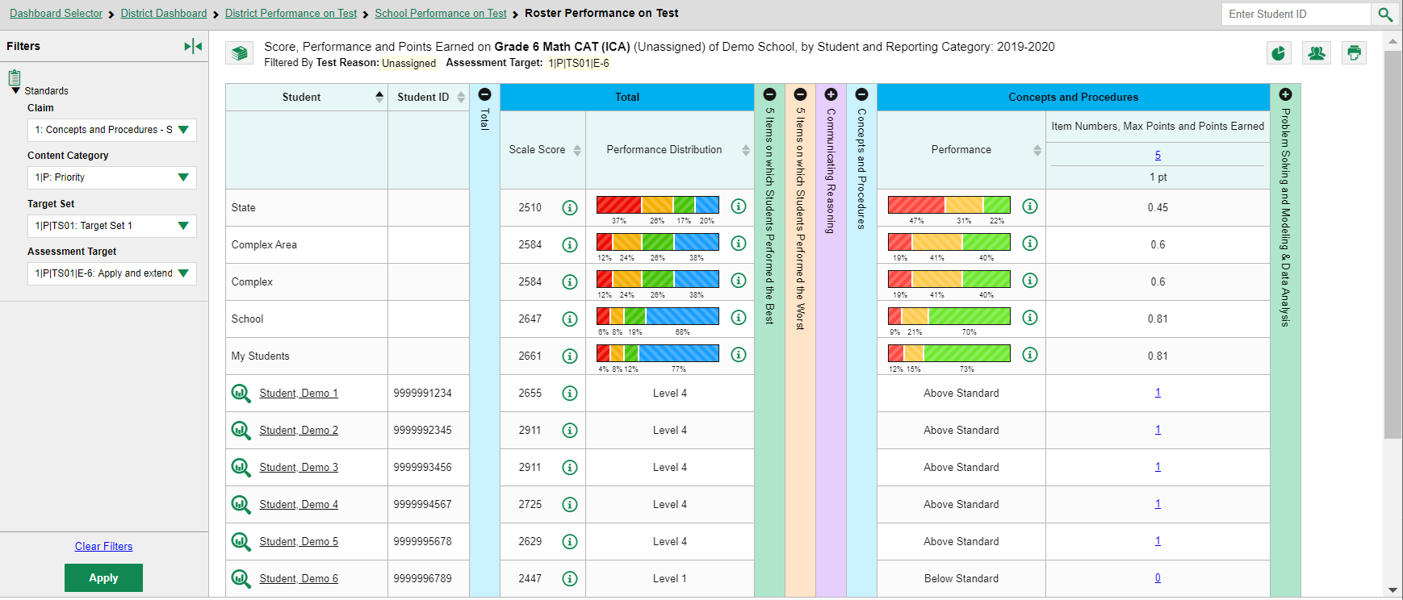
Student Score Link
Notes:
This is the same Interim Comprehensive Assessment (ICA) in Grade 6 math showing six sample students on a roster. You can click on the student score link to open the Item-View Window for Item #5.
Now we explain the Test Reason Manager and the Test Reason filter. These are two options that apply only to interim and benchmark tests.

Slide 15
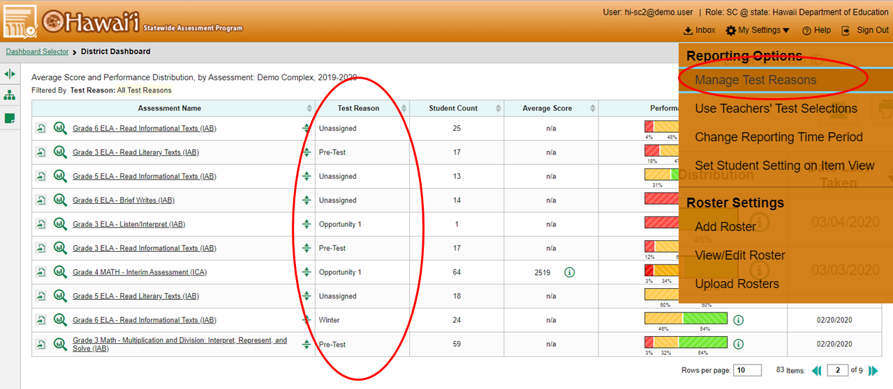
2
3
1
4
5
Notes:
(1) Test reasons are categories used to classify test opportunities for reporting purposes.
They typically indicate a numbered opportunity, a timeframe in which tests were taken, or a category like “Pre-test”, and they’re a good way to organize tests into groups.
Test reasons should ideally be assigned in the Test Administration Site at the time of testing. However, you can use the Test Reason Manager in the Centralized Reporting System to assign a different test reason to an interim or benchmark test opportunity after the test is completed.
From the (2) My Settings drop-down menu in the banner, select (3) Manage Test Reasons. The (4) Test Reason Manager window opens.
To search for test opportunities to categorize, do either of the following:
In the Session ID field, enter the session ID in which the opportunities were completed in the test delivery system or (TDS).
Or select a test reason associated with the opportunities you want to edit.
Then select a range of dates during which the test session was administered. The range cannot exceed seven days. Then click (5) Search.

Slide 16
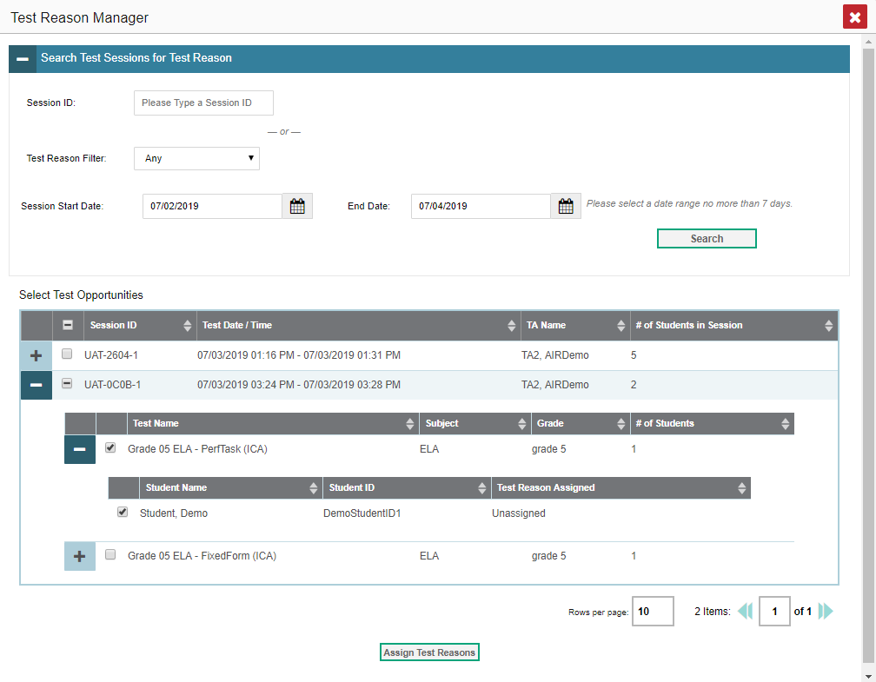
1
2
3
4
5
6
7
Notes:
A list of retrieved test sessions appears in the section (1) Select Test Opportunities.
Click the (2) + button(s) to expand the (3) list of tests in each session and the list of students who took each test opens. Mark the checkboxes for each session, test, or opportunity that requires a test reason. Click (4) Assign Test Reasons.
In the (5) confirmation window, select a (6) new test reason to assign to the selected opportunities and click (7) Confirm.
Assigning or reassigning test reasons will make the filter by test reason option more useful. We explain why on the next slide.

Slide 17
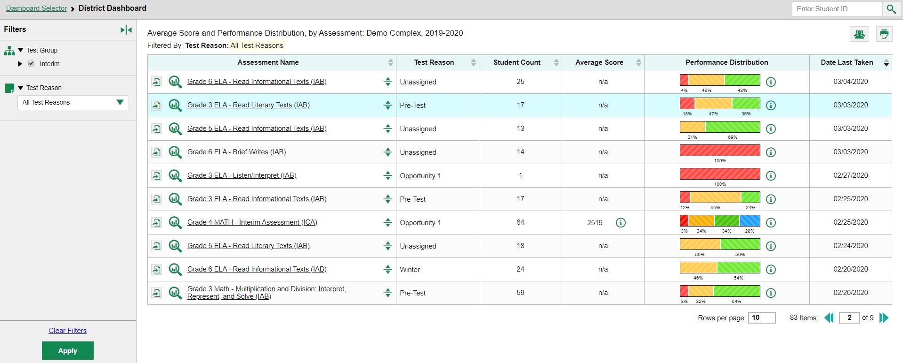
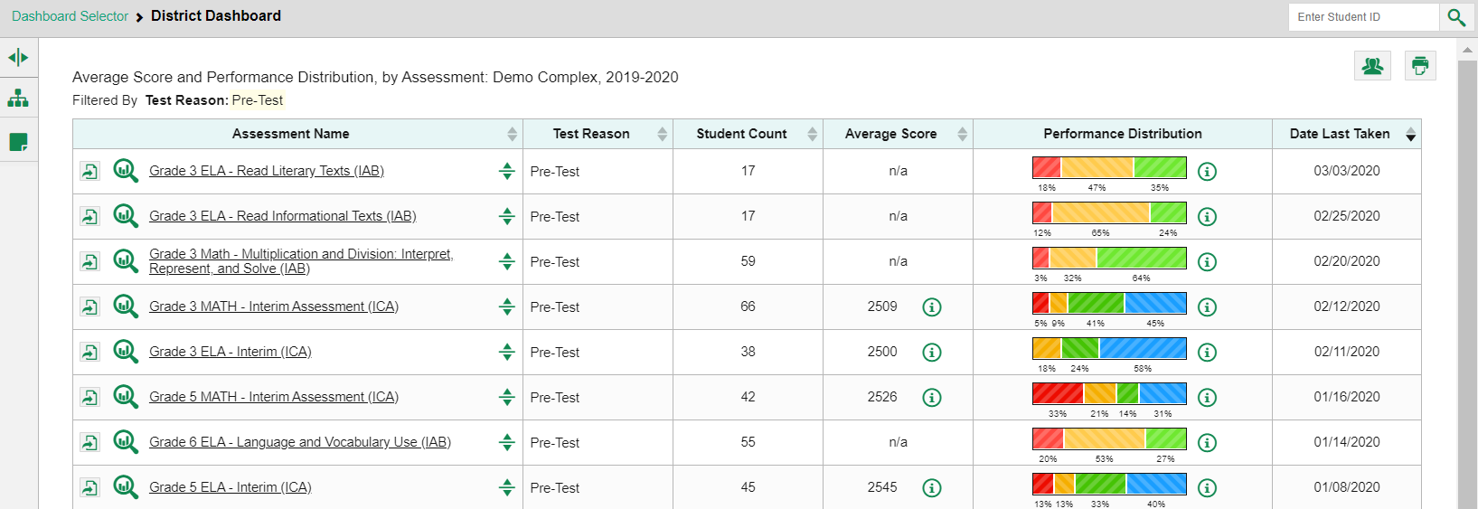
1
Fall
Opportunity 1
Opportunity 2
Post-Test
Pre-Test
Unassigned
Winter
2
3
4
Notes:
When your test opportunities have test reasons, you can filter reports by a single test reason.
For example, you may want to filter by Pre-Test and look at ELA performance, then filter by Test One and see if students have improved on ELA material. If you don’t filter, you’ll see data for all different test reasons. Filtering allows you to view a single test reason instead of multiple test reasons side by side. You may find reports easier to understand when you’re viewing only a single test reason. The (1) test reasons filter is available on the dashboards for teachers as well as school- and complex-level users. On the left side of the dashboard, click the (2) Test Reason button to display the drop-down list of test reasons. Make a selection from the drop-down list and click (3) Apply. For our example we selected the Pre-Test reason.
The (4) filtered report displays with an updated table header. You see only the tests identified with that reason in your results. You can return to the Filters drop-down menu and select another reason to make comparisons.

Slide 18
Centralized Reporting System Training Module Series
1. How to Print ISRs and Student Data Files
2. How to Print and Export Data You Can See in Your Reports
3. How to Use the Roster Manager to Add, Modify, and Upload Rosters
4. How to Analyze Item-Level Reports
5. How to Hand-Score Unscored Items and Modify Machine Scores
Notes:
Thank you for viewing this training module on analyzing item-level reports. More training modules are posted on the Aloha HSAP online portal. You may also consult the Centralized Reporting System User Guide.

