Slide 1
How to Use the Advanced Features of the Reporting System to View your Interim Assessment Data
Centralized Reporting system series #11
Copyright © 2020 Cambium Assessment, Inc. All rights reserved.
Notes:
Welcome to training module #11 in the Centralized Reporting System series, How to Use the Advanced Features of the Reporting System to View Your Interim Assessment Data. In this module we show you some advanced features of non-summative assessment reports.

Slide 2
Objectives
Explain Cluster Items and Scoring Assertions
Filter Item-Level Reports by Standard
Assign Test Reasons (Categories) to Interim Test Opportunities
Filter the Dashboard or the Performance on Tests Report by Test Reason
2
Notes:
Our objectives in the training are as follows:
Explain what cluster items and scoring assertions are
Explain how to filter item-level reports by standards (You can filter either by a group of standards or by a single standard.)
Teach you how to use test reasons to make sense of your data (You can assign a test reason to an interim or benchmark test opportunity, and you can then filter to show only test opportunities with a particular test reason.)

Slide 3
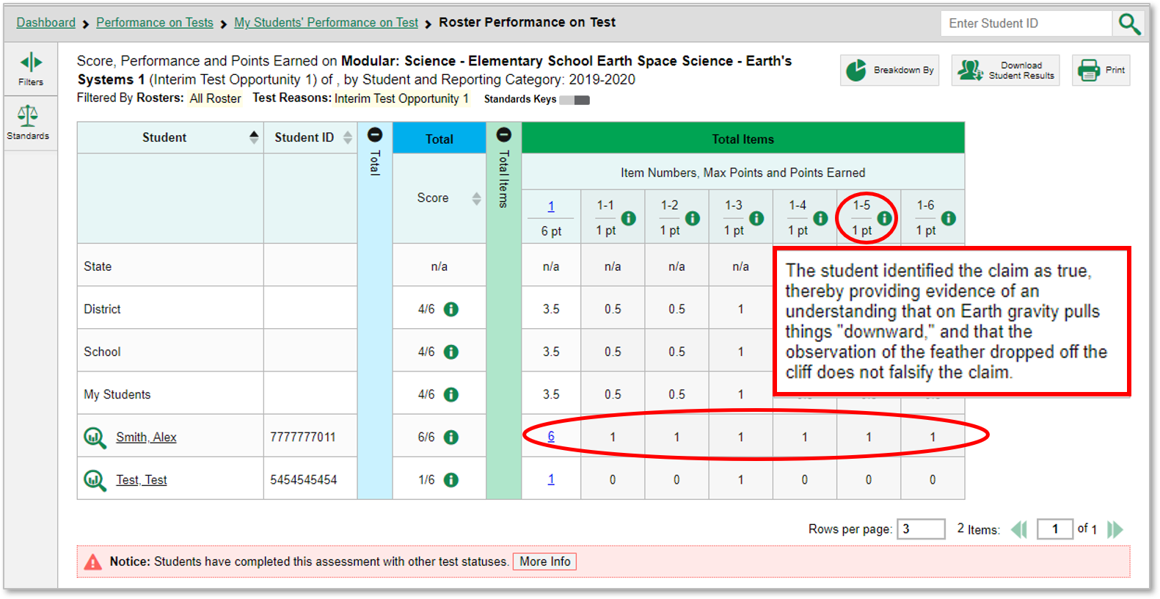
Items with Multiple Scoring Assertions
3
Notes:
The report shown here is for a modular science assessment on Earth’s systems.
The items on the modular science interim tests include cluster items. Cluster items usually feature a stimulus consisting of a reading passage, maps, tables, and/or illustrations. Several items are associated with the stimulus. Students are instructed to use what they have learned from the stimulus to perform the associated tasks. You can see that the first student in the table responded to all the items correctly. The student earned 6 of the possible 6 points.
The information button displays the scoring assertions associated with each item. The legend displayed here is from items #1–#5.
Next, we show you what you see when you click the student’s score link for item #1.

Slide 4
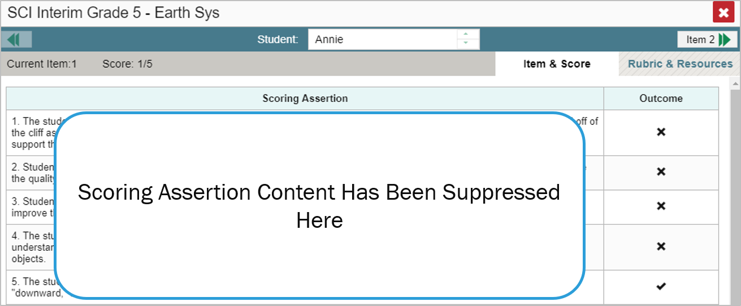
Items with Multiple Scoring Assertions (continued)
Notes:
When you click the link indicating the student’s score, you can see all the scoring assertions associated with the student’s score. The student outcomes for each item are also indicated.
We now show you how to filter your item-level data by standard.

Slide 5
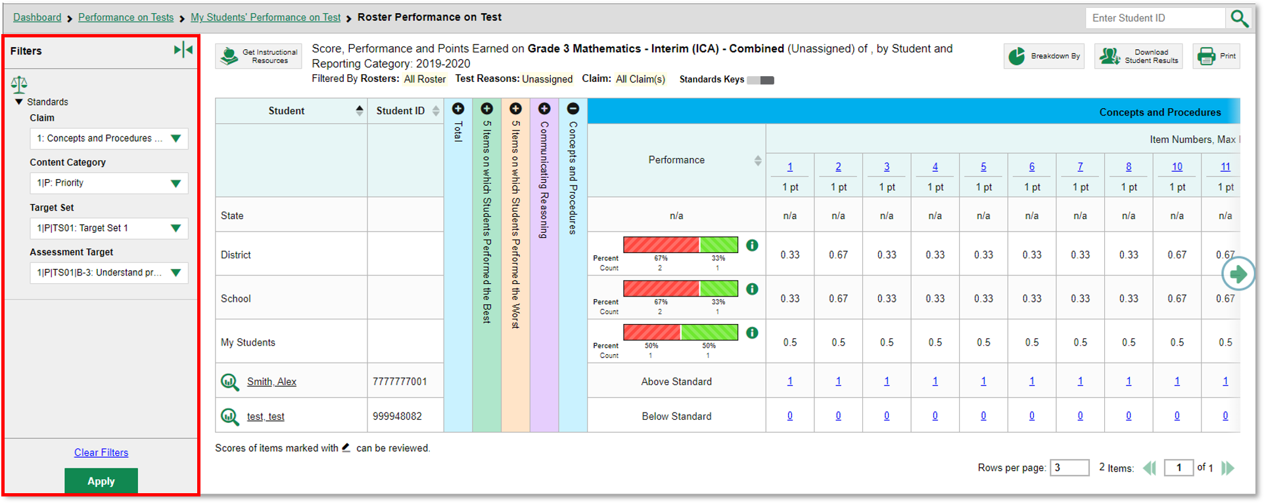
Use the Standards Filter
5
Notes:
Sometimes it is helpful to use the Standards filter so you can see how students perform on a particular standard. Please note that the terminology and filter options vary by state, complex, and test.
In our example, there are 37 items on the sample Grade 3 Mathematics—Interim (ICA) assessment. The items are associated with three reporting categories: Communicating Reasoning in purple, Concepts and Procedures in blue, and Problem Solving and Modeling & Data Analysis (not shown).
Open the Filters panel by clicking the Filters button or the Standards button. Use the drop-down list under Standards to select a standard, claim, or target.
Click Apply to filter your data by your selections.
On the next slide, we show you the effects of the filter we applied.

Slide 6
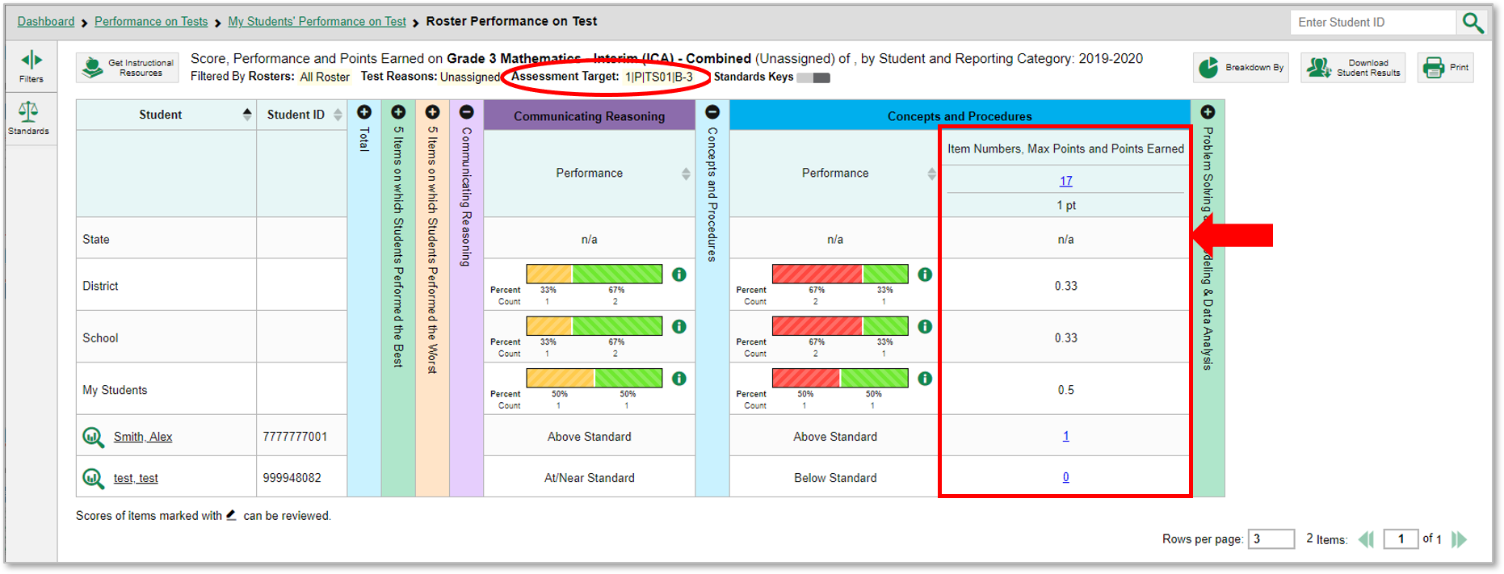
Use the Standards Filter (continued)
6
Notes:
This is the same sample Grade 3 Mathematics—Interim (ICA) data, now filtered to show only items associated with the standards selected, Understand Properties of Multiplication. Notice that there are now no items shown in the first reporting category, Communicating Reasoning. None of the items in this reporting category are associated with the standard we filtered for.
The second reporting category, Concepts and Procedures, shows one item belonging to the standard.
The filter details under the report header have updated to specify the standards by which the report is filtered.
Now we explain the Test Reason Manager and the Test Reason filter. These two tools are useful only with interim and benchmark tests.

Slide 7
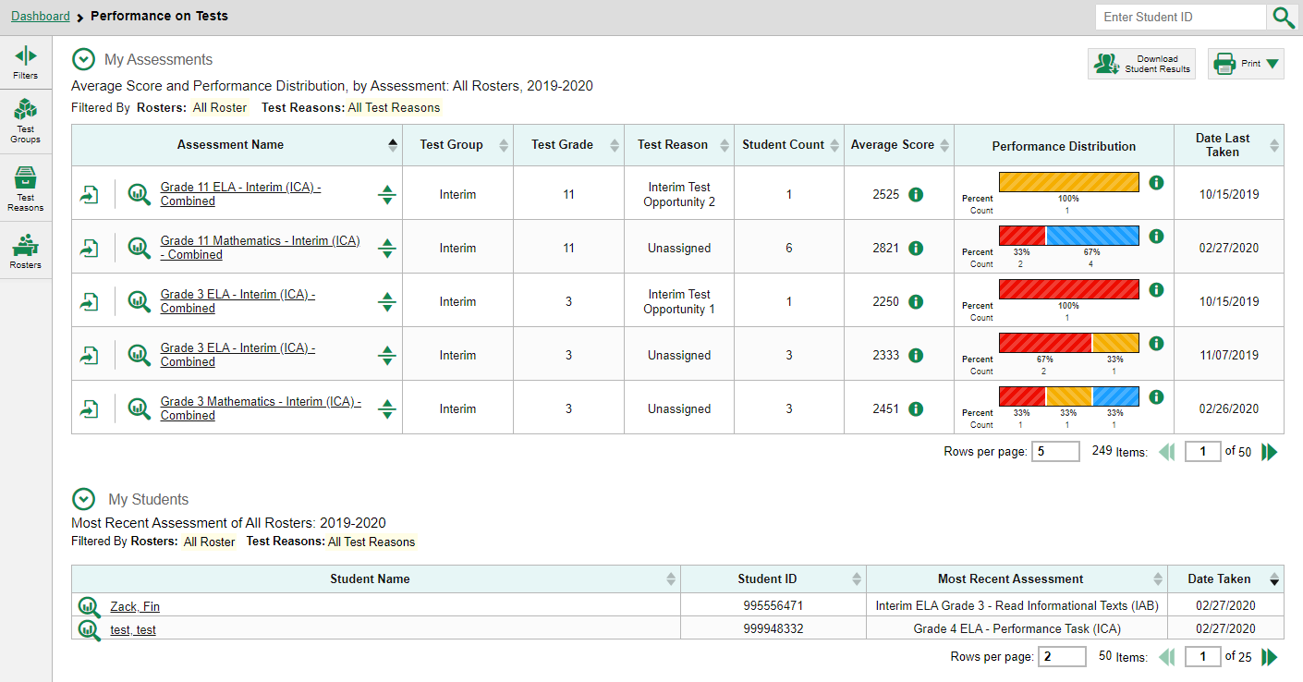
Test Reasons
7
Notes:
Test reasons are categories used to classify test opportunities for reporting purposes. They commonly indicate the timeframe in which a test was taken, like “Pre-Test,” or “Fall” or “First”, “Second”, and “Third”. Test reasons are a good way to organize interim and benchmark tests into groups. If your students will take the same assessment multiple times, assigning different test reasons can help you distinguish scores for the different test opportunities in Reporting.
Test reasons should ideally be assigned in the Test Administration Site at the time of testing. However, you can use the Test Reason Manager in the Reporting System to assign a different test reason to an interim or benchmark test opportunity after the test is completed. Otherwise, the test reason will appear as “Unassigned.”
On the next slide we show you the first step to assigning a new test reason.

Slide 8
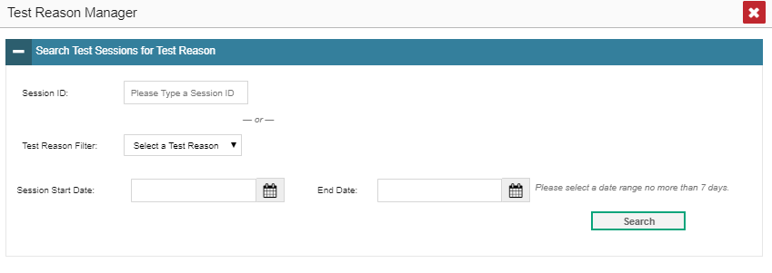
Assign Test Reasons
Manage Access
Change Role
Reporting Options
Manage Test Reasons
Select Tests to Include on Reports
Change Reporting Time Period
Set Student Settings on Item View
Roster Settings
Add Roster
View/Edit Roster
Upload Rosters
8
Notes:
From the My Settings drop-down menu, select Manage Test Reasons.
To search for test opportunities to categorize, do either of the following:
In the Session ID field, enter the session ID in which the opportunities were completed in the test delivery system (TDS).
Select a test reason associated with the opportunities you want to edit.
Then select a range of dates during which the test session was administered. The range cannot exceed seven days. Then, click Search.

Slide 9
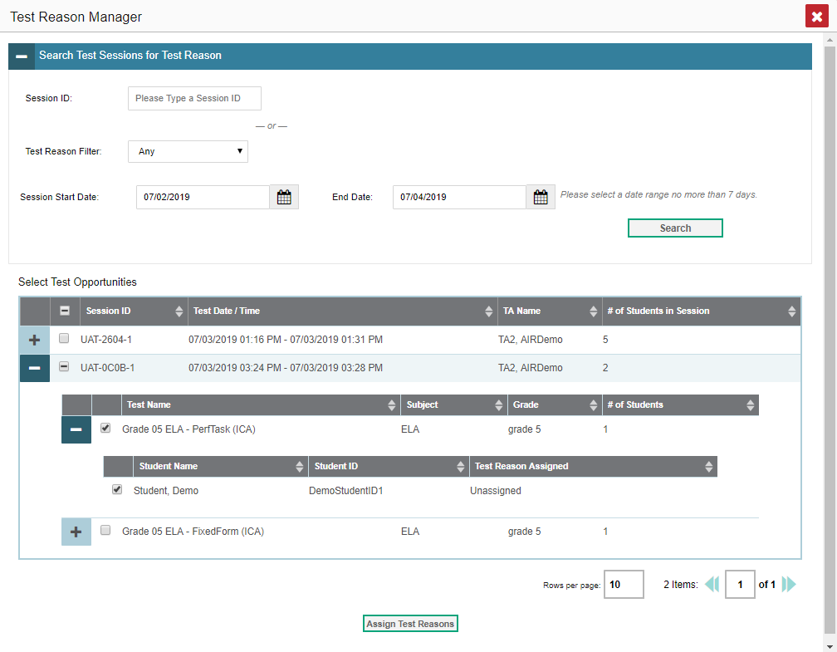
Assign Test Reasons (continued)
9
Notes:
A list of retrieved test sessions appears in the Select Test Opportunities section.
Click the plus sign buttons to expand the list of tests in each session and, under a test, the list of students who took that test in that session. Mark the checkboxes for each session, test, or opportunity that requires a test reason.
Click Assign Test Reasons.
In the confirmation window, select a new test reason to assign to the selected opportunities and click Confirm.
Assigning or reassigning test reasons will make the filter by test reason option more useful. We explain why on the next slide.

Slide 10
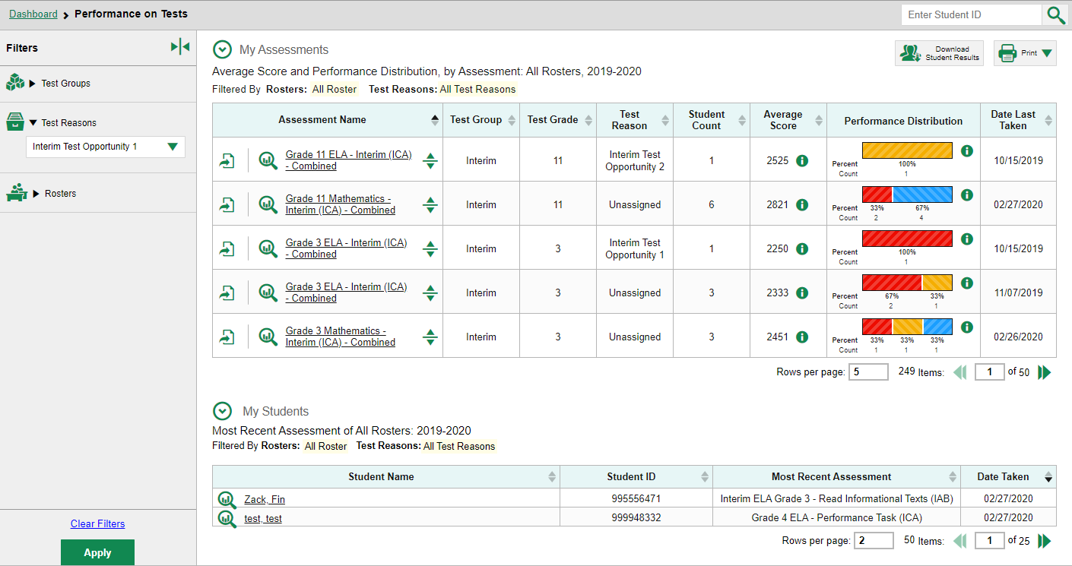
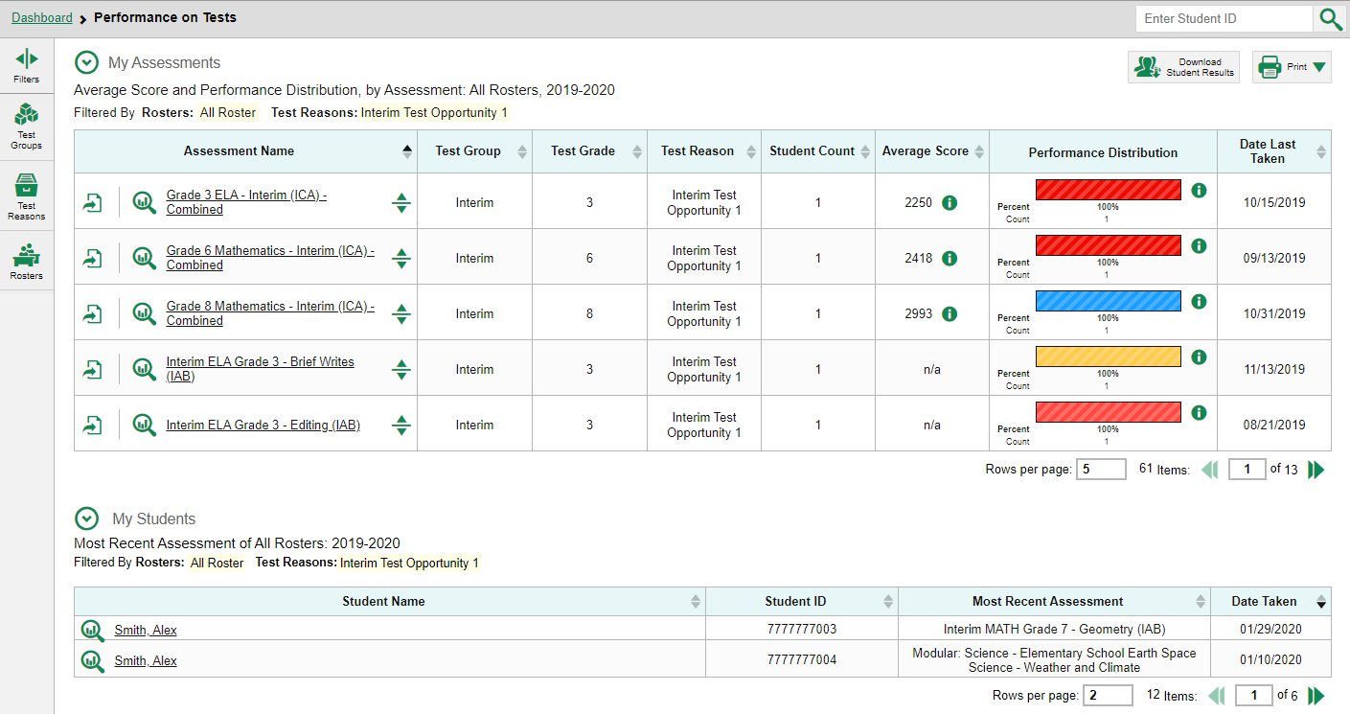
Filter by Test Reason
10
Notes:
When your test opportunities have test reasons, you can filter reports by a single test reason.
For example, you may want to filter by Interim Test Opportunity 1 and look at ELA performance, then filter by Opportunity 2 and see if students have improved on ELA material. If you don’t filter, you’ll see data for all your different tests together. Filtering allows you to view a single set of tests (defined by meaningful names such as Interim 1, Interim 2, and Interim 3). You may find reports more useful if you organize your data this way.
The test reasons filter is available on the dashboards for teachers as well as school- and complex-level users, and in the Performance on Tests report. Here we show the Performance on Tests report. On the left side of the page, click the Test Reason button to display the drop-down list of test reasons. Make a selection from the drop-down list and click Apply. For our example we selected the Interim Test Opportunity 1 reason.
The filtered report displays an updated table header. You see only the tests identified with that reason in your results. You can return to the Filters drop-down menu and select another reason to make comparisons.

Slide 11
The Centralized Reporting System Series
1. How to Navigate the Dashboard and Access Your Summative Results
2. How to Understand Measures for Standards, Depth of Knowledge (DoK) Levels, and Writing Dimensions
3. How to Understand a Demographic Breakdown Report and a Student Portfolio Report
4. How to Drill Down into Your Results by Selecting Specific Tests & Classes
5. How to Drill Down into Your Results by Selecting Previous School Years & Previous Students
6. How to Track Student Performance Over Time Using the Longitudinal Report
7. How to Print Individual Student Reports (ISR) and Student Data Files
8. How to Print and Export Data You Can See in Your Reports
9. How to Use the Roster Manager to Add, Modify, and Upload Rosters
10. How to Analyze a Basic Interim Test Report
11. How to Use the Advanced Features of Reporting to View Interim Data
12. How to Handscore Unscored Items and Modify Machine Scores
Interim and Benchmark Assessments Only
Notes:
Thank you for viewing this training module on item-level reports. You now know how to define cluster items and scoring assertions; how to filter by standards; how to assign test reasons; and how to filter by test reason.
More training modules are posted on the HSAP portal.

Slide 12
More Help
Further Information: Centralized Reporting Guide 2020–2021
HSAP Portal Website: https://alohahsap.org/
HSAP Help Desk Email: hsaphelpdesk@cambiumassessment.com
Help Desk Phone Number: 1-866-648-3712
Notes:
For more detailed information, consult your Centralized Reporting Guide 2020–2021, located on your HSAP portal, or contact your Help Desk.

