Slide 1

Performance Task Overview
Notes:
Performance Task Overview

Slide 2
Introduction

Slide 3

PERFORMANCE TASK
This training module answers the following questions:
  What is a performance task?
  What does a performance task in English language arts/literacy look like?
Notes:
This training module provides an introduction to performance tasks by answering the following questions:
What is a performance task?
What does a performance task in English language arts/literacy look like?

Slide 4
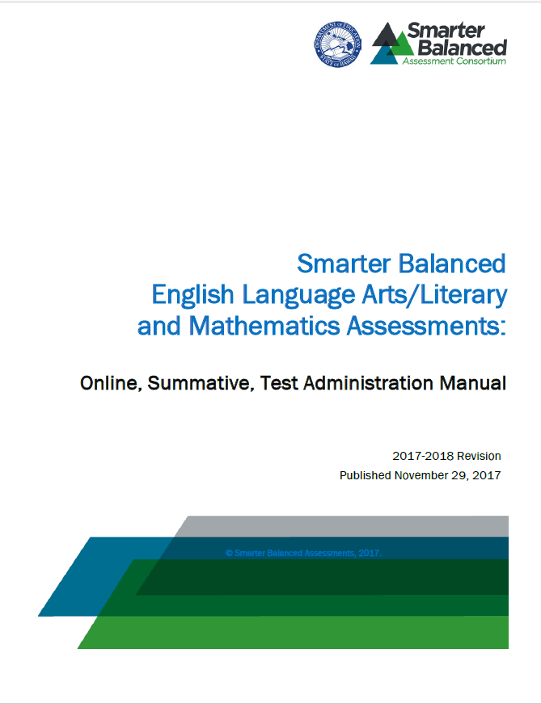
Notes:
This presentation is a general overview of the performance task. Test Administrators and classroom teachers who administer the performance task should be sure to review the additional information provided in the Online Test Administration Manual. This information provides greater detail about how to plan for the performance task event within the Hawaii test administration process.

Slide 5
What is a Performance Task?

Slide 6
Smarter Balanced Assessment
CAT
Performance Task
Notes:
As you know, the Smarter Balanced assessment consists of two components: a CAT portion for the ELA and Mathematics tests, and a Performance Task for the ELA section.

Slide 7
PERFORMANCE TASK (PT)
Portion of the test that requires students to answer a set of questions centered on a common topic or problem.
Notes:
A performance task, also referred to as a PT, is a portion of the test that requires students to answer a set of questions that are centered on a common topic or problem. There is one performance task per content area on the summative assessment.

Slide 8
PERFORMANCE TASK
Administered online;
Helps ensure test items are more accessible; and
Allows students to respond in ways that are different from how they might respond or access paper-and-pencil tests.
Notes:
The Smarter Balanced assessment is administered as an online assessment on the computer, which helps ensure test items are more accessible.
Online assessments allow students to respond in ways that are different from how they might respond or access the paper-and-pencil tests.

Slide 9
PERFORMANCE TASK
Measures how well a student can integrate knowledge and skills across multiple claims and targets
  Claim: Broad evidence-based statements about what students know and can do as demonstrated by their performance on the assessment
  Target: Connects the Hawaii Common Core State Standards to evidence that will be collected from the assessment
Notes:
The performance task is intended to measure how well a student can integrate knowledge and skills across multiple claims and targets.

Slide 10


PERFORMANCE TASK
KNOWLEDGE + SKILLS
Notes:
The ability to integrate knowledge and skills across multiple claims and targets is a very important part of being college- and career-ready.

Slide 11
What is a performance task?
Introduction to Performance Tasks
Measures capacities such as depth of understanding, research and writing skills, and/or complex analysis with relevant evidence, and
Designed to provide students with an opportunity to demonstrate their ability to apply their knowledge and higher-order thinking skills to explore and analyze a complex, real-world scenario.
ELA
Expectations
Notes:
As its name suggests, a performance task measures capacities such as depth of understanding, research and writing skills, and/or complex analysis with relevant evidence. It is designed to provide students with an opportunity to demonstrate their ability to apply their knowledge and higher-order thinking skills to explore and analyze a complex, real-world scenario.

Slide 12

Simplifying rational expressions
Conversion of decimal to percent
Order of operations
Notes:
When students enter college or begin a career, they are often confronted with tasks that require them to seek information, analyze that information, determine which information is needed and which is not, and then evaluate and/or synthesize that information.
Problems in the world do not come to us neatly packaged and ready to solve. Performance tasks are intended to measure a student’s ability to grapple with these scenarios.

Slide 13
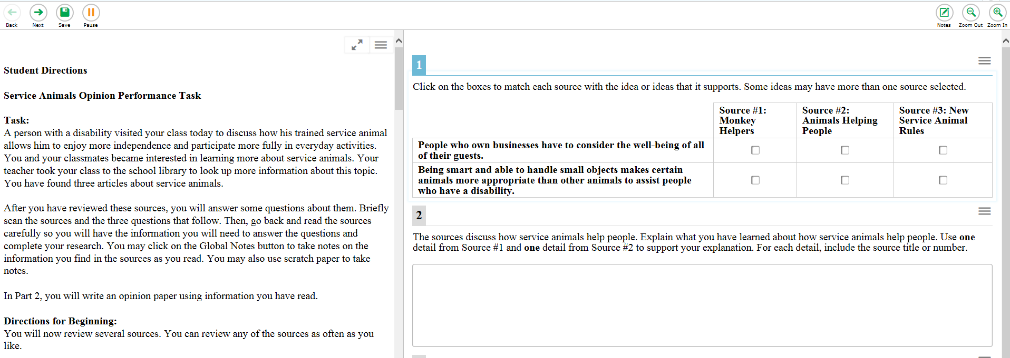
What is a performance task?
ELA
In ELA, performance tasks require students to integrate research and writing to inform/explain, to narrate, or to support an opinion/argument for a designated audience.
Notes:
In ELA, performance tasks require students to integrate research and writing to inform/explain, to narrate, or to support an opinion/argument for a designated audience.

Slide 14
What is a performance task?
Student is expected to work more extensively with the test materials, such as:
  informational sources,
  research articles, or
  tables of data.
ELA
Expectations
Notes:
In a performance task, a student is expected to work more extensively with the test materials, such as informational sources, research articles, or tables of data, in ways that closely mirror the kinds of tasks students would be expected to do in the real world.

Slide 15
ELA Performance Task Examples

Slide 16
PERFORMANCE TASK
To review these and other examples in more detail, please visit the
Smarter Balanced Practice Tests available on alohahsap.org.
Notes:
Let’s look at a performance task examples for English language arts/literacy. Examples such as these can be found on the Smarter Balanced Practice Test available on alohahsap.org.

Slide 17
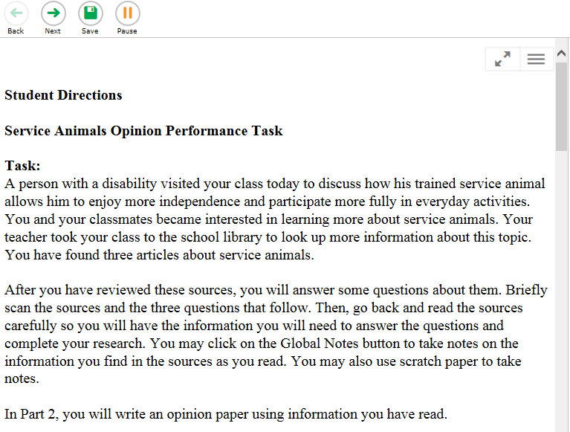
ELA Performance Task
What happens next:
Students are randomly assigned different performance tasks.
There are two parts to each ELA performance task:
  Part 1 — Research
  Part 2 — Writing
Recommendation: Administer the two parts in two sessions.
Notes:
Students are randomly assigned different performance tasks. There are two parts to each ELA performance task: Part 1 is Research and Part 2 is Writing (sometimes referred to as the “full-write”). It is recommended that these two parts be administered in two sessions.

Slide 18
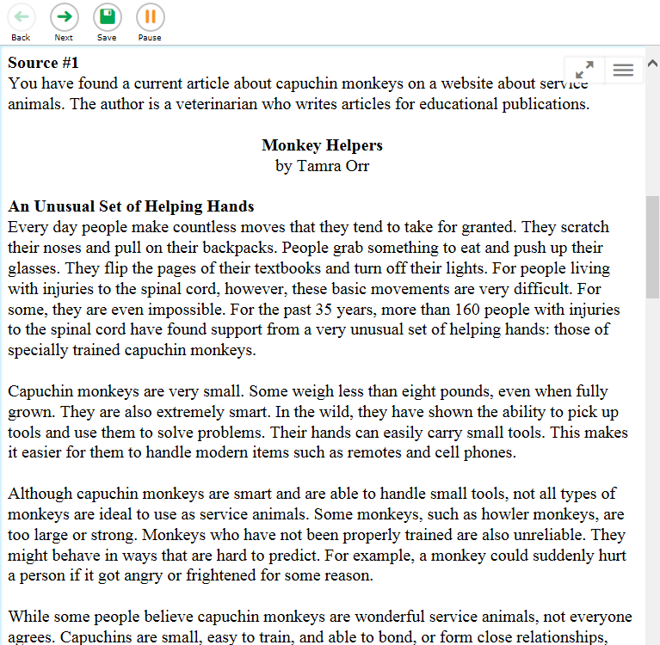
ELA Performance Task
In Part 1, students are given a set of two or more sources to be used on both parts of the test.
Information may be in the form of informational or argumentative articles, research articles, charts, or other sources.
What happens next:
Notes:
In Part 1, students are given a set of two or more sources to be used on both parts of the test. This information may be in the form of informational or argumentative articles, research articles, charts, or other sources.

Slide 19
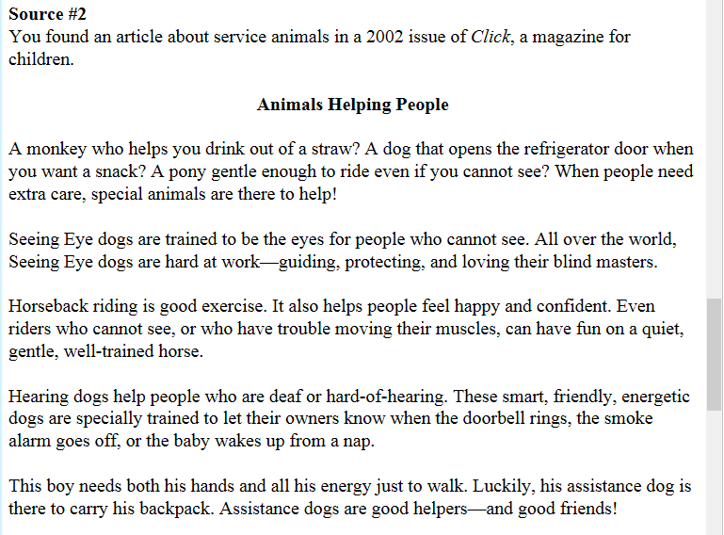
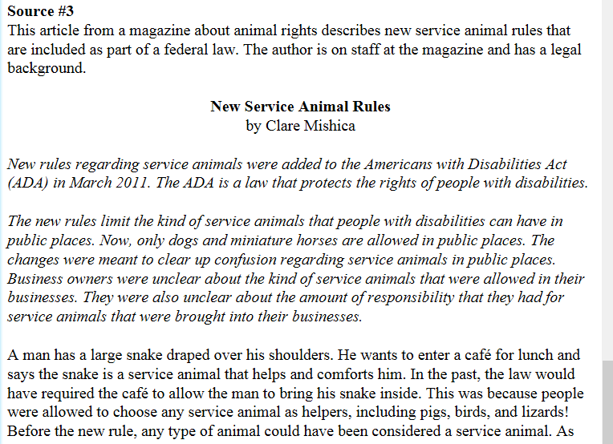
ELA Performance Task
Example:
In this example, students access research articles from several sources about the same
topic — in this case, how service animals help people.
Notes can be taken on paper or on the computer.
Notes:
In this example, students access research articles from several sources about the same topic — in this case, how service animals help people. They may take notes on paper or on the computer.

Slide 20
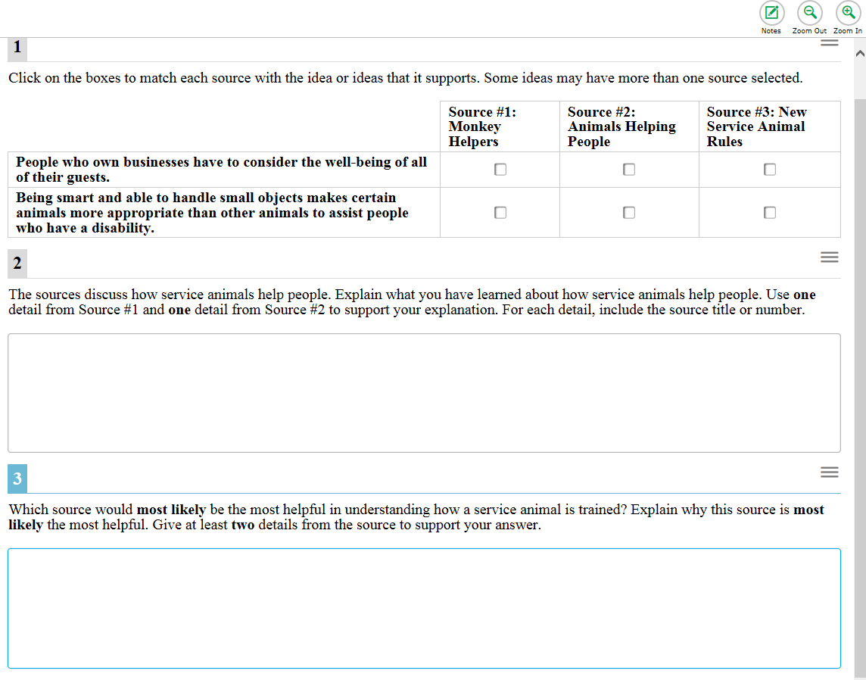
ELA Performance Task Questions
ELA Performance Task Question Examples
The ELA task then requires the student to answer research questions about the information in the sources.
Notes:
The ELA task then requires the student to answer research questions about the information in the sources.

Slide 21
ELA Performance Task Questions
Example Question 1
1) The student is asked to match each source with the idea or ideas that it supports.
Notes:
1) The student is asked to match each source with the idea or ideas that it supports..

Slide 22
ELA Performance Task Questions
Example Question 2
2) The student is asked to explain evidence that supports the given statement.
Notes:
2) The student is asked to explain evidence that supports the given statement.

Slide 23
ELA Performance Task Questions
Example Question 3
2) The student is asked to provide details from one source that supports the student’s response to the question.
Notes:
3) The student is asked to provide details from one source that supports the student’s response to the question.

Slide 24

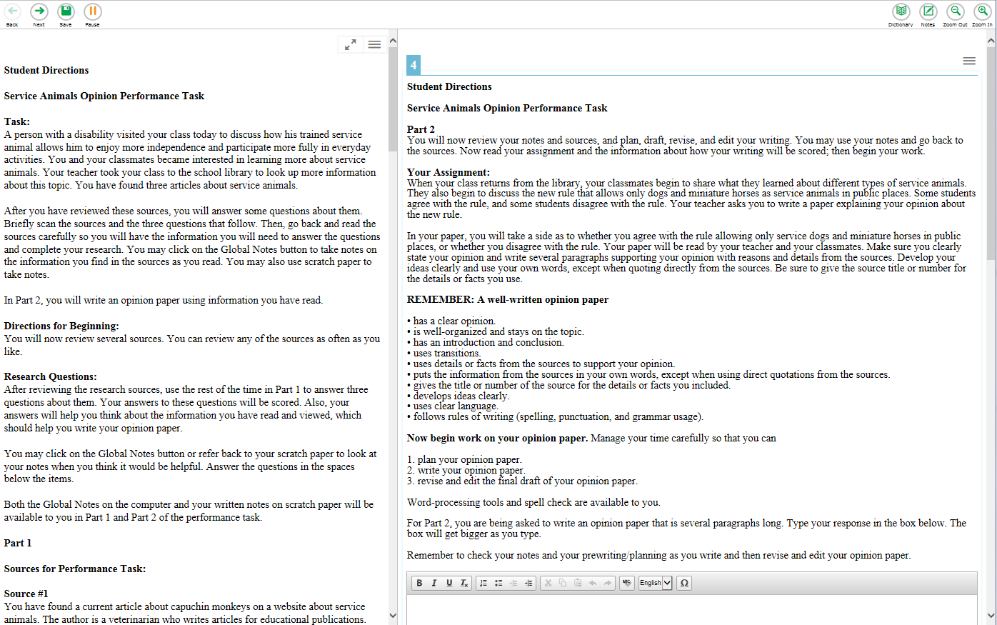
Notes:
In the final part of the ELA performance task, students are asked to respond to a writing assignment using the full-write process: drafting, revising, and editing.

Slide 25
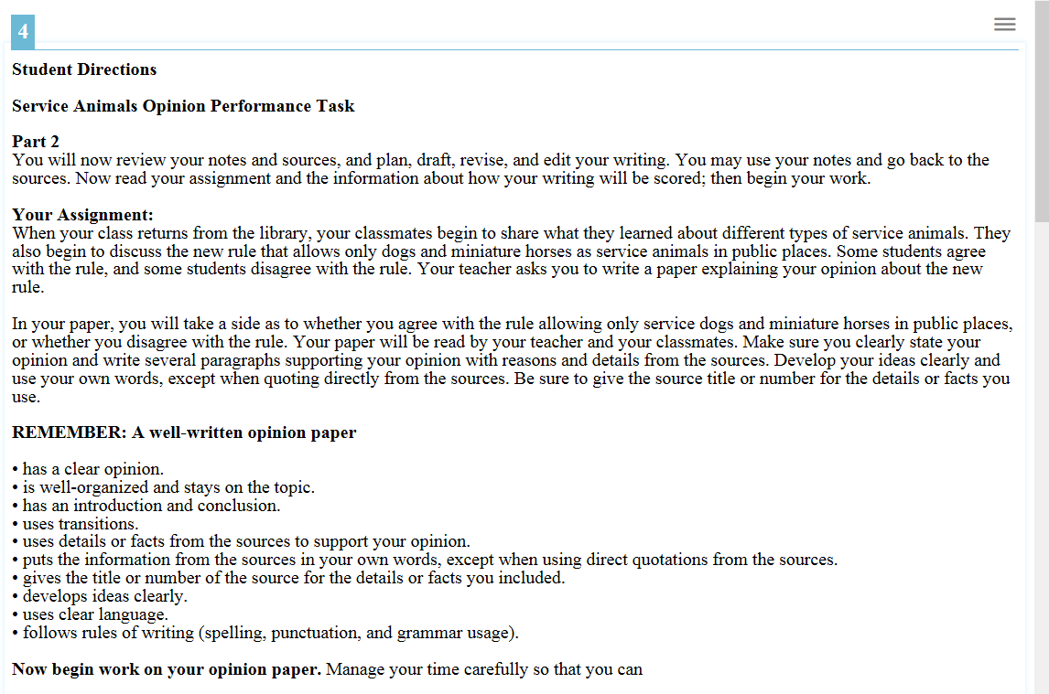

Make sure you clearly state your opinion and write several paragraphs and write several paragraphs supporting your opinion with reasons and details from the sources.
Notes:
The writing assignment, or full-write assignment as it is sometimes called, is designed so students use information from the sources presented previously in the performance task. They use these sources when writing their multi-paragraph essays, articles, reports, or narratives. In the ELA performance task, sources and global notes from Part 1 are available in Part 2 so students may refer to the sources and their global notes even though they are not able to return to the research questions in Part 1. Paper notes from Part 1 should be made available for Part 2.

Slide 26
Notes:
The online system provides many common word-processing tools such as an embedded dictionary and thesaurus, bold, italics, underlining, copy, paste, and spell check to assist the student with the writing assignment.

Slide 27
Administration, Timing, and Sequencing

Slide 28
EXAMPLE SEQUENCE
Day 1 | Day 2 | Day 3
ELA | ELA Part 1 | ELA Part 2
Day 4
Math
CAT
PT
PT
CAT
Notes:
Here’s a sample order of administration for both the ELA and mathematics CAT and ELA performance task.
The ELA performance task should be administered over two sessions (Part 1 and Part 2). It is recommended that students complete Part 1 of the ELA performance task in one test session and Part 2 the next school day.

Slide 29
ADMINISTRATION SEQUENCE AND TIMING
Outlines the number and duration of:
Sessions
Breaks
Estimated testing times
Content Area | Grades | Computer Adaptive Test (CAT) items hrs : mins | Performance Task (PT) hrs : mins | Total hrs : mins
English Language Arts/Literacy | 3–5 | 1:30 | 1:45 | 3:15
 | 6–8 | 1:25 | 1:20 | 2:45
 | HS | 1:15 | :55 | 2:10
Mathematics | 3–5 | 1:35 | N/A | 1:35
 | 6–8 | 1:35 | N/A | 1:35
 | HS | 1:05 | N/A | 1:05
Both | 3–5 | 3:05 | 1:45 | 4:50
 | 6–8 | 3:00 | 1:20 | 4:20
 | HS | 2:20 | :55 | 3:15
Notes:
The Online Test Administration Manual includes tables of recommended sequences for ELA and mathematics.
The tables provide estimated average times for students to complete the Smarter Balanced assessments and outlines the number and duration of sessions, breaks, total duration of the assessment, and additional resources for the mathematics CAT and ELA CAT items and performance tasks.

Slide 30
Don’t forget these details.

Slide 31
PERFORMANCE TASK
You might want to take a few notes on the information in the next few slides.
Notes:
There are some other important details to know about performance tasks, so please take note of the following information.

Slide 32
PERFORMANCE TASK
Ten-day
expiration
Notes:
Performance tasks expire after ten calendar days once initiated by the student.

Slide 33
PERFORMANCE TASK —Pausing
There are no pause rules for the performance task.
Students can take breaks during the administration of the performance task but will be automatically logged out after 20 minutes in a paused state or 30 minutes of inactivity.
For ELA, students have access to the items within either Part 1 or Part 2.
Notes:
There are no pause rules for the performance task. Students can take breaks during the administration of the performance task but will be automatically logged out after twenty minutes in a paused state or thirty minutes of inactivity.
For ELA, after taking a break, students will have access to only those items within the part of the task they were working on (Part 1 or Part 2) prior to the break. Students may not go back to Part 1 if they take a break during Part 2, however, the Global notes are retained for both parts 1 and 2.

Slide 34
PERFORMANCE TASK Tools Global Notes — ELA
Used only for the ELA PT
Global notes is an embedded universal tool;
Notes are retained from Part 1 to Part 2
  A student taking Part 2 of the ELA PT may refer back to the notes even though the student is not able to go back to the research questions in
  Part 1; and
  Preferred mode for note taking.
Notes:
During the ELA PT, the notes on the embedded universal tool, Global Notes, are retained from Part 1 to Part 2 so that the student may go back to the notes even though he or she is not able to go back to the research questions in Part 1. Embedded Global Notes is the preferred mode for note taking. Global Notes is not available for the mathematics PT.

Slide 35
PERFORMANCE TASK Tools Scratch Paper — ELA
Students may choose to use scratch paper to make notes in ELA.
Collect scratch paper at completion of Part 1 of the ELA performance task and store securely until Part 2.
After administration, all scratch paper must be securely destroyed in adherence to test security procedures.
Notes:
To ensure that students using scratch paper for notes have the same allowance as students using the online notes, TAs should direct students to write their names on the scratch paper before collecting it at the completion of Part 1 of the ELA PT and securely store the paper for students’ use during Part 2 of the ELA PT.

Slide 36
For more information,
please visit:
www.smarterbalanced.org
Notes:
For more information, please visit:
www.smarterbalanced.org

