Slide 1
Online Testing System Assessment Viewing Application (AVA)
Training Module
Notes:
Welcome to the Assessment Viewing Application (AVA) training module.
AVA is a component of the Online Testing System that allows authorized users to view interim assessments for administrative or instructional purposes.
This training module is designed to help you navigate the Assessment Viewing Application. You should consult the Assessment Viewing Application User Guide located on AlohaHSAP.org portal for additional information.

Slide 2
Objectives
After viewing this presentation, you should understand how to:
Log in to AVA
Access the assessments
Navigate through the test
Notes:
After viewing this presentation, you should understand how to:
Log in to AVA
Access the assessments
Navigate through the test

Slide 3
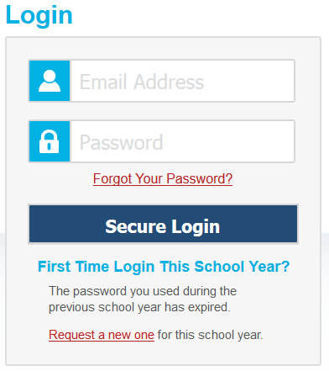
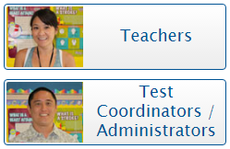
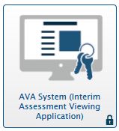
Logging in to AVA
3
Notes:
To log in to AVA, you must have an authorized email address and password, which is the same as the one you use for TIDE and the TA Interface. Contact your School Test Coordinator if you do not have a TIDE account.
To log in to AVA, go to the AlohaHSAP.org portal. Click the appropriate assessment card and user role. On the next page, click the AVA System card. Enter your username and password, and then click Secure Login.

Slide 4
Choosing a Test Grade
Notes:
After logging in, the Choose a Test Grade page appears.
From the Grade drop-down list, select the desired grade level and click Next.

Slide 5
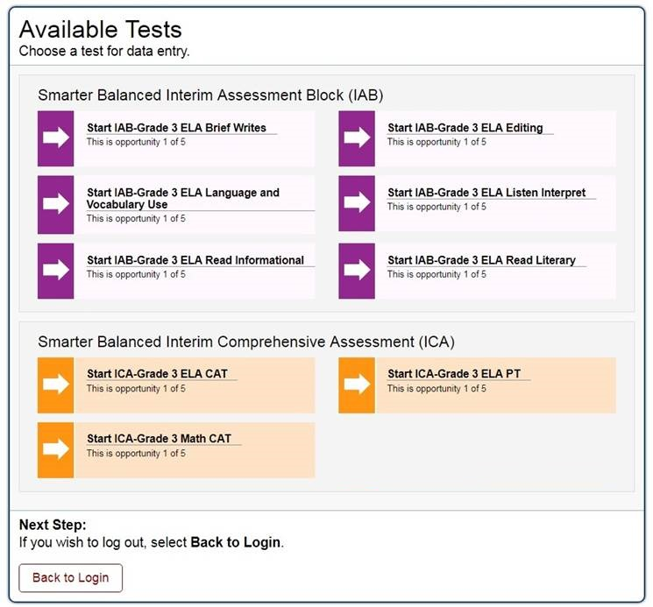
Selecting the Test
Notes:
The Available Tests page displays the tests available for the selected grade level. Click the appropriate test name.

Slide 6
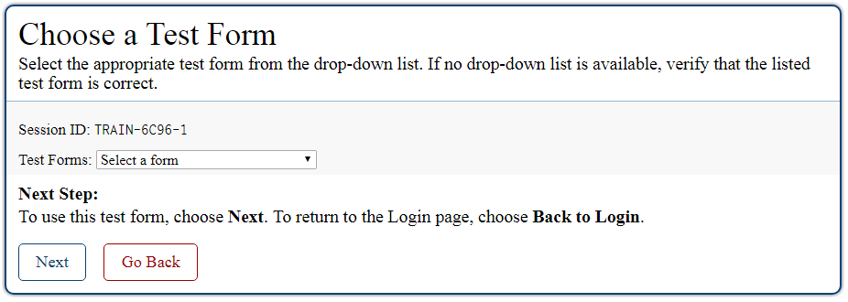
Confirming the Test
Notes:
The Choose a Test Form page displays one or more test forms, as well as the Session ID that is generated after you select a test.
If the Test Forms drop-down list is available, select the appropriate form. If the drop-down list is not available, verify that the correct test is listed in the Test Forms field.
Click Next. If the test includes audio features, the Sound Check page appears. If the test does not include audio features, the first page of the test appears.

Slide 7
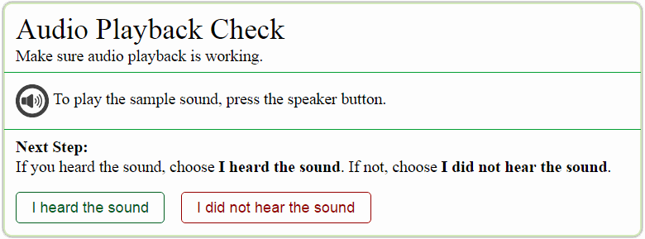
Audio Playback Check
Notes:
The Audio Playback Check page allows you to verify the functionality of any audio features that the test may include. To perform the Audio Playback Check:
First, make sure the speakers on your computer are not muted and your volume is set appropriately. Click the speaker icon to hear a sample sound. If you hear a sound, click I heard the sound. The first page of the test will appear. If you do not hear a sound, click I did not hear the sound and consult your technology coordinator for assistance.

Slide 8
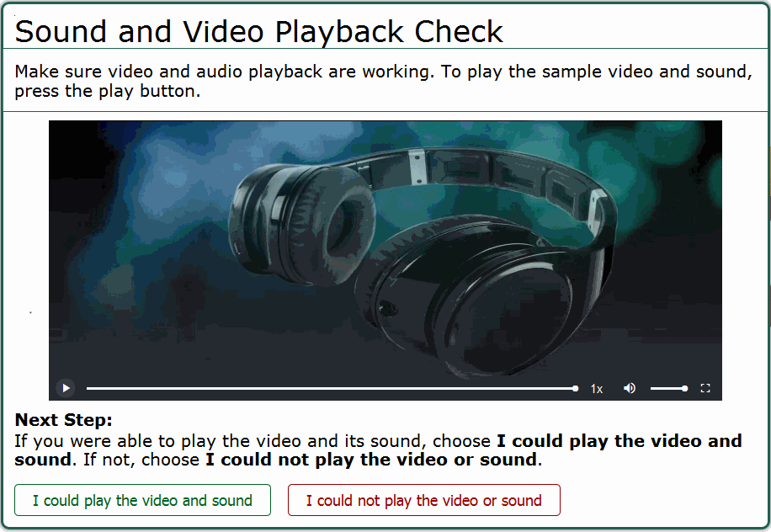
Sound and Video Playback Check
Notes:
On tests that contain video, you will be presented with a Sound and Video Playback Check screen. Click the play button to play the video and audio. If you can see the video and hear the audio, click I could play the video and sound to proceed. If you cannot see the video and hear the audio, click I could not play the video and sound and consult your technology coordinator for assistance.

Slide 9
Understanding the Test Page
Notes:
This slide displays a sample test page.
AVA includes several on-screen tools, including global tools and context menu tools.
Global tools are those available on every page in the banner. These include the Zoom, Pause, Back, and Next buttons.
The context menu displays the tools available for that test item.
For a detailed list of tools, consult your AVA User Guide.

Slide 10
Responding to Items
Notes:
Next we will discuss how to navigate a test, pause a test, and complete a test review.
When viewing a test, you can practice responding to the test items. You must respond to all the items on a page before advancing to the next page. Pages may have only a single item, or they may contain multiple items. Responses you enter will not be scored when you complete the test review.

Slide 11
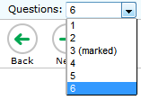
Navigating to Items
Notes:
You can navigate to items page-by-page or jump directly to an item’s page.
To navigate page-by-page, click the Back or Next buttons at the top of the screen.
To jump directly to an item page, select the appropriate item from the Questions drop-down list.

Slide 12
Pausing Tests
Notes:
You may pause the test at any time. Pausing the test automatically logs you out of AVA. To return to the test, you must log back in and select the appropriate test again.
To pause the test, click Pause in the banner. A pause test message will appear. Click Yes to confirm that you want to pause the test.
As a security measure, after 30 minutes of inactivity on the site, you are automatically logged out.

Slide 13
Finishing the Test Review
Notes:
After viewing all the items in a test, the Finished button appears at the top of the page.
When you click Finished, a popup message appears. Click Yes to complete the test review, or click No to continue reviewing the test.

Slide 14
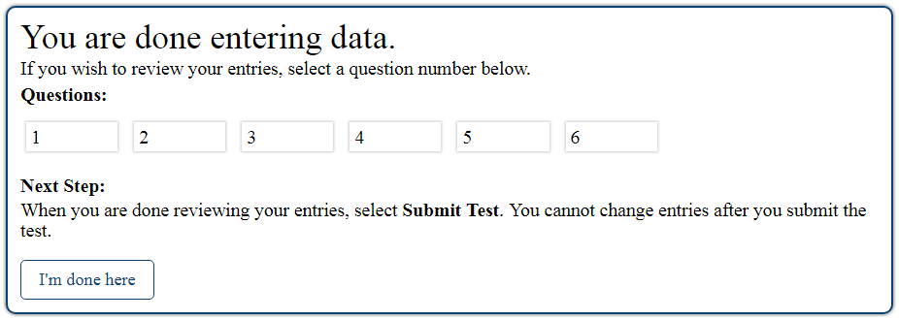
Reviewing Marked Items
Notes:
After clicking [Yes] in the Attention message, you will have one more opportunity to review items. Click an item number to return to review that item. You can navigate through the test as before, and click the Finish button to return to the review page at any time.
When finished reviewing, click I’m done here.

Slide 15
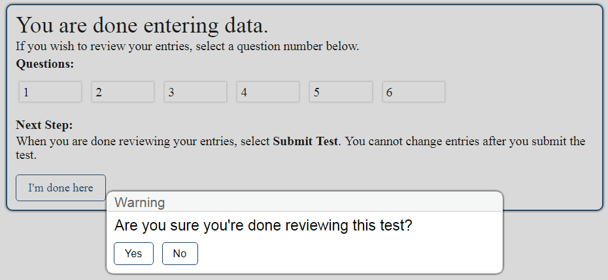
Completing the Review
Notes:
You will be asked one more time to confirm that you are done viewing the test. Click No to return to the review screen, or click Yes to complete the test.

Slide 16
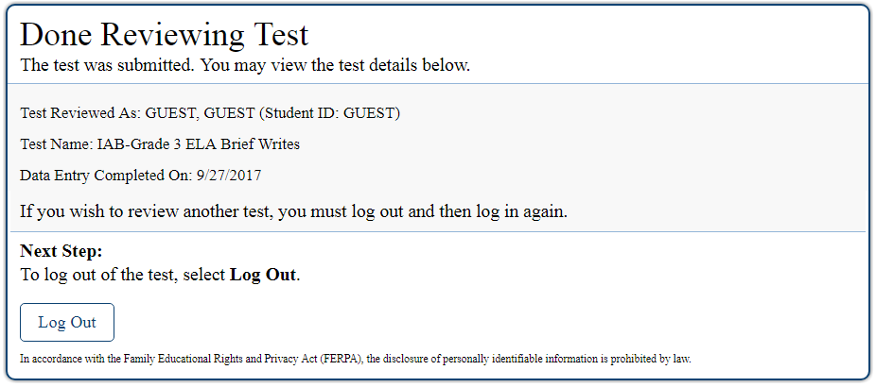
Logging Out
Notes:
The Done Reviewing Assessment page displays a confirmation that the test review is over. Click Log Out to return to the AVA login page.

Slide 17
Thank You!
Further Information
Visit
www.alohahsap.org
www.smarterbalanced.org
Call, fax, or email the American Institutes for Research HSAP Help Desk
Hours: 7:30 am to 4:00 p.m. HST, Monday-Friday (except holidays)
Phone: 1-866-648-3712
Fax: 1-877-231-7813
Email: HSAPHelpDesk@air.org
Notes:
Thank you for taking the time to view this training module. For additional information, refer to your AVA User Guide located on the AlohaHSAP.org portal or contact the HSAP Help Desk.

