Slide 1

Accessibility and Accommodations
Notes:
Accessibility and Accommodations

Slide 2
Introduction
Notes:
Introduction

Slide 3

Accessibility and Accommodations
Positive and productive assessment experience
Results that are fair and accurate
Notes:
It’s the goal of the Smarter Balanced Assessment Consortium to provide each student with a positive and productive assessment experience, generating results that are a fair and accurate estimate of each student’s achievement.

Slide 4
Accessibility and Accommodations
Notes:
Smarter Balanced is building on a framework of accessibility for all students, including accurate measures of achievement and growth for students with disabilities and English learners.

Slide 5
Accessibility and Accommodations
college- and
career-readiness
Notes:
Smarter Balanced has developed next-generation assessments to measure students’ knowledge and skills as they progress toward college-and career-readiness. These assessments provide information about student performance and preparedness to meet English language arts and mathematics requirements for postsecondary education and career-readiness associated with the wide array of occupations.

Slide 6
Accessibility and Accommodations
Validity depends on students having appropriate:
Universal tools
Designated supports
Accommodations when needed
Notes:
Smarter Balanced recognizes that the validity of assessment results depends on each and every student having appropriate universal tools, designated supports, and accommodations based on student need, which are in line with the intended constructs being measured by the assessment. The availability of these features may differ by grade, content area, and intended construct within each of the content areas.

Slide 7
Accessibility and Accommodations
Usability, Accessibility, and Accommodations Guidelines
www.smarterbalanced.org
Notes:
This training module outlines the designated supports and accommodations available for the online assessments, as described in the Usability, Accessibility, and Accommodations Guidelines available on the Smarter Balanced website. Following these Guidelines will contribute to a valid test score for students.

Slide 8
Accessibility and Accommodations
What are the available designated supports and accommodations for students?
Notes:
At the end of this training, you should be able to answer three questions:
1. What are the available designated supports and accommodations for students?

Slide 9
Accessibility and Accommodations
What do the designated supports and accommodations look like in the test delivery system?
Notes:
2. What do the designated supports and accommodations look like in the test delivery system?

Slide 10
Accessibility and Accommodations
How do I ensure that students receive their assigned designated supports and accommodations within the test delivery system (embedded) as well as those outside the test delivery system (non-embedded)?
Notes:
3. How do I ensure that students receive their assigned designated supports and accommodations within the test delivery system (embedded) as well as those outside the test delivery system (non-embedded)?

Slide 11
Accessibility and Accommodations
The examples shown in this module are for the test delivery system. It is important to note that the way to access these tools and how these tools present on your screen may vary slightly depending on the test delivery system used in your state.
Notes:
The examples shown in this module are for the test delivery system. It is important to note that the way to access these tools and how these tools present on your screen may vary slightly depending on the test delivery system used in your state.

Slide 12

Accessibility and Accommodations
Universal tools, designated supports, and accommodations may be different from those that your state has allowed in the past.
Notes:
The online assessments for English language arts (ELA) and mathematics are based on the Common Core State Standards.
Thus, the universal tools, designated supports, and accommodations that are appropriate for these assessments may be different from those that your state has allowed in the past.

Slide 13
Accessibility and Accommodations
For the secure assessments, a state can only provide students with the universal tools, designated supports, and accommodations that are included in the Usability, Accessibility, and Accommodations Guidelines.
Notes:
For the secure assessments, a state can only provide students with the universal tools, designated supports, and accommodations that are included in the Usability, Accessibility, and Accommodations Guidelines.
Your state, as a member state of Smarter Balanced, may elect not to provide its students with any universal tool, designated support, or accommodation that is otherwise included in the Guidelines when the implementation or use of the universal tool, designated support, or accommodation is in conflict with your state’s law, regulation, or policy.

Slide 14

Accessibility and Accommodations
Check with your state education agency to make sure you understand the use of a testing consideration in your state.
Notes:
If you have a question about a particular resource, you should contact your state education agency to make sure you understand the use of a testing consideration in your state.

Slide 15






Accessibility and Accommodations
Same Expectations
Notes:
These Guidelines are designed so that all students (including students with disabilities, English Learners (ELs) and ELs with disabilities) are offered a more equitable opportunity to show what they know.

Slide 16
Accessibility and Accommodations
Exemptions May Apply
Notes:
Eligible students with the most significant cognitive disabilities may participate in the state’s alternate assessments. In addition, ELs enrolled for the first year in a U.S. school may be eligible for an exemption from participation.

Slide 17
Accessibility and Accommodations
To confirm if these conditions apply, you should check with your state education agency about the criteria for participation requirements for these students.
Notes:
To confirm if these conditions apply, you should check with your state education agency about the criteria for participation requirements for these students.

Slide 18
Embedded
Breaks, Calculator, Digital Notepad, English Dictionary, English Glossary, Expandable Passages, Global Notes, Highlighter,
Keyboard Navigation, Mark for Review,
Math Tools,
Spell Check, Strikethrough,
Writing Tools, Zoom
Non-embedded
Breaks,
English Dictionary, Scratch Paper, Thesaurus
Universal Tools
Notes:
First, let’s orient you to the conceptual model of the Usability, Accessibility, and Accommodations Guidelines.
The first resource category is Universal Tools (available for all students, including those receiving designated supports and/or accommodations).

Slide 19
Embedded
Breaks, Calculator, Digital Notepad, English Dictionary, English Glossary, Expandable Passages, Global Notes, Highlighter,
Keyboard Navigation, Mark for Review,
Math Tools,
Spell Check, Strikethrough,
Writing Tools, Zoom
Non-embedded
Breaks,
English Dictionary, Scratch Paper, Thesaurus
Designated Supports
Embedded
Color Contrast, Masking,
Text-to-speech, Translated Test Directions,
Translations (Glossary), Translations (Stacked), Turn off Any Universal Tools
Non-embedded
Bilingual Dictionary,
Color Contrast,
Color Overlay,
Magnification,
Read Aloud,
Scribe,
Separate Setting, Translated Test Directions, Translation (Glossary),
Noise Buffers
Universal Tools
Notes:
The second resource category is Designated Supports. Designated supports are available for students who have a need indicated by an educator (or team of educators with a parent/guardian or the student). The educator making the decision must be knowledgeable of the student's needs as well as the student's familiarity and success with resources available.

Slide 20
Embedded
Breaks, Calculator, Digital Notepad, English Dictionary, English Glossary, Expandable Passages, Global Notes, Highlighter,
Keyboard Navigation, Mark for Review,
Math Tools,
Spell Check, Strikethrough,
Writing Tools, Zoom
Non-embedded
Breaks,
English Dictionary, Scratch Paper, Thesaurus
Designated Supports
Embedded
Color Contrast, Masking,
Text-to-speech, Translated Test Directions,
Translations (Glossary), Translations (Stacked), Turn off Any Universal Tools
Non-embedded
Bilingual Dictionary,
Color Contrast,
Color Overlay,
Magnification,
Read Aloud,
Scribe,
Separate Setting, Translated Test Directions, Translation (Glossary), Noise Buffers
Accommodations
Embedded
American Sign Language, Braille,
Closed Captioning, Text-to-speech
Non-embedded
Abacus, Alternate Response Options, Calculator, Multiplication Table, Print on Demand, Read Aloud,
Scribe, Speech-to-text
Universal Tools
Notes:
And the third resource category is Accommodations. Accommodations are available when the need is documented in an Individualized Education Program (IEP) or 504 plan, or in unique circumstances where a student who may not typically require an accommodation may make use of one. For example, if a student who has not needed an accommodation in the past were to break his or her arm, then this student might use a scribe if appropriately documented.

Slide 21
Embedded
Breaks, Calculator, Digital Notepad, English Dictionary, English Glossary, Expandable Passages, Global Notes, Highlighter,
Keyboard Navigation, Mark for Review,
Math Tools,
Spell Check, Strikethrough,
Writing Tools, Zoom
Non-embedded
Breaks,
English Dictionary, Scratch Paper, Thesaurus
Designated Supports
Embedded
Color Contrast, Masking,
Text-to-speech, Translated Test Directions,
Translations (Glossary), Translations (Stacked), Turn off Any Universal Tools
Accommodations
Embedded
American Sign Language, Braille,
Closed Captioning, Text-to-speech
Non-embedded
Abacus, Alternate Response Options, Calculator, Multiplication Table, Print on Demand, Read Aloud,
Scribe, Speech-to-text
Universal Tools
Non-embedded
Bilingual Dictionary,
Color Contrast,
Color Overlay,
Magnification,
Read Aloud,
Scribe,
Separate Setting, Translated Test Directions, Translation (Glossary), Noise Buffers
Notes:
For each of these three categories of assessment resources—universal tools, designated supports, and accommodations—there exist both embedded…

Slide 22
Embedded
Breaks, Calculator, Digital Notepad, English Dictionary, English Glossary, Expandable Passages, Global Notes, Highlighter,
Keyboard Navigation, Mark for Review,
Math Tools,
Spell Check, Strikethrough,
Writing Tools, Zoom
Non-embedded
Breaks,
English Dictionary, Scratch Paper, Thesaurus
Designated Supports
Embedded
Color Contrast, Masking,
Text-to-speech, Translated Test Directions,
Translations (Glossary), Translations (Stacked), Turn off Any Universal Tools
Accommodations
Embedded
American Sign Language, Braille,
Closed Captioning, Text-to-speech
Non-embedded
Abacus, Alternate Response Options, Calculator, Multiplication Table, Print on Demand, Read Aloud,
Scribe, Speech-to-text
Universal Tools
Non-embedded
Bilingual Dictionary,
Color Contrast,
Color Overlay,
Magnification,
Read Aloud,
Scribe,
Separate Setting, Translated Test Directions, Translation (Glossary), Noise Buffers
Notes:
and non-embedded versions.

Slide 23
Embedded
Breaks, Calculator, Digital Notepad, English Dictionary, English Glossary, Expandable Passages, Global Notes, Highlighter,
Keyboard Navigation, Mark for Review,
Math Tools,
Spell Check, Strikethrough,
Writing Tools, Zoom
Non-embedded
Breaks,
English Dictionary, Scratch Paper, Thesaurus
Designated Supports
Embedded
Color Contrast, Masking,
Text-to-speech, Translated Test Directions,
Translations (Glossary), Translations (Stacked), Turn off Any Universal Tools
Accommodations
Embedded
American Sign Language, Braille,
Closed Captioning, Text-to-speech
Non-embedded
Abacus, Alternate Response Options, Calculator, Multiplication Table, Print on Demand, Read Aloud,
Scribe, Speech-to-text
Universal Tools
Non-embedded
Bilingual Dictionary,
Color Contrast,
Color Overlay,
Magnification,
Read Aloud,
Scribe,
Separate Setting, Translated Test Directions, Translation (Glossary), Noise Buffers
Notes:
Embedded refers to resources provided as digitally delivered components of the test delivery system.

Slide 24
Embedded
Breaks, Calculator, Digital Notepad, English Dictionary, English Glossary, Expandable Passages, Global Notes, Highlighter,
Keyboard Navigation, Mark for Review,
Math Tools,
Spell Check, Strikethrough,
Writing Tools, Zoom
Non-embedded
Breaks,
English Dictionary, Scratch Paper, Thesaurus
Designated Supports
Embedded
Color Contrast, Masking,
Text-to-speech, Translated Test Directions,
Translations (Glossary), Translations (Stacked), Turn off Any Universal Tools
Non-embedded
Bilingual Dictionary,
Color Contrast,
Color Overlay,
Magnification,
Read Aloud,
Scribe,
Separate Setting, Translated Test Directions, Translation (Glossary), Noise Buffers
Accommodations
Embedded
American Sign Language, Braille,
Closed Captioning, Text-to-speech
Non-embedded
Abacus, Alternate Response Options, Calculator, Multiplication Table, Print on Demand, Read Aloud,
Scribe, Speech-to-text
Universal Tools
Notes:
Non-embedded refers to resources that are provided locally or that are essentially separate from the test delivery system.

Slide 25
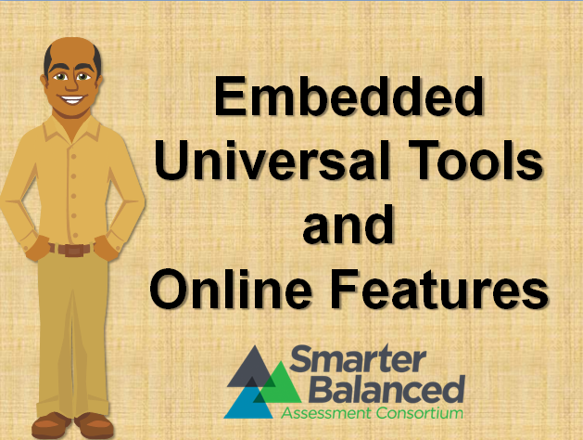
Notes:
Universal tools (the resources that are available to all students) are described in detail in the training module titled “Embedded Universal Tools and Online Features.”
Since the resources included in universal tools are discussed in that training module, let's focus on the types of designated supports that are available to students.

Slide 26
What are Designated Supports?
Notes:
What are Designated Supports?

Slide 27
What are Designated Supports?
Defined
Designated supports for the ELA and mathematics online assessments are resources that are available for use by any student for whom the need has been indicated by an educator or team of educators with parent/guardian and student. Assigning a designated support does not require documentation of need in an IEP or 504 plan. It is recommended that a consistent process be used to determine these supports for individual students.
Designated supports need to be identified and assigned in the Test Information Distribution Engine (TIDE) prior to assessment administration.
Students should be familiar with using the designated supports assigned to them.
Defined
Decisions
Notes:
Designated supports for the ELA and mathematics online assessments are resources that are available for use by any student for whom the need has been indicated by an educator (or team of educators with parent/guardian and student). Assigning a designated support does not require documentation of need in an IEP or 504 plan. It is recommended that a consistent process be used to determine these supports for individual students.
Designated supports need to be identified and assigned in the Test Information Distribution Engine (TIDE) prior to assessment administration.
Students should be familiar with using the designated supports assigned to them.

Slide 28
What are Designated Supports?
Decisions
Informed adults make decisions about these designated supports. Ideally, the decisions are made by educators familiar with the student’s needs, as well as those supports that the student has been using during instruction and for other assessments. Student and parent/guardian participation in the decision, particularly for older students, is also recommended.
Defined
Decisions
Notes:
Informed adults make decisions about these designated supports. Ideally, the decisions are made by educators familiar with the student’s needs, as well as those supports that the student has been using during instruction and for other assessments. Student and parent/guardian participation in the decision, particularly for older students, is also recommended.

Slide 29
What are Accommodations?
Notes:
What are Accommodations?

Slide 30
What are Accommodations?
Accommodations
Accommodations are changes in procedures or materials that increase equitable access during the online assessments. Assessment accommodations generate valid assessment results for students who need them; they allow these students to show what they know and can do.
Smarter Balanced states have identified accommodations for students for whom there is a documented need for the accommodation(s) on an Individualized Education Program (IEP) or 504 accommodation plan or special circumstance, such as the example of the broken arm.
Accommodations
Accommodations Continued
Notes:
Accommodations are changes in procedures or materials that increase equitable access during the online assessments. Assessment accommodations generate valid assessment results for students who need them; they allow these students to show what they know and can do.
Smarter Balanced states have identified accommodations for students for whom there is a documented need for the accommodation(s) on an Individualized Education Program (IEP) or 504 accommodation plan or special circumstance, such as the example of the broken arm.

Slide 31
What are Accommodations?
Accommodations Continued
IEP teams, educators, and parents/guardians make decisions about accommodations. These teams (or educators for 504 plans) provide evidence of the need for accommodations and ensure that they are noted on the IEP or 504 plan. School staff are responsible for ensuring that information from the IEP is entered into TIDE so that all embedded accommodations can be activated prior to testing.
Accommodations
Accommodations Continued
Notes:
IEP teams, educators, and parents/guardians make decisions about accommodations. These teams (or educators for 504 plans) provide evidence of the need for accommodations and ensure that they are noted on the IEP or 504 plan.
School staff are responsible for ensuring that information from the IEP is entered into TIDE so that all embedded accommodations can be activated prior to testing.

Slide 32
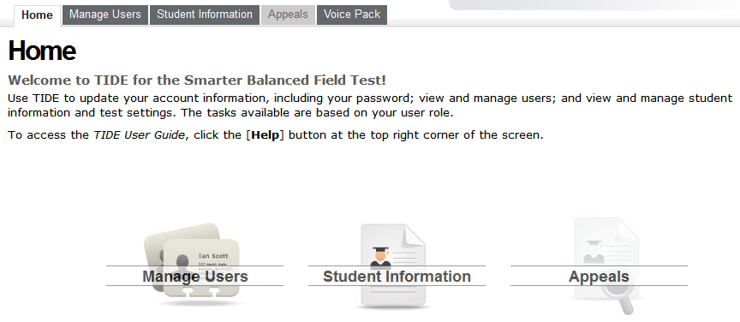
NEXT: How to assign designated supports and accommodations
Notes:
Now that we’ve discussed the differences between the available features, let’s discuss how to assign designated supports and accommodations.

Slide 33
Assigning Designated Supports and Accommodations
Notes:
Assigning Designated Supports and Accommodations

Slide 34

Accessibility and Accommodations
Notes:
Now that you have an overview of the types of designated supports and accommodations that are available, it is important to know how to verify that students are scheduled to receive their assigned designated support and/or accommodation during test administration.

Slide 35
Embedded
Breaks, Calculator, Digital Notepad, English Dictionary, English Glossary, Expandable Passages, Global Notes, Highlighter,
Keyboard Navigation, Mark for Review,
Math Tools,
Spell Check, Strikethrough,
Writing Tools, Zoom
Non-embedded
Breaks,
English Dictionary, Scratch Paper, Thesaurus
Designated Supports
Embedded
Color Contrast, Masking,
Text-to-speech, Translated Test Directions,
Translations (Glossary), Translations (Stacked), Turn off Any Universal Tools
Non-embedded
Bilingual Dictionary,
Color Contrast,
Color Overlay,
Magnification,
Read Aloud,
Scribe,
Separate Setting, Translated Test Directions, Translation (Glossary), Noise Buffers
Accommodations
Embedded
American Sign Language, Braille,
Closed Captioning, Text-to-speech
Non-embedded
Abacus, Alternate Response Options, Calculator, Multiplication Table, Print on Demand, Read Aloud,
Scribe, Speech-to-text
Universal Tools
Notes:
It would be a highly unusual situation in which any particular student is assigned a large number of these designated supports or accommodations. Rather, these designated supports and accommodations are selected specifically according to the unique need of the student that has been indicated by an educator or a team of educators with a parent/guardian or the student. Another variable is the student’s familiarity with a tool and how effective the tool has been in the past for that student.

Slide 36
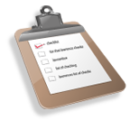
Accessibility and Accommodations
Notes:
Among the important responsibilities of the Test Administrator (TA) is confirming that students have access to the designated supports and accommodations that their teams have assigned to them.
Failure to do so could result in a need for a reset, a retake, or an invalidation of the student’s test.

Slide 37

Accessibility and Accommodations
Confirm that students are assigned the appropriate designated supports and accommodations.
Notes:
The TA must confirm that students are assigned the appropriate designated supports and accommodations at the beginning of the first testing session. Prior to the testing session, the TA should obtain a list of students in his or her administration session for which designated supports and/or accommodations have been assigned. The list should contain the specific designated supports and/or accommodations for the individual student.

Slide 38
Accessibility and Accommodations
The TA should use this list when granting students access to the test through the test delivery system.
Notes:
The TA should use this list when granting students access to the test through the test delivery system. The process for granting students access through the test delivery is detailed in the Test Administrator User Guide. A brief overview of that process is provided here.

Slide 39
Accessibility and Accommodations
Review each student’s information to ensure that he or she has the correct designated support(s) and/or accommodation(s) set.
Notes:
The TA should review each student's information prior to testing day to ensure that each student has the correct designated support(s) and/or accommodation(s) set in TIDE. Accommodations and designated supports are assigned at the student level by content area and test, either the computer adaptive test (CAT) or the performance task (PT).
If a student's settings are incorrect, please contact your School or District Test Coordinator. The student should not test until the settings are correct.

Slide 40

Accessibility and Accommodations
The student should not proceed with testing until the discrepancy is resolved.
Notes:
The student should not proceed with testing until the discrepancy is resolved.
After the accommodations and designated supports have been set in TIDE, the TA will need to verify and approve settings once each student has logged in to begin testing. Let’s take a look at that process now.

Slide 41
Approvals and
Student Test Settings
Notes:
Approvals and Student Test Settings

Slide 42
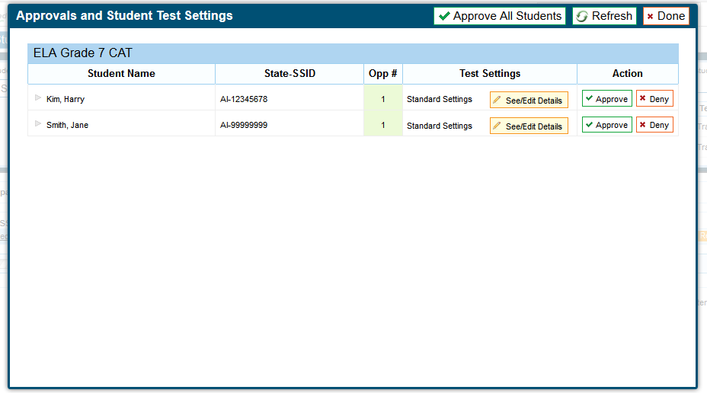
Approvals and Student Test Settings
Standard
or
Custom
Notes:
The Approvals and Student Test Settings screen displays each student who is awaiting approval for entry into your session. You will see each student’s name, SSID, current opportunity for the selected assessment, whether the test settings are standard or custom, and the option to approve or deny each student.
In the column Test Settings, students with standard test settings are students whose test settings are set to default.
Students with custom test settings are those who have at least one test setting that is a designated support or accommodation.

Slide 43
Approvals and Student Test Settings
Notes:
To view the custom test settings, click the [See/Edit Details] button for that student. The screen will change to show the student’s test information.

Slide 44
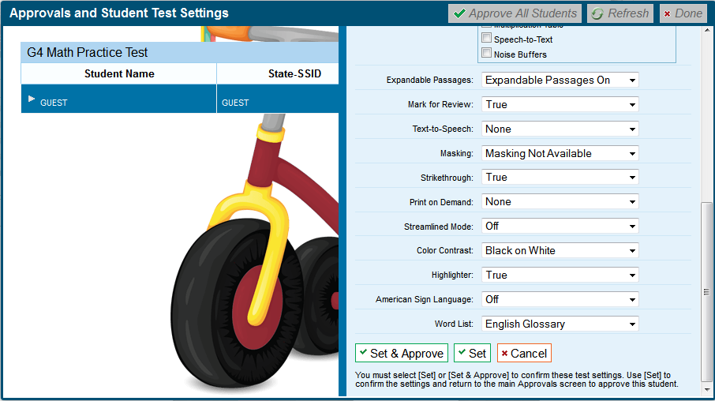
Approvals and Student Test Settings
Notes:
Most of the student's information on this screen is read-only. Universal Tools are available to all students and act as the default setting. Accommodations and designated supports must be pre-set in TIDE by the District or School Test Coordinator. This responsibility may vary state to state. Test settings should be loaded prior to testing.
We have now discussed how to set designated supports and accommodations and how to approve the test settings in the TA Interface. Next, we are going to review the specifics of designated supports followed by details on accommodations.

Slide 45
Embedded Designated Supports
Notes:
Embedded Designated Supports

Slide 46
Embedded Designated Supports
Color Contrast
Masking
Text-to-Speech
Translated Test Directions
Translations (Glossary with audio)
Translations (Stacked) of items
Turning off Universal Tools
Notes:
Now, we are going to go into more detail about designated supports. Embedded and non-embedded designated supports need to be identified and entered into the test delivery system prior to assessment administration.
Currently, there are seven different designated supports that are embedded in (or part of) the test delivery system.

Slide 47
Embedded
Breaks, Calculator, Digital Notepad, English Dictionary, English Glossary, Expandable Passages, Global Notes, Highlighter,
Keyboard Navigation, Mark for Review,
Math Tools,
Spell Check, Strikethrough,
Writing Tools, Zoom
Non-embedded
Breaks,
English Dictionary, Scratch Paper, Thesaurus
Designated Supports
Embedded
Color Contrast, Masking,
Text-to-speech, Translated Test Directions,
Translations (Glossary), Translations (Stacked), Turn off Any Universal Tools
Non-embedded
Bilingual Dictionary,
Color Contrast,
Color Overlay,
Magnification,
Read Aloud,
Scribe,
Separate Setting, Translated Test Directions, Translation (Glossary), Noise Buffers
Accommodations
Embedded
American Sign Language, Braille,
Closed Captioning, Text-to-speech
Non-embedded
Abacus, Alternate Response Options, Calculator, Multiplication Table, Print on Demand, Read Aloud,
Scribe, Speech-to-text
Universal Tools
Notes:
These embedded designated supports are described in the following section.

Slide 48
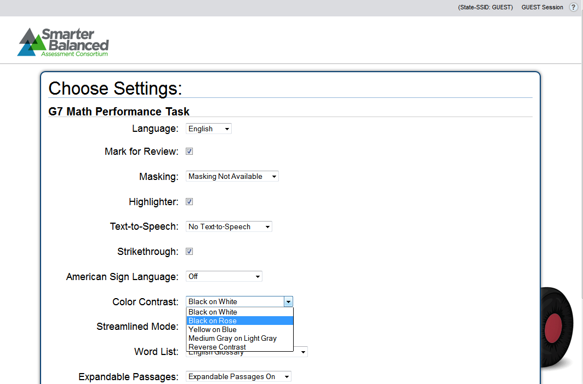
Color Contrast
Notes:
Color Contrast enables students to adjust screen background or font color based on student needs or preferences. This may include reversing the colors for the entire interface or choosing the color of the font and background. The color choices are black on white, black on rose, yellow on blue, medium gray on light gray, and reverse contrast.

Slide 49
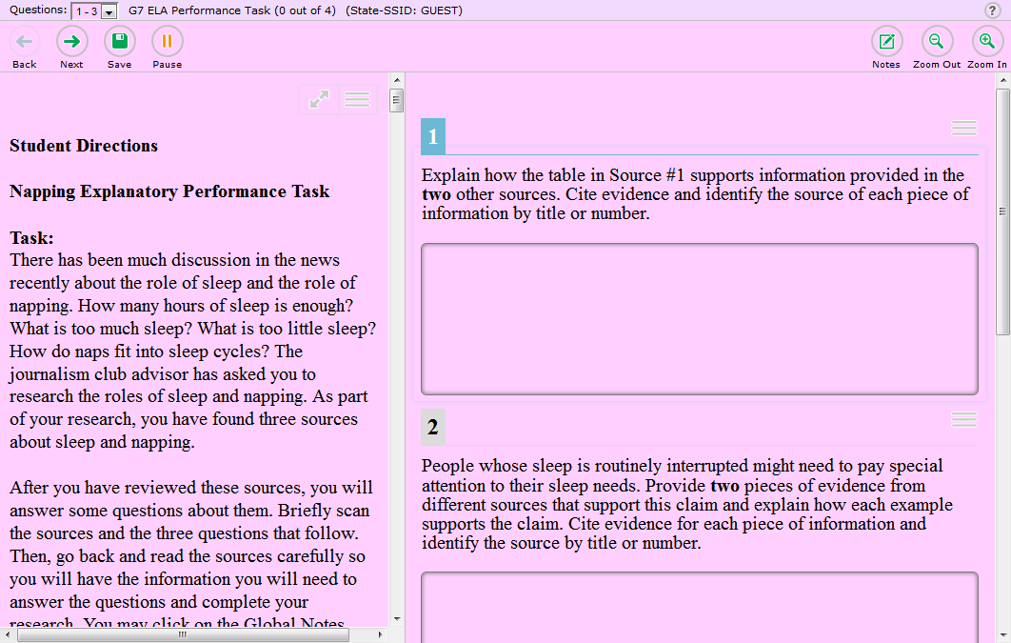
Color Contrast
Notes:
This designated support might be used for students with attention difficulties when viewing test content. It also may be needed by some students with visual impairment or other print disabilities (including learning disabilities).
The choice of colors should be informed by evidence that color selections meet the student's needs.

Slide 50
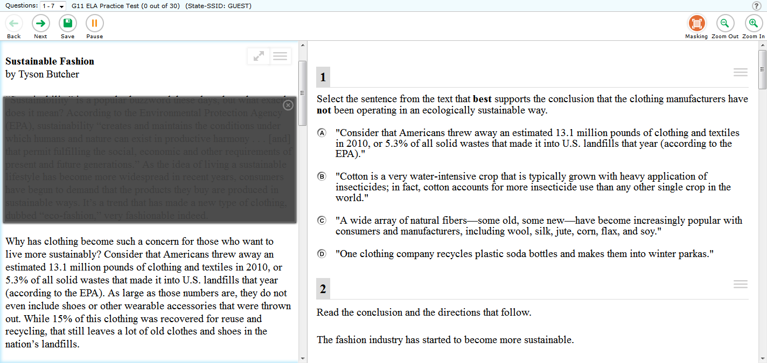
Masking
Notes:
Masking involves blocking off content that is not of immediate need or that may be distracting to the student. Students are able to focus their attention on a specific part of a test item.
Students with attention difficulties may need to mask content not of immediate need or that may be distracting during the assessment. This support also may be needed by students with print disabilities (including learning disabilities) or visual impairments. Masking allows students to hide and reveal individual answer options, as well as all navigational buttons and menus.

Slide 51
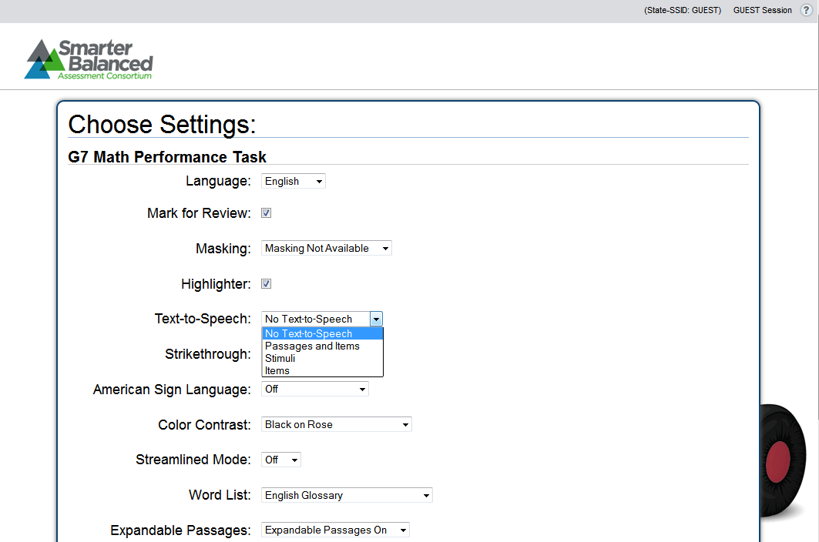
Text-to-Speech
For ELA Items, ELA PT Stimuli, Math Items and Stimuli
(Not Reading Passages)
Notes:
Text-to-Speech allows a student to listen to test content, subject to certain conditions and must be set up in TIDE prior to testing. It is available as either an embedded designated support or as an embedded accommodation for students with an identified need. Students can use this feature as a designated support for mathematics items and stimuli and ELA items and ELA PT stimuli but not for ELA reading passages. Students in grades 6–8 and 11 may also have Text-to-Speech for ELA reading passages as an accommodation. However, this accommodation is not available for ELA reading passages for students in grades 3–5 because it would compromise the construct being measured.
More on Text-to-Speech as an accommodation will come later in this module.
Text is read aloud to the student via an embedded Text-to-Speech technology. The student is able to set the speed prior to starting the test and can raise or lower the volume of the voice via a volume control during testing.
Assignment of Text-to-Speech should be made at the individual student level, by content area, and by test (PT or CAT) keeping in mind student need, student experience using this functionality, and appropriate use of each resource per the Usability, Accessibility, and Accommodations Guidelines.

Slide 52
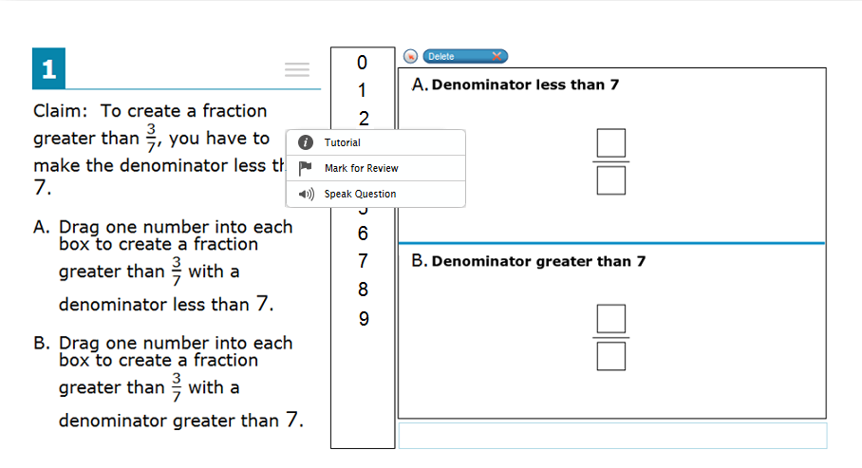
Text-to-Speech
For ELA Items, ELA PT Stimuli, Math Items and Stimuli
(Not Reading Passages)
Notes:
Students who are struggling readers may need assistance accessing the assessment by having all or portions of the assessment read aloud by the software. This support may also be needed by students with reading-related disabilities or by students who are blind and do not yet have adequate braille skills. For students who don’t regularly use Text-to-Speech during instruction, this support will likely be confusing and may impede their performance.
Students who use Text-to-Speech will need headphones unless tested individually in a separate setting.
To activate Text-to-Speech students should right-click anywhere on the item and select the [Speak Question] option from the menu that appears.

Slide 53
Translated Glossaries (math only)
Student can be assigned:
English glossary only (default– Universal Tool)
English and one second-language glossary
One second-language glossary only
No glossary at all (by turning this off in universal tools)
Notes:
Translated Glossaries are a language support in the mathematics assessment– they are available both on screen and/or as audio.
Students can be assigned:
English glossary only (default– Universal Tool)
English and one second-language glossary
One second-language glossary only
No glossary at all (by turning this off in universal tools)

Slide 54
Glossary Languages (math only)
Spanish
Vietnamese
Arabic
Filipino (Tagalog/Ilokano)
Cantonese
Mandarin
Korean
Punjabi
Russian
Ukrainian
Notes:
Currently, translated glossaries are available in Spanish, Vietnamese, Arabic, Filipino (Tagalog, Ilokano), Cantonese, Mandarin, Korean, Punjabi, Russian, and Ukrainian.
Students with limited English language skills who know one of the glossary languages (whether or not designated as ELs or ELs with disabilities) can use the translated glossary for specific items. The use of this support may result in the student needing additional overall time to complete the assessment.

Slide 55
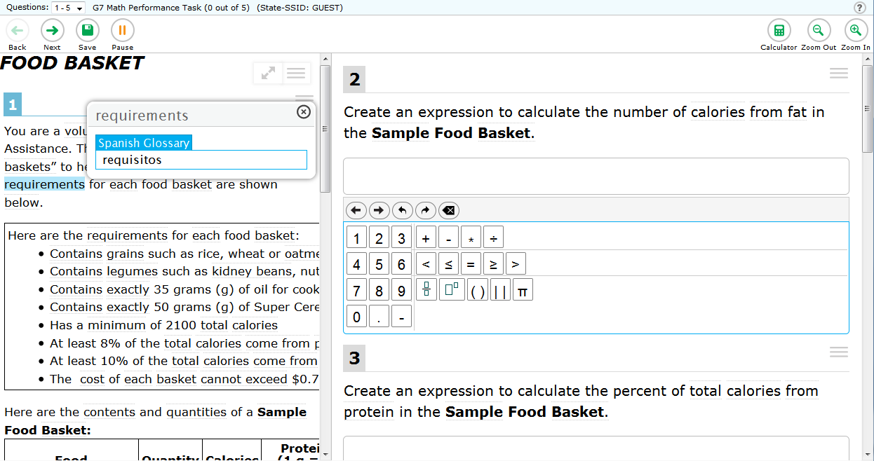
Translated Glossaries (math only)
Notes:
English glossaries are available to all students, but the use of Translated glossaries is a designated support and provided for selected construct–irrelevant terms for mathematics.
When there is a term for which a glossary translation is available, there will be a faint border around the term. If the student holds the cursor over a word with glossary functionality, the word will highlight blue. While the word is highlighted blue, students click on the word and a pop-up window with the grade-appropriate and context-specific translations for these terms appear on the screen. When the student is done using this designated support, he or she can click the [X] at the top right-hand corner of the pop-up window to close the glossary.

Slide 56
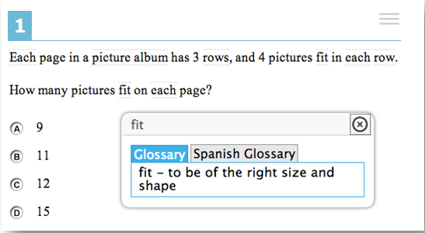
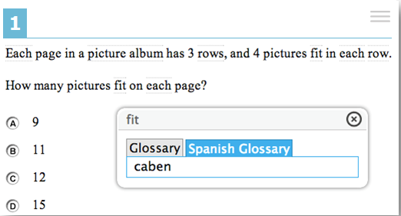
Translated Glossaries (math only)
Notes:
When the English and one second-language glossary option is enabled, the terms that use both glossaries will have two tabs in the pop-up window. One will be for English, labeled only as “Glossary,” and the other tab will be for the additional language, labeled with the selected language glossary. The enabled glossary will be highlighted in blue, and the student will be able to switch between the language glossary options by clicking on the appropriate tab in the pop-up window.
Please note that, based on differences in complexity across languages, different language glossaries may provide support for different English language terms. Therefore, if a student has access to the English and one second-language glossary, some terms may have both glossaries while other terms may have only one of the two glossaries present.

Slide 57
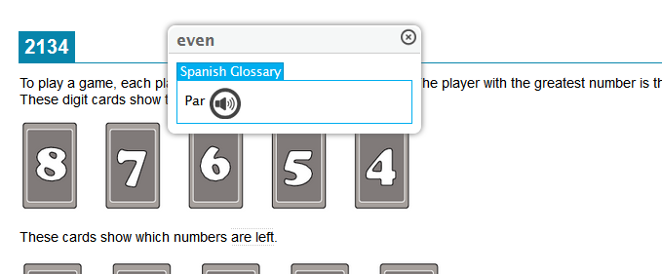

Audio Glossaries (math only)
Notes:
Audio Glossaries are a feature of the translated glossaries. This feature plays the translation of a term for the student. Students using audio glossaries or translated audio glossaries will require headphones. The student clicks the sound icon to play the audio clip.

Slide 58
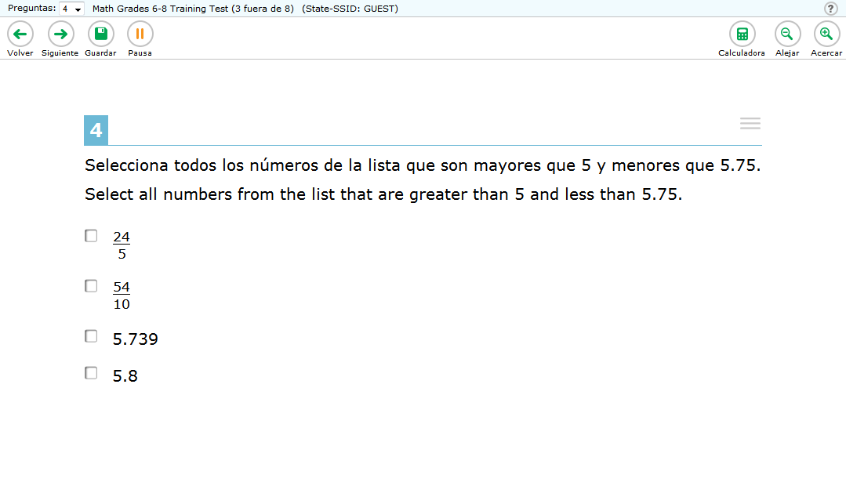
Stacked Translations (math only)
Notes:
Stacked Translations are a Spanish language support available for mathematics items. This feature provides the full translation of each mathematics item and item directions above—or “stacked” on top of—the original item in English.
For students whose primary language is not English and who use dual language supports in the classroom, the use of the stacked (dual language) translation may be appropriate. Students participate in the assessment regardless of the language. This support will increase reading load and cognitive load. The use of this support may result in the student needing additional overall time to complete the assessment.
Students with the embedded designated support for translation (stacked) for mathematics tests will also receive Spanish translated test directions. Translated test directions are also available as a PDF (non-embedded designated support) for all languages supported in the translated glossary designated support.

Slide 59
Turning off Universal Tools
English Dictionary
English Glossary
Expandable Passages
Mark for Review
Strikethrough
Notes:
The last embedded designated support is Turning off Universal Tools. This feature will allow you to turn off some universal tools that might be distracting, or that students do not need to use or are unable to use.

Slide 60
Turning off Universal Tools
Notes:
Students who are easily distracted (whether or not designated as having attention difficulties or disabilities) could be overwhelmed by some of the universal tools. Knowing which specific tools may be distracting to a student is important for determining which tools to turn off.

Slide 61
Non-Embedded Designated Supports
Notes:
Non-Embedded Designated Supports

Slide 62
Non-Embedded Designated Supports
Bilingual Dictionary
Color Contrast
Color Overlay
Magnification
Read Aloud
Scribe
Separate Setting
Translation (Glossary)
Translated Test Directions (PDF format)
Noise Buffers
Notes:
Some designated supports may need to be provided outside the digital-test delivery system and are called non-embedded. These supports will be provided locally for those students unable to use the designated supports when provided digitally.
There are several different non-embedded designated supports approved in the Usability, Accessibility, and Accommodations Guidelines. These non-embedded designated supports are described in the following section.

Slide 63
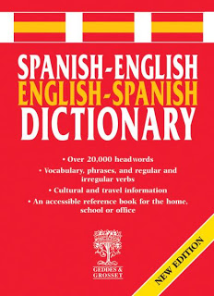
Non-Embedded Designated Supports
Bilingual Dictionary
Dictionary > Diccionario, colección alfabética de las palabras de una lengua, arte o ciencia, con sus definiciones o explicaciones.
Notes:
The first is a Bilingual/Dual Language Word-to-Word Dictionary. This dictionary is a language support. It can be provided for the full-write portion of an ELA performance task. A full-write is the second part of the ELA performance task assessment.
For students whose primary language is not English and who use dual language supports in the classroom, use of a bilingual/dual language word-to-word dictionary may be appropriate. The use of this support may result in the student needing additional overall time to complete the assessment.

Slide 64
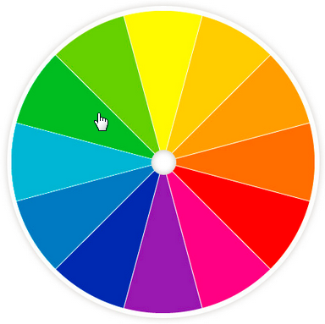

Non-Embedded Designated Supports
2. Color Contrast
Notes:
The second is Color Contrast. Like an embedded support, color contrast can also be a non-embedded support.
Students with attention difficulties may need this support for viewing the test when digitally provided color contrast does not meet their needs. Some students with visual impairments or other print disabilities (including learning disabilities) also may need this support. The choice of colors should be informed by evidence of those colors that meet the student's needs.

Slide 65
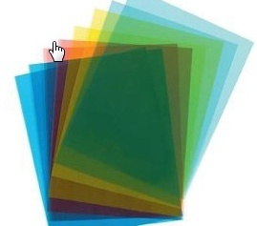
Non-Embedded Designated Supports
3. Color Overlay
Notes:
The third is Color Overlay. This non-embedded support is used when color transparencies are placed over a paper-based assessment.
Students with attention difficulties may need this support to view test content. This support also may be needed by some students with visual impairments or other print disabilities (including learning disabilities). The choice of color should be informed by evidence of those colors that meet the student’s needs and which are used regularly during instruction.

Slide 66
Non-Embedded Designated Supports
4. Magnification
Notes:
The fourth is Magnification. The size of specific areas of the screen such as text, formulas, tables, graphics, and navigation buttons, may be adjusted by the student with an assistive technology device that works with the system and with which the student is familiar.
Students familiar with viewing enlarged text, graphics, or navigation buttons, may need magnification to comfortably view content. This support also may meet the needs of students with visual impairments and other print disabilities. The use of this designated support may result in the student needing additional overall time to complete the assessment.

Slide 67
Non-Embedded Designated Supports
5. Read Aloud
For ELA Items, ELA PT Stimuli, Math Items and Stimuli (Not Reading Passages)
To create a fraction greater than….
Notes:
The fifth is Read Aloud. Read Aloud is when text is read aloud to the student by a trained and qualified human reader who follows the Read Aloud guidelines provided in the Usability, Accessibility, and Accommodations Implementation Guide. The read-aloud designated support may be used for mathematics items and stimuli, and ELA items and stimuli; however, this may not be used for ELA reading passages as a designated support.
Students who are struggling readers may need assistance accessing the assessment by having all or portions of the assessment read aloud. This support also may be needed by students with reading-related disabilities or by students who are blind and do not yet have adequate braille skills. If not used regularly during instruction, this support is likely to be confusing and may impede a student's performance on assessments. Readers should be provided to students on an individual basis—not to a group of students. A student should have the option of asking a reader to slow down or repeat text. The use of this support may result in the student needing additional overall time to complete the assessment.
Assignment of Read Aloud should be made at the individual student level, keeping in mind student need, student experience using either format, and appropriate use of each resource per the Guidelines.

Slide 68

Non-Embedded Designated Supports
6. Scribe
For ELA Non-Writing Items and Math Items
Notes:
The sixth is a Scribe. When using a Scribe, students dictate their responses to a human who records verbatim what they dictate. The scribe designated support may be used for mathematics items and non-writing ELA items; however, this designated support is not available on the ELA writing items. The scribe must be trained and qualified and must follow the Scribing guidelines provided in the Usability, Accessibility, and Accommodations Implementation Guide.
Students who have documented significant motor or processing difficulties, or who have had a recent injury (such as a broken hand or arm) that makes it difficult to produce responses, may need to dictate their responses to a human, who then records the students’ responses verbatim. The use of this support may result in the student needing additional overall time to complete the assessment.

Slide 69

Non-Embedded Designated Supports
7. Separate Setting
Notes:
The seventh is Separate Setting (or test location). The test location can be altered so that the student is tested in a setting different from that made available for most students.
Students who are easily distracted in the presence of other students, or who may distract others, may need an alternate location to be able to take the assessment. The separate setting may be in a different room that allows them to work individually or among a smaller group, or in the same room but in a specific location (for example, away from windows, doors, or pencil sharpeners, in a study carrel, near the teacher's desk, or in the front of a classroom). Some students may benefit from being in an environment that allows for movement, such as being able to walk around. In some instances, students may need to interact with instructional or test content outside of school, such as in a hospital or their home. A specific adult, trained in a manner consistent with the Test Administration Manual (TAM), can act as test proctor, or test administrator, when student requires it.

Slide 70
Non-Embedded Designated Supports
8. Translated Glossary
For Math Items
Notes:
The eighth non-embedded support is Translated Glossary. This glossary is a language support and something that would accompany only a paper-and-pencil assessment.

Slide 71

Non-Embedded Designated Supports
9. Translated Test Directions (PDF format)
For Math Only
Notes:
The ninth non-embedded support is PDF of Translated Test Directions. This is a support for students taking the online translated assessment in mathematics and provides a PDF of test directions translated in each of the languages currently supported. A bilingual adult can read to the student. The PDF of translated test directions will be located where you find other materials such as multiplication table and other printable documents – most likely your state website or test delivery portal.

Slide 72

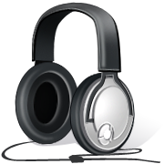
Non-Embedded Accommodations
10. Noise Buffers
Noise Cancelling
Notes:
The last is Noise Buffers. Noise buffers (e.g. ear mufflers, white noise, and/or other equipment used to block external sounds) will be permitted as a non embedded accommodation. Specific noise buffers most familiar to students other than white noise (e.g., waves crashing, forest sounds) are permitted, as long as they are specifically designated by the student’s IEP team and do not violate the construct being assessed. Questions about permissible noise buffers should be directed to your State Lead. Noise buffers can be state, district, or school provided.

Slide 73
Embedded
Breaks, Calculator, Digital Notepad, English Dictionary, English Glossary, Expandable Passages, Global Notes, Highlighter,
Keyboard Navigation, Mark for Review,
Math Tools,
Spell Check, Strikethrough,
Writing Tools, Zoom
Non-embedded
Breaks,
English Dictionary, Scratch Paper, Thesaurus
Designated Supports
Embedded
Color Contrast, Masking,
Text-to-speech, Translated Test Directions,
Translations (Glossary), Translations (Stacked), Turn off Any Universal Tools
Non-embedded
Bilingual Dictionary,
Color Contrast,
Color Overlay,
Magnification,
Read Aloud,
Scribe,
Separate Setting, Translated Test Directions, Translation (Glossary), Noise Buffers
Accommodations
Embedded
American Sign Language, Braille,
Closed Captioning, Text-to-speech
Non-embedded
Abacus, Alternate Response Options, Calculator, Multiplication Table, Print on Demand, Read Aloud,
Scribe, Speech-to-text
Universal Tools
Notes:
Now, let's move to the embedded and non-embedded accommodations. Smarter Balanced states have identified digitally embedded and non-embedded accommodations for students for whom there is documentation of the need for the accommodations in an Individualized Education Program (IEP) or 504 accommodation plan.

Slide 74
Embedded Accommodations
Notes:
Embedded Accommodations

Slide 75
Embedded Accommodations
American Sign Language (ASL) (for ELA listening items and math items)
Braille
Closed Captioning (for ELA listening items)
Text-to-Speech (for ELA reading passages)
Streamlined Interface
Notes:
There are five embedded accommodations in the test system. These embedded accommodations are described in the following section. Planned use of these accommodations must be registered in TIDE, or your state’s registration system, prior to administration.

Slide 76
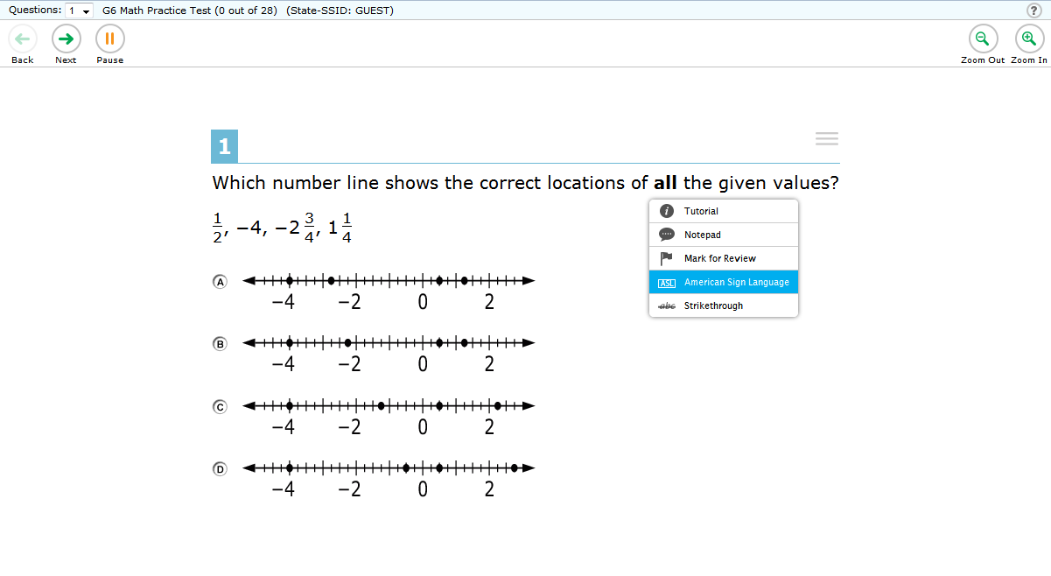
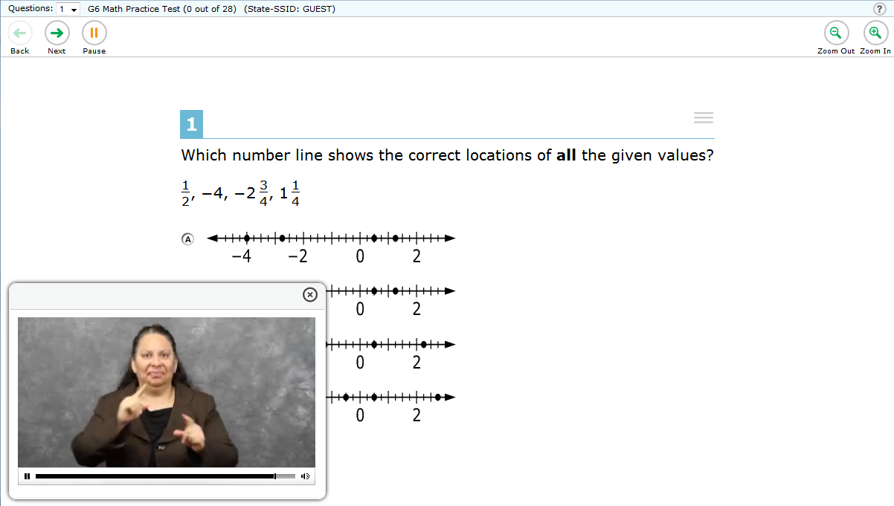
American Sign Language (ASL)
For ELA listening items and math items
Notes:
The first is American Sign Language (ASL). Content from mathematics and the Listening portion of the ELA assessment is available when a student selects the American Sign Language option from the menu where they access other test features. This can be done by right-clicking on the stimulus, passage, or item, and the tools that are available for that particular object will appear as a small pop-up. The student then selects American Sign Language from this list, if it is available.
Some students who are deaf or hard of hearing and who typically use ASL may need this accommodation when accessing text-based content in the assessment. The use of this accommodation may result in the student needing additional overall time to complete the assessment. For many students who are deaf or hard of hearing, viewing signs is the only way to access information presented orally. It is important to note, however, that some students who are hard of hearing will be able to listen to information presented orally if provided with appropriate amplification and a setting in which extraneous sounds do not interfere with clear presentation of the audio presentation in a listening test.

Slide 77
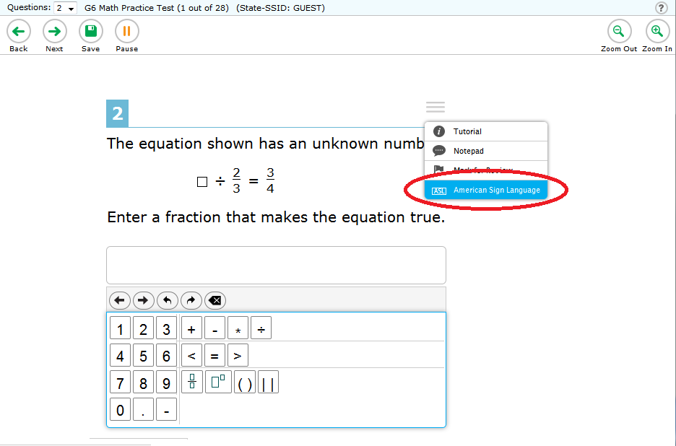
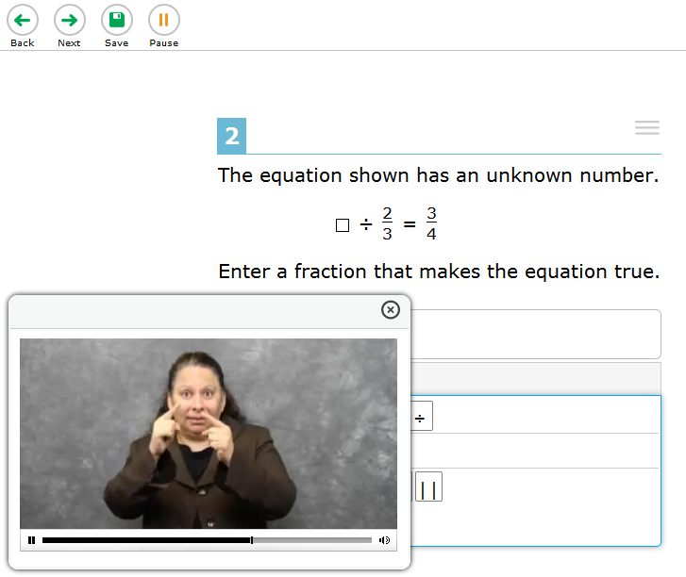
American Sign Language (ASL)
For ELA listening items and math items
Notes:
When using ASL, an ASL human signer and the signed test content are viewed on the same screen. To use this feature during the test, students right-click anywhere on the item in order to access ASL. From the menu, the student selects the American Sign Language option.
Students may view portions of the ASL video as often as needed. This ASL video window can be resized by using the [Zoom In] and [Zoom Out] buttons at the top of the screen. The window can be moved anywhere on the screen by selecting the window and using the cursor. The video can also be paused, rewound, fast-forwarded and replayed by using the duration bar at the bottom of the video window. To close the ASL video window, students simply click the [X] in the top right-hand corner of the window.

Slide 78


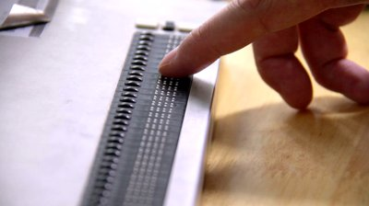
Braille
Notes:
The second is Braille. Braille is a raised-dot code that individuals read with their fingertips. Graphic materials, such as maps, charts, graphs, diagrams, and illustrations, are presented in a raised format — either paper or thermoform. Contracted and uncontracted braille are available; Nemeth Code is available for mathematics only.
Students with visual impairments may read text via braille. Tactile overlays and graphics also may be used to assist the student in accessing content through touch. Refreshable braille is available only for ELA because Nemeth Code is not available via refreshable braille. For mathematics, braille will be presented via embosser; embosser-created braille can also be used for ELA. The type of braille presented to the student (Nemeth, contracted, or uncontracted) is set in TIDE. The use of this accommodation may result in the student needing additional overall time to complete the assessment.

Slide 79
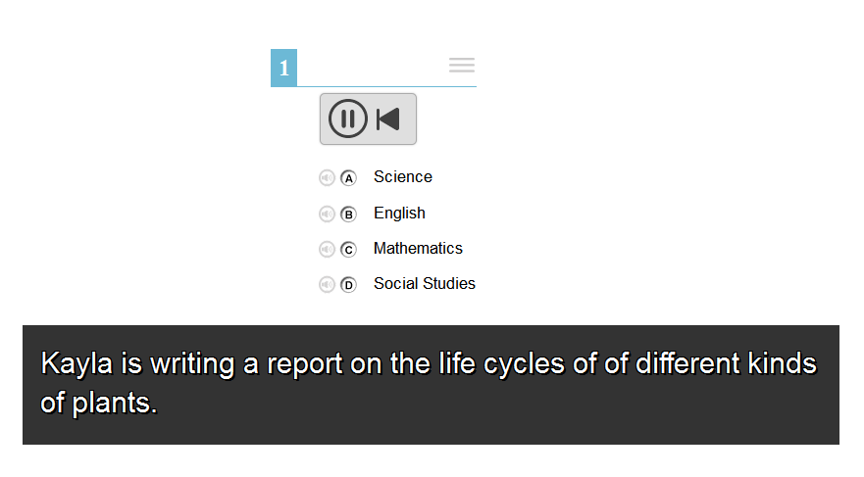
Closed Captioning
For ELA listening items only
Audio materials are presented as printed text.
Notes:
The third is Closed Captioning, which is for ELA listening items only. Closed captioning is an embedded accommodation. Students who are deaf or hard of hearing and who typically access information presented via audio by reading words that appear in synchrony with the audio presentation may need this support to access audio content. For many students who are deaf or hard of hearing, viewing words (sometimes in combination with reading lips and ASL) is how they access information presented orally. It is important to note, however, that some students who are hard of hearing will be able to listen to information presented orally if provided with appropriate amplification and a setting in which extraneous sounds do not interfere with clear presentation of the audio presentation in a listening test.

Slide 80
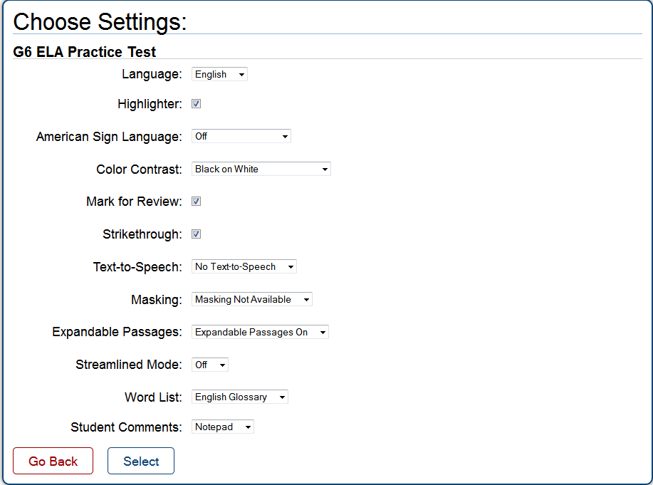
Text-to-Speech
For ELA Items, ELA PT Stimuli, Math Items and Stimuli
(Not Reading Passages)
Notes:
The fourth accommodation is Text-to-Speech. As mentioned earlier, Text-to-Speech can serve as a designated support. However, Text-to-Speech can also be an accommodation.
As an accommodation, Text-to-Speech is available for ELA Reading passages in grades 6–8 and 11. This accommodation is not available for ELA reading passages for students in grades 3–5 because it would compromise the construct being measured.
In this accommodation, ELA reading passages at grade 6 and above are read aloud to the student via embedded Text-to-Speech technology. The student is able to set the speed prior to testing as well as raise or lower the volume of the voice via a volume control during testing.

Slide 81
Text-to-Speech
For ELA Reading Passages, Grades 6–8 and 11
Notes:
This accommodation is appropriate for a very small number of students, estimated to be approximately 1–2% of students with disabilities participating in a general assessment.
Assignment of Text-to-Speech as an accommodation should be made at the individual student level, keeping in mind student need, student experience, and appropriate use of each resource per the Guidelines.

Slide 82
Text-to-Speech
For ELA Reading Passages:
For students in grades 3–5, Text-to-Speech is not an allowed accommodation for ELA reading passages as it would compromise the construct being measured. However, students can use this feature as a designated support for math items and stimuli, and ELA items and stimuli.
Students in grades 6–8 and 11 may have Text-to-Speech for ELA reading passages as an accommodation for students whose need is documented in an IEP or 504 plan.
Notes:
For ELA Reading Passages:
For students in grades 3–5, Text-to-Speech is not an allowed accommodation for ELA reading passages as it would compromise the construct being measured. However, students can use this feature as a designated support for mathematics items and stimuli, and ELA items and stimuli.
Students in grades 6–8 and 11 may have Text-to-Speech for ELA reading passages as an accommodation for students whose need is documented in an IEP or 504 plan.

Slide 83
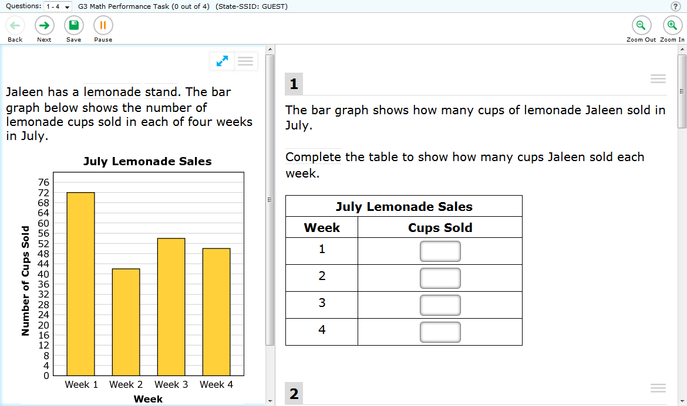
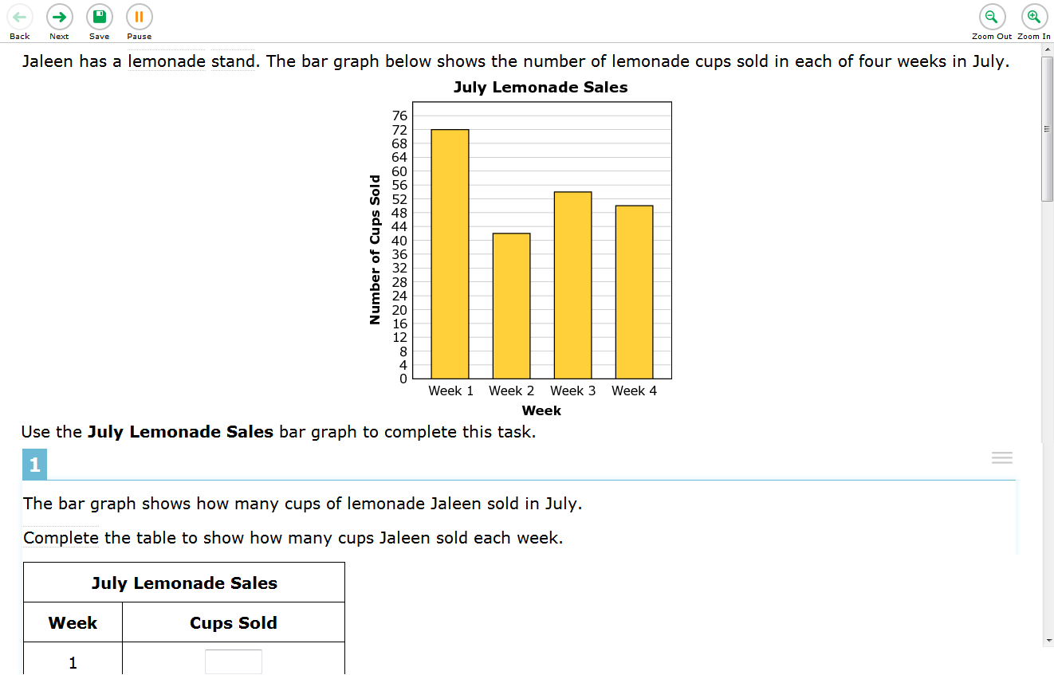
Streamlined Interface
Standard
Interface
Streamlined Interface
Notes:
The last embedded accommodation is the Streamlined Interface. This accommodation provides a streamlined interface of the test in an alternate, simplified format in which the items are displayed below the stimuli. This accommodation may benefit a small number of students who have specific learning and/or reading disabilities in which the text is presented in a more sequential format.

Slide 84
Non-Embedded Accommodations
Notes:
Non-Embedded Accommodations

Slide 85
Embedded
Breaks, Calculator, Digital Notepad, English Dictionary, English Glossary, Expandable Passages, Global Notes, Highlighter,
Keyboard Navigation, Mark for Review,
Math Tools,
Spell Check, Strikethrough,
Writing Tools, Zoom
Non-embedded
Breaks,
English Dictionary, Scratch Paper, Thesaurus
Designated Supports
Embedded
Color Contrast, Masking,
Text-to-speech, Translated Test Directions,
Translations (Glossary), Translations (Stacked), Turn off Any Universal Tools
Non-embedded
Bilingual Dictionary,
Color Contrast,
Color Overlay,
Magnification,
Read Aloud,
Scribe,
Separate Setting, Translated Test Directions, Translation (Glossary), Noise Buffers
Accommodations
Embedded
American Sign Language, Braille,
Closed Captioning, Text-to-speech
Non-embedded
Abacus, Alternate Response Options, Calculator, Multiplication Table, Print on Demand, Read Aloud,
Scribe, Speech-to-text
Universal Tools
Notes:
Now, let’s review the non-embedded accommodations.

Slide 86
Non-Embedded Accommodations
Abacus
Alternate Response Options
Calculator
Multiplication Table
Print on Demand
Read Aloud
Scribe
Speech-to-Text
Notes:
Smarter Balanced states have identified nine non-embedded accommodations for students for whom there is documentation of the need for the accommodation on an Individualized Education Program (IEP) or 504 plan.
These non-embedded accommodations are described in the following section.

Slide 87
Non-Embedded Accommodations
1. Abacus
Notes:
The first is the Abacus. The abacus accommodation may be used in place of scratch paper for students who typically use an abacus.

Slide 88

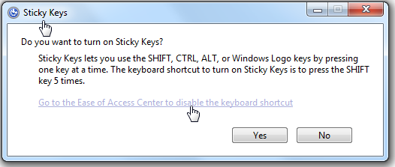

Non-Embedded Accommodations
2. Alternate Response Options
Notes:
The second is Alternate Response Options. Alternate response options are allowed accommodations and include but are not limited to adapted keyboards, large keyboards, StickyKeys, MouseKeys, FilterKeys, adapted mouse, touch screen, head wand, and switches.
Students with some physical disabilities, including both fine motor and gross motor skills, may need to use this accommodation. Some alternate response options are external devices that must be plugged in and be compatible with the test delivery system.

Slide 89
Non-Embedded Accommodations
3. Non-Embedded Calculator
Five nine seven minus three four
Notes:
The third is a Non-Embedded Calculator. Although embedded calculators are available as a universal tool, a non-embedded calculator is allowed for students needing a special calculator, such as a braille calculator or a talking calculator, currently unavailable within the test delivery system. The use of this accommodation is for calculator-allowed items only.
Students with visual impairments who are unable to use the embedded calculator for calculator-allowed items will be able to use the calculator that they typically use, such as a braille calculator or a talking calculator. TAs should ensure that the calculator is available only for designated calculator items.

Slide 90
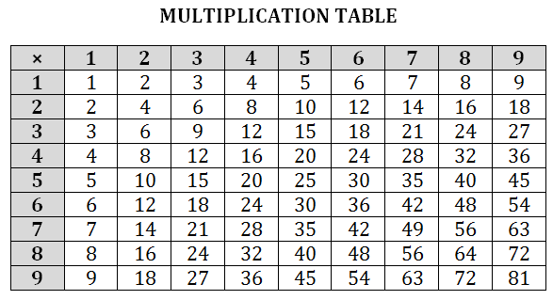
Non-Embedded Accommodations
4. Multiplication Table
Notes:
The fourth is a Multiplication Table. A paper-based single digit, 1–9, multiplication table will be available from Smarter Balanced for reference.
This non-embedded accommodation is designed for students in grade 4 and above with a documented and persistent calculation disability, for example dyscalculia.

Slide 91



Non-Embedded Accommodations
5. Print on Demand
For passages/Stimuli and/or Items
Notes:
The fifth is Print on Demand. This feature is not intended to print out a paper version of the test. Paper copies of either passages/stimuli and/or items are printed for students via the Print on Demand accommodation. For those students needing a paper copy of a passage or stimulus, permission for the students to request printing must first be set in the test delivery system. For those students needing a paper copy of one or more items, your Help Desk must be contacted by the School or District Test Coordinator to have the accommodation set for the student.
Some students with disabilities may need paper copies of either passages/stimuli and/or items. A very small percentage of students should need this accommodation. The use of this accommodation may result in the student needing additional time to complete the assessment.

Slide 92
Non-Embedded Accommodations
6. Read Aloud
For ELA Passages
To create a fraction greater than….
Notes:
The sixth is Read Aloud. As described earlier, Read Aloud is when text is read aloud to the student by a trained and qualified human reader who follows the administration guidelines provided in the Test Administration Manual. The Read Aloud guidelines are developed and available within the Usability, Accessibility, and Accommodations Implementation Guide.
As an accommodation, Read Aloud is available for ELA Reading passages in grades 6–8 and 11. It can also be available to students who are struggling readers, who may need assistance accessing the assessment by having all or portions of the assessment read aloud. This support also may be needed by students with reading-related disabilities, or by students who are blind and do not yet have adequate braille skills.
States will need to develop processes and procedures to monitor training and the qualifications of individuals who provide the Read Aloud accommodation when Text-to-Speech is not appropriate for a student.
This accommodation is appropriate for a very small number of students, estimated to be approximately 1–2% of students with disabilities participating in a general assessment.
Assignment of Read Aloud should be made at the individual student level, keeping in mind student need, student experience, and appropriate use of each resource per the Guidelines.

Slide 93
Non-Embedded Accommodations
7. Scribe
For ELA Writing Items
Notes:
The seventh non-embedded accommodation is a Scribe. The Scribing guidelines are developed and available within the Usability, Accessibility, and Accommodations Implementation Guide.
As an accommodation, scribe is available for ELA writing items in grades 6–8 and 11.
Students dictate their responses to an adult scribe who records verbatim what they dictate. The scribe must be trained and qualified and must follow the administration guidelines provided in the Test Administration Manual.
Students who have documented significant motor or processing difficulties, or who have had a recent injury (such as a broken hand or arm) that makes it difficult to produce responses, may need to dictate their responses to a human who then records the students' responses verbatim. The use of this accommodation may result in the student needing overall additional time to complete the assessment.
For many of these students, dictating to a human scribe is the only way to demonstrate their composition skills. It is important that these students be able to develop planning notes via the human scribe and to view what they produce while composing via dictation to the scribe.

Slide 94
Non-Embedded Accommodations
8. Speech-to-Text
Notes:
The eighth is Speech-to-Text. This technology is available as a non-embedded accommodation. Voice recognition software allows students to use their voices as input devices to the computer, to dictate responses or give commands, such as saving work. Students use their own assistive technology devices. Students should take practice or training tests with the device prior to taking the live test.
Students who have motor or processing disabilities (such as dyslexia), or who have had a recent injury (such as a broken hand or arm) that makes it difficult to produce text or commands using computer keys, may need alternative ways to work with computers. Students will need to be familiar with the software and have had many opportunities to use it prior to testing. Speech-to-Text software requires that the student go back through all generated text to correct errors in transcription, including use of writing conventions; thus, prior experience with this accommodation is essential.
If students use their own assistive technology devices, all assessment content should be deleted from these devices after the test for security purposes. It is important that students who use Speech-to-Text also be able to develop planning notes via Speech-to-Text and be able to view what they produce while composing via Speech-to-Text.

Slide 95
Resources
Notes:
Resources

Slide 96
Visit the Smarter Balanced website for:
Resources and Practices Comparison Crosswalk
Usability, Accessibility, and Accommodations Implementation Guide
Updated list of Frequently Asked Questions about the Usability, Accessibility, and Accommodations Guidelines
Notes:
This training covered the kinds of designated supports and accommodations available to assigned students on the ELA and mathematics online assessments. It provided an overview of these supports and accommodations—both embedded and non-embedded—during test administration. It also provided information on the important activity of verifying that students have the correct designated support or accommodation assigned to their administration.
Smarter Balanced has made available a Resources and Practices Comparison Crosswalk, which can assist educators by providing a description of both the resource and its classroom equivalent, along with the Usability, Accessibility, and Accommodations Implementation Guide
This implementation guide provides states with both (a) clarification of the critical information to convey to districts and schools about the document Usability, Accessibility, and Accommodations Guidelines, and (b) strategies for ensuring that the information in that document is conveyed to districts and schools.
An updated list of Frequently Asked Questions about the Usability, Accessibility, and Accommodations Guidelines is also available.
All of these resources can be found on the Smarter Balanced website.

Slide 97
For more information,
please visit:
www.alohahsap.org
www.smarterbalanced.org
Or call, fax, or email the
American Institutes for Research HSAP Help Desk
Hours: 7:30 a.m. to 4:00 p.m. HST,
Monday – Friday (except holidays)
Phone: 1-866-648-3712
Fax: 1-877-231-7813
Email: HSAPHelpDesk@air.org
Notes:
For more information, please visit:
www.smarterbalanced.org

