Slide 1

Introduction
Notes:
Introduction

Slide 2





Embedded Universal Tools
and
Online Features
Notes:
You will soon be taking the online assessments for English language arts (ELA) and mathematics using a computer or tablet.

Slide 3
NEW EXPERIENCE
Notes:
If you have taken paper-and-pencil tests in the past, this may be a new experience for you.

Slide 4

Embedded
Universal Tools and
Online Features
Notes:
Embedded Universal Tools and Online Features

Slide 5
Embedded Universal Tools and Online Features
This training module will help prepare you for using embedded universal tools and online features when taking the online assessments.
Notes:
This training module will help prepare you for using the embedded universal tools and online features when taking the online assessments.

Slide 6
Embedded Universal Tools and Online Features
Embedded: these universal tools and online features are accessed from within the online system.
Notes:
Embedded means these universal tools and online features are accessed from within the online system. These embedded universal tools and online features will help you do your very best in answering the test questions.

Slide 7
Embedded Universal Tools and Online Features
Tools: embedded universal tools
Features: online features that help you navigate the test system or work with the universal tools
Note that the pictures shown in this training module may be different from what you will see on your screen during the test.
Notes:
When you hear the word “tools” throughout the module, we are referring to embedded universal tools.
When you hear the word “features,” we are referring to online features that will help you navigate the test system or online features that work with the universal tools.
The universal tools and online features that will be covered are available to all students.
Note that the pictures shown in this training module may be different from what you will see on your screen during the test.

Slide 8
Embedded Universal Tools and Online Features
At the end of this module, you should be able to answer:
What embedded universal tools and online features are available to help me do my best on the online assessments?
Notes:
At the end of this training module, you should be able to answer:
What embedded universal tools and online features are available to help me do my best on the online assessments?

Slide 9
Embedded Universal Tools and Online Features
At the end of this module, you should be able to answer:
How can I practice using these embedded universal tools and online features before taking the test?
Notes:
How can I practice using these embedded universal tools and online features before taking the test?

Slide 10

Embedded Universal Tools and Online Features
Notes:
Like many software programs, the test comes with a set of embedded universal tools and online features for you to use.

Slide 11
Embedded Universal Tools and Online Features
For this training, we
will use a
two-button mouse
to demonstrate the embedded universal tools and online features.
Notes:
For this training, we will use a two-button mouse to demonstrate the embedded universal tools and online features.

Slide 12
Embedded Universal Tools and Online Features
How you access these embedded universal tools and online features may be different depending on your device.
Your teacher can help you become familiar with the device you will be using.
You can practice using these embedded universal tools and online features by trying out the Practice or Training Tests.
Notes:
How you access these embedded universal tools and online features may be different depending on your device.
Your teacher can help you become familiar with the device you will be using.
You can practice using these embedded universal tools and online features by trying out the Practice or Training Tests. Ask your teacher for more details.

Slide 13
Embedded Universal Tools and Online Features
Three things you want to do with the embedded universal tools and online features:
Know the purpose of each embedded universal tool and online feature;
Figure out which ones work best for you; and
Know how to find and use each embedded universal tool or online feature correctly.
Notes:
There are many embedded universal tools and online features to choose from. However, you probably will not use all of them. Here are some things you need to know about these embedded universal tools and online features.
First, know the purpose of each embedded universal tool and online feature;
Second, figure out which ones work best for you; and
Third, for the embedded universal tools and online features you choose to use, know how to find and use them correctly.

Slide 14
Embedded Universal Tools and Online Features
Only use the tools and features that help you to:
Understand the question
Read the text
Answer the question
Notes:
Only use the tools and features that help you to:
Understand the question
Read the text
Answer the question

Slide 15
Accessing the Embedded Universal Tools and
Online Features
Notes:
Accessing the embedded universal tools and online features

Slide 16
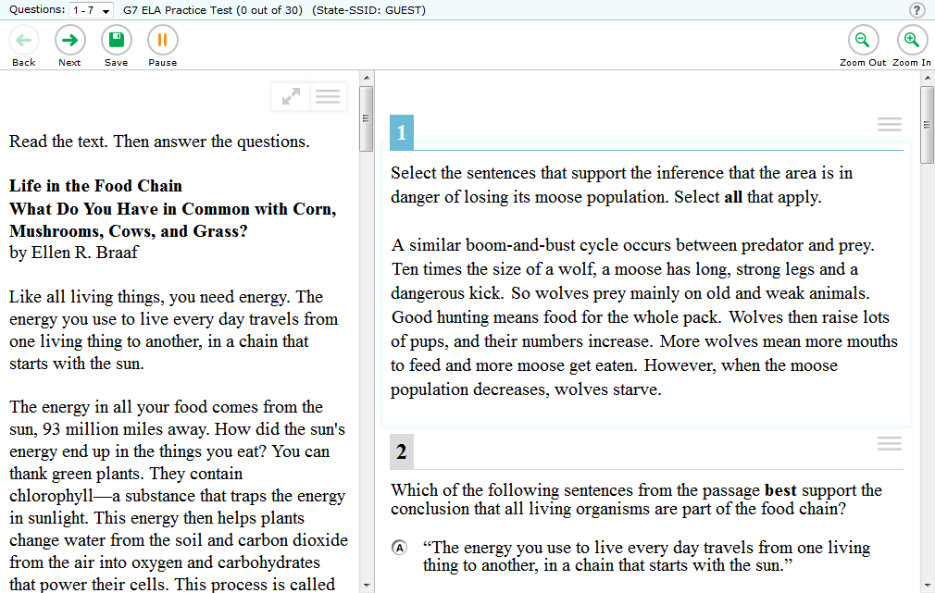
Accessing the embedded universal tools and online features is easy.
Notes:
Accessing the embedded universal tools and online features is easy.

Slide 17
Your teacher can provide a copy of the keyboard command chart.
Notes:
You can access the embedded universal tools and online features by using a mouse or keyboard commands.
Most of you will be using a mouse with your computer; however, if you usually use keyboard commands, ask your teacher to provide you a copy of the keyboard command chart, which is available in the Test Administrator User Guide.

Slide 18
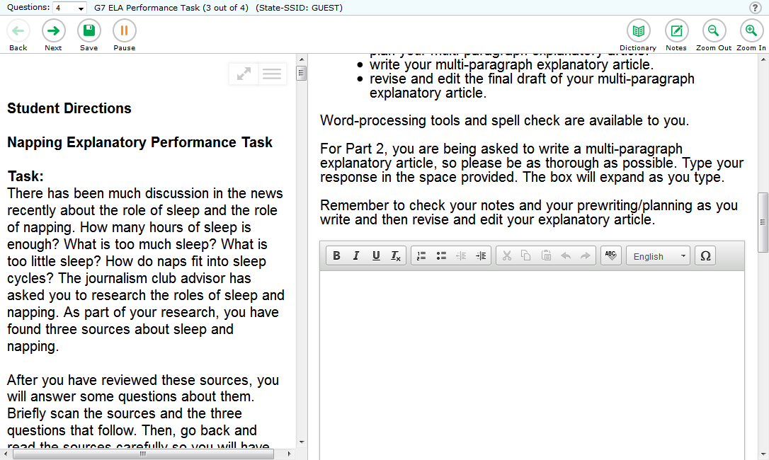
TOOLBAR
TOOLBAR
Notes:
You can access the embedded universal tools and online features in many different ways.
Some embedded universal tools and online features appear in the toolbar at the top of the screen, while others may appear above the area where you would type in an answer.

Slide 19
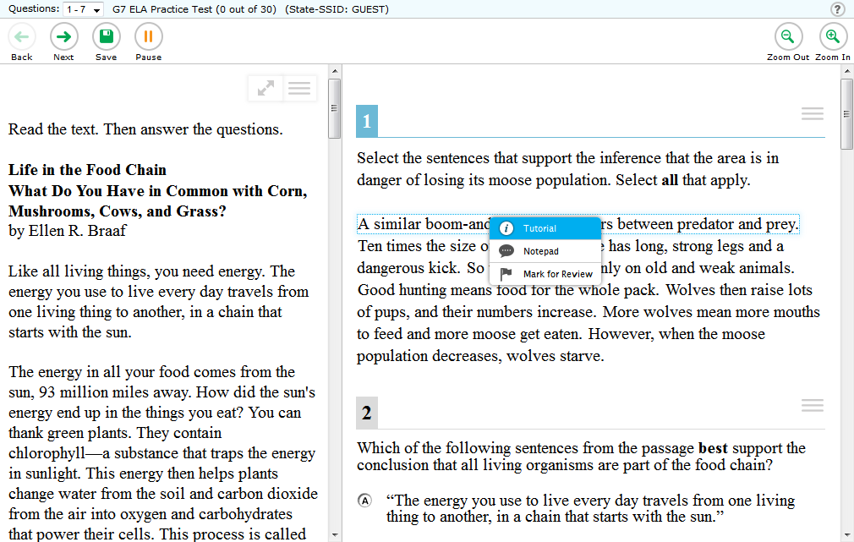

Notes:
Some embedded universal tools and online features appear in a small box when you right-click on that specific question or passage.

Slide 20
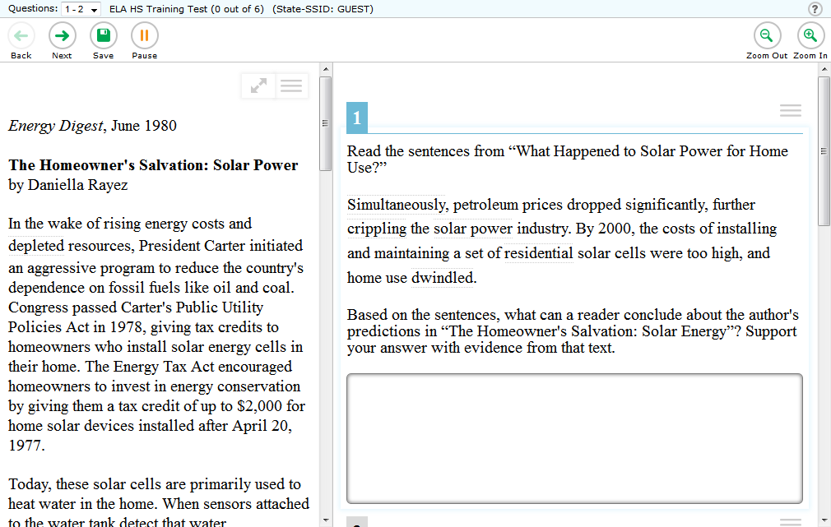
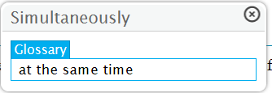
Notes:
Other embedded universal tools and online features appear as a small box when you click on a word.

Slide 21
Notes:
And some embedded universal tools and online features appear when you click the context menu icon for a passage or question.

Slide 22
Tool options may change based on the test or grade level.
Notes:
Embedded universal tools and online features options may change based on the test or grade level.
For example, some mathematics questions may allow a calculator, which, of course, you will not find on the ELA tests.

Slide 23
Embedded Universal Tools Overview
Notes:
Embedded universal tools overview

Slide 24
Let’s talk about the embedded universal tool:
HIGHLIGHTER
Notes:
The first embedded universal tool is the highlighter, and it works just like a highlighter that you might use in your classes.
This embedded universal tool will help you mark important words or text in a passage that you read.

Slide 25
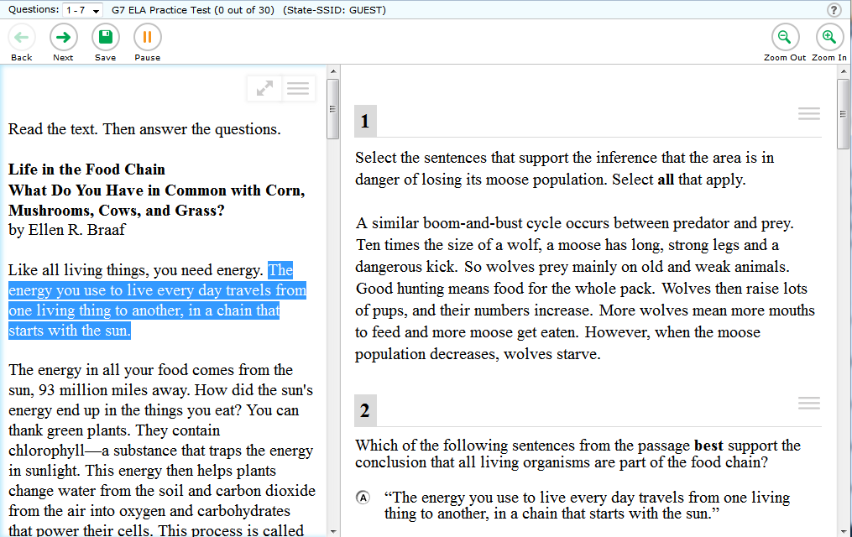
Notes:
To use the highlighter, you will need to use your mouse.
Hold down the left button on your mouse at the beginning of the text you want to highlight.
While holding down the left mouse button, move the mouse to the end of the text that you want to highlight, and release the left mouse button.

Slide 26
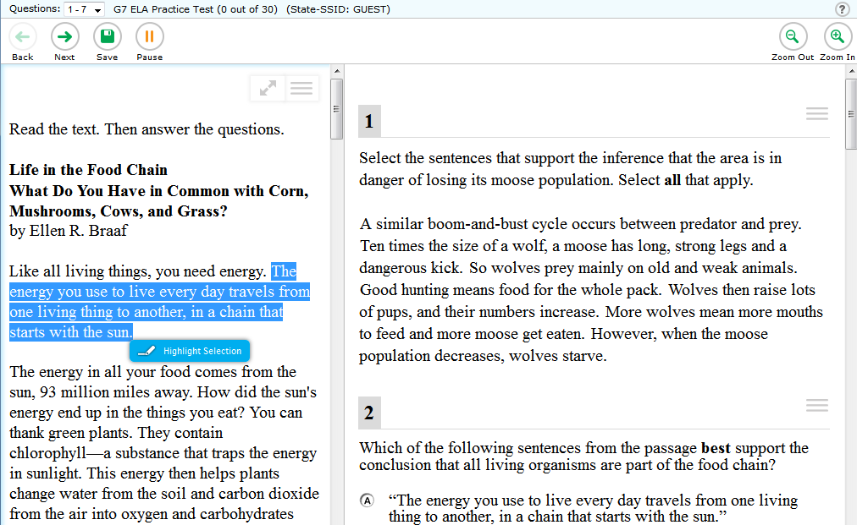
Notes:
Next, within the selected text, right-click and select [Highlight Selection].

Slide 27
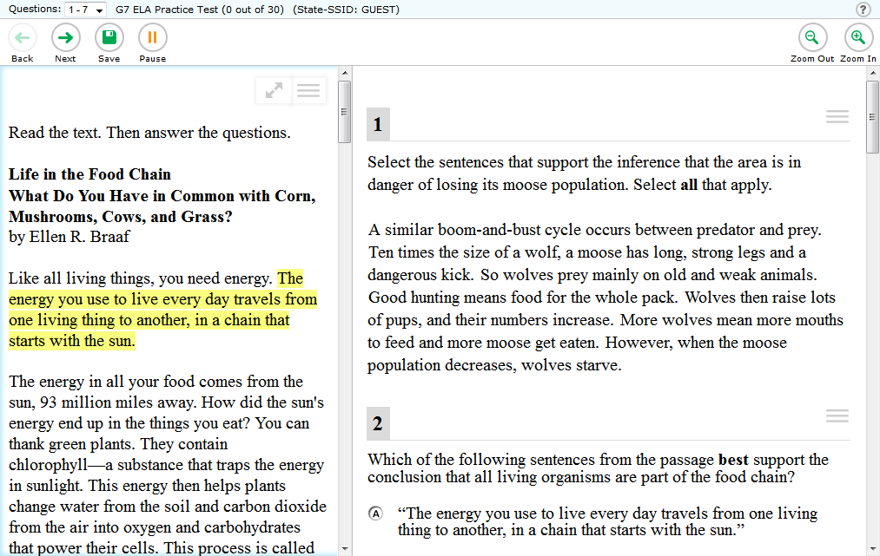
Notes:
The text you selected is now highlighted and will remain highlighted throughout that segment (or section) of the test.

Slide 28
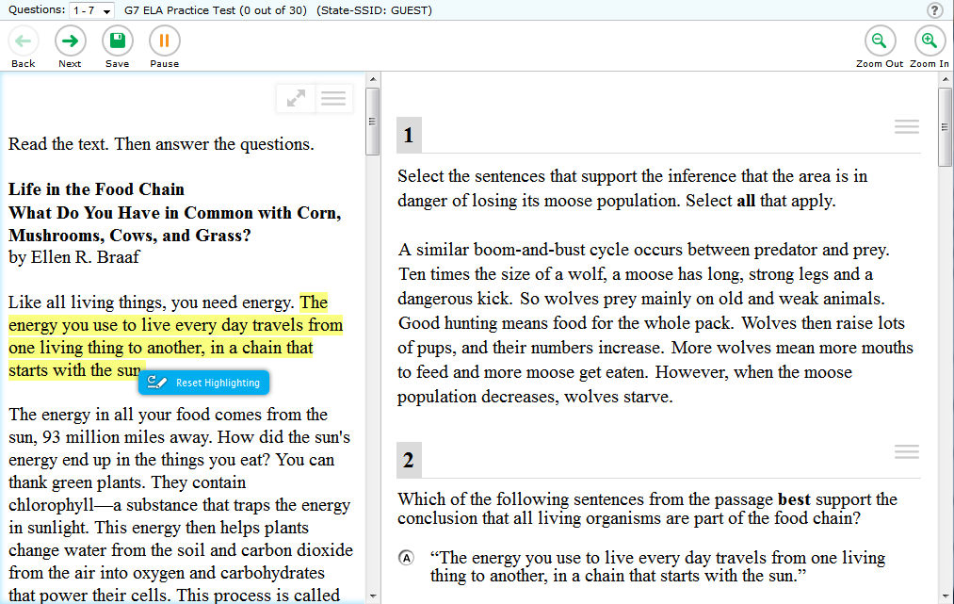
Notes:
To undo or remove the highlight, simply click the highlighted text and then right-click and select [Reset Highlighting]. The highlight is now removed.

Slide 29
Let’s talk about the embedded universal tool: STRIKETHROUGH
Notes:
The next embedded universal tool to help you answer questions is a strikethrough tool.
If you’re looking at a question with multiple answer choices and you know for certain that one is incorrect, you can strike through that option.
It will shade the text for that answer option and show a line through the words to remind you that you do not want to choose that answer option.

Slide 30
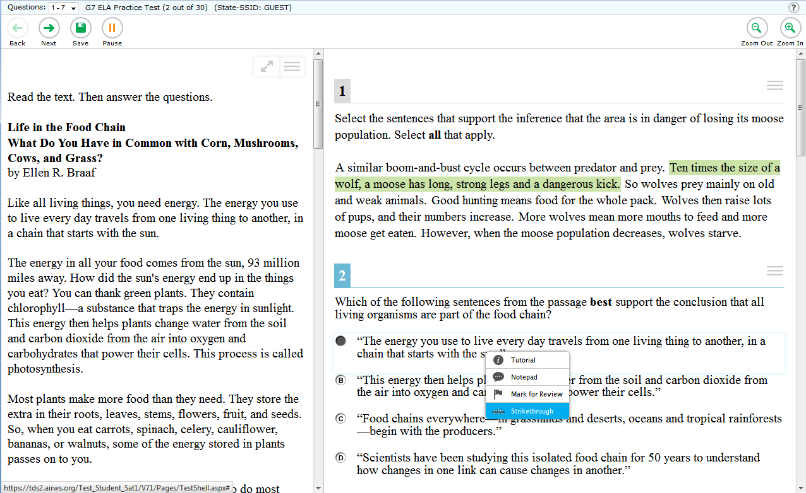
Notes:
To use the strikethrough embedded universal tool, use your mouse and right-click on the answer choice you want to cross out.
When the pop-up box appears, select [Strikethrough].

Slide 31
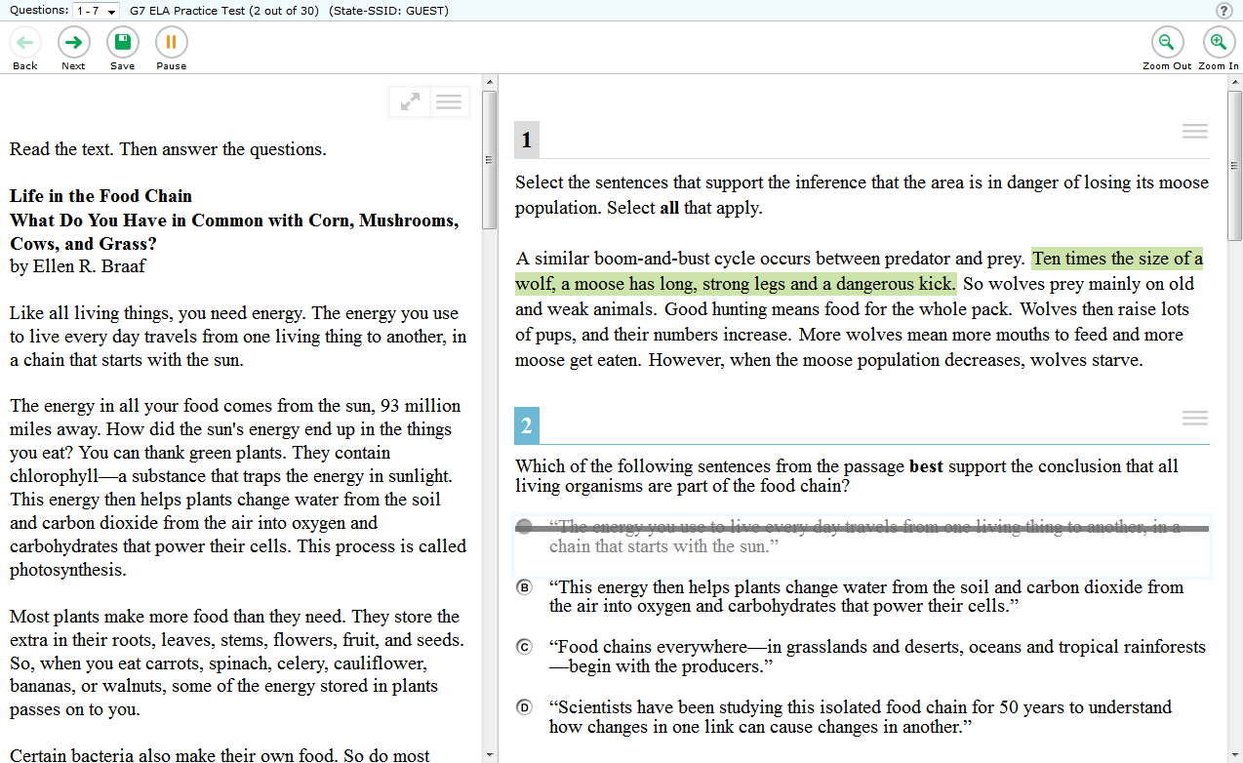
Notes:
That answer choice will now appear shaded with a line through the text.

Slide 32
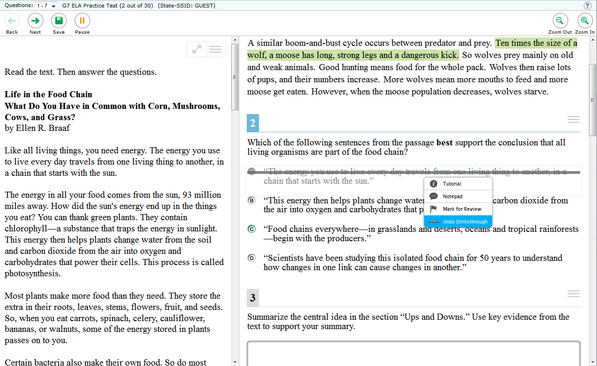
Notes:
To remove a strikethrough, right-click the answer option and select [Undo Strikethrough]. The strikethrough is now removed.

Slide 33
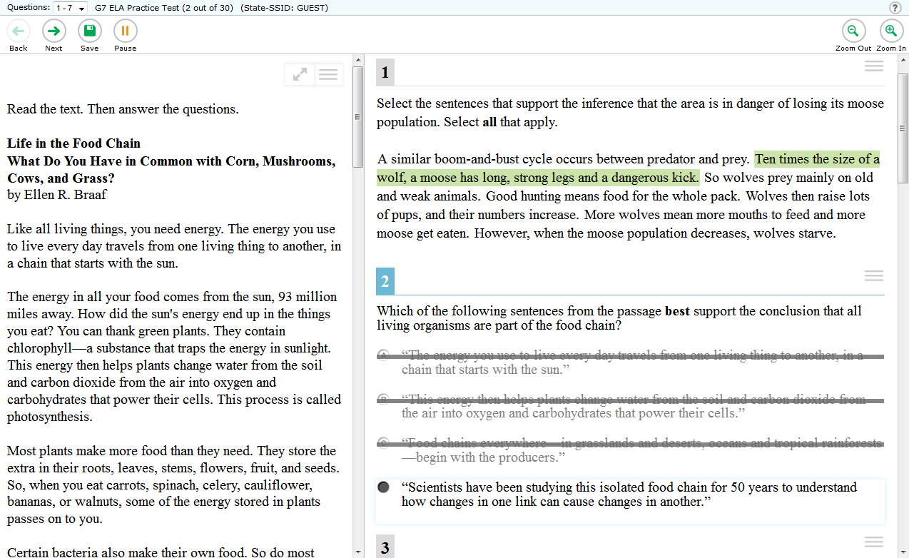
Notes:
Don’t forget: you must still select an answer.

Slide 34
Let’s talk about the embedded universal tool:
DIGITAL NOTEPAD
Notes:
Another embedded universal tool is the digital notepad.
While taking other tests, you may have been allowed to use scratch paper to take notes.
You have that same option on this test, only it can be real paper or the online digital notepad within the test.

Slide 35
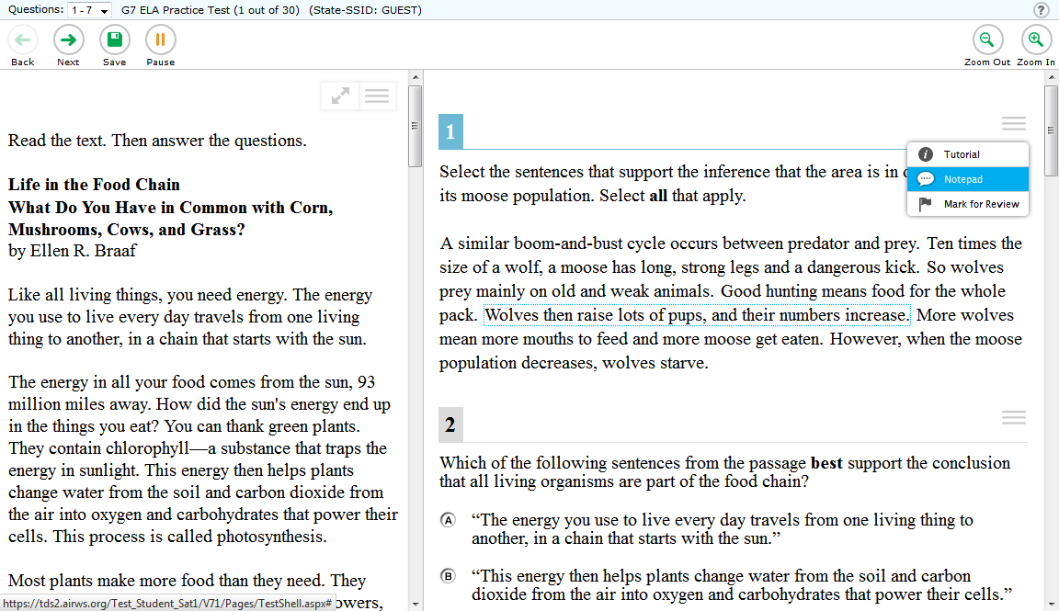
Notes:
To access the digital notepad, open the context menu for a question and click on the [Notepad] option.

Slide 36
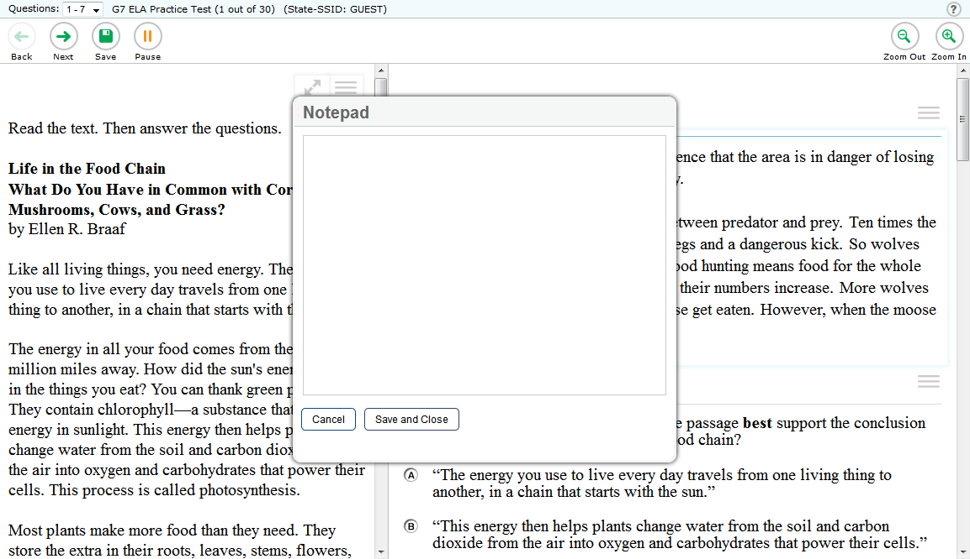
Type your notes here….
Notes:
When you click on the notepad option, a box will appear where you can type your notes.

Slide 37
Type your notes here….
Click “Save and Close” to close the Notepad
Notes:
To close the notepad, click [Save and Close]. You will be able to see your notes until the test session ends. Notes are not saved when the student moves on to the next segment or after a break of more than 20 minutes.
There is a new notepad for each question. For example, if you type notes on question three, you will only see those notes when working on that question. The next question will show a blank notepad.
As long as you have access to the question, you can access your notes by selecting [Notepad] in the context menu for that question. Notes on the digital notepad are available through the end of the test segment.

Slide 38
GLOBAL NOTES
for ELA Performance Task
Notes:
If you’re taking an ELA performance task, you will access your notepad a bit differently. However once it is accessed, it looks and works the same as the digital notepad. An ELA performance task has the embedded universal tool - global notes. This means notes are kept from PART 1 to PART 2 so that a student may go back to the notes for PART 1 even though the student is not able to go back to the three research questions in PART 1.
When this is available, there will be a [Notes] button that appears on the toolbar at the top of the screen. The button looks like a pad of paper and pencil with the word [Notes].
Global Notes is not available for the mathematics performance task. Students should use scratch paper and/or graph paper to take notes.

Slide 39
Let’s talk about the embedded universal tool: Mark for Review
Notes:
There is an embedded universal tool that may be helpful to keep track of your thinking as you answer the questions. Let’s talk about Mark for Review.

Slide 40
Mark for Review allows you to mark the question and come back to review it later.
Notes:
Mark for Review allows you to mark the question and come back to review it later.

Slide 41
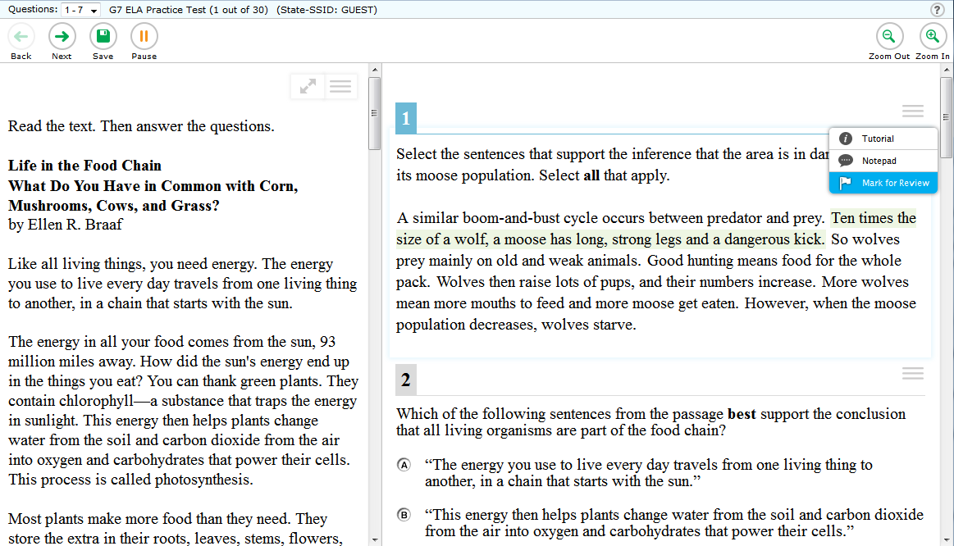
Notes:
If you want to remind yourself to go back to a question, you will open the context menu for a question and select the [Mark for Review] option.

Slide 42
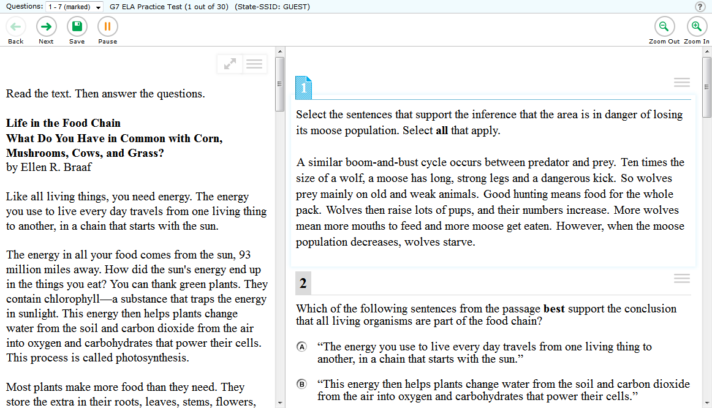
Notes:
To go back to questions you have marked for review, you can either use the back arrow or the question drop down list which is an online feature that we will talk about later in this module.

Slide 43
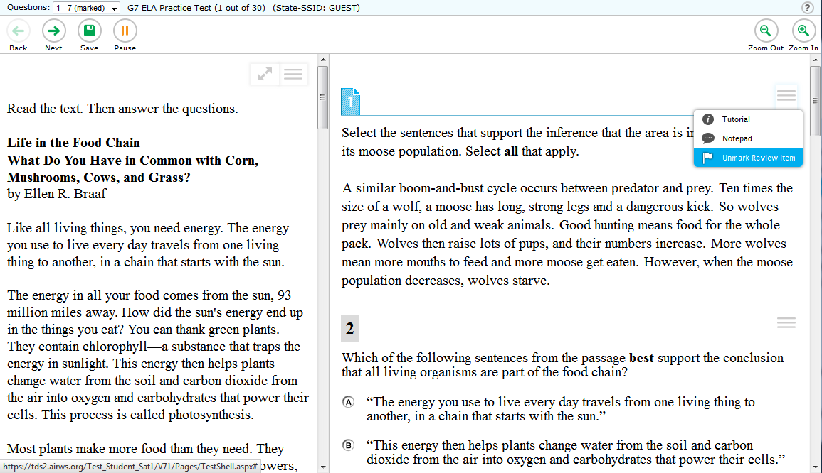
Notes:
Once you have answered the question and no longer want to come back to review it, unmark the question by opening the context menu and selecting the [Unmark Review Item] option.

Slide 44
Let’s talk about the embedded universal tool:
Zoom
Notes:
Another embedded universal tool is Zoom.

Slide 45
You can change the size of the words and pictures on the screen.
Notes:
On the computer, you have the option to change the size of the words and pictures on the screen.

Slide 46
Notes:
The Zoom embedded universal tool is controlled through the [Zoom In] and [Zoom Out] buttons that are located at the top of the toolbar on the right-hand side of the screen.

Slide 47
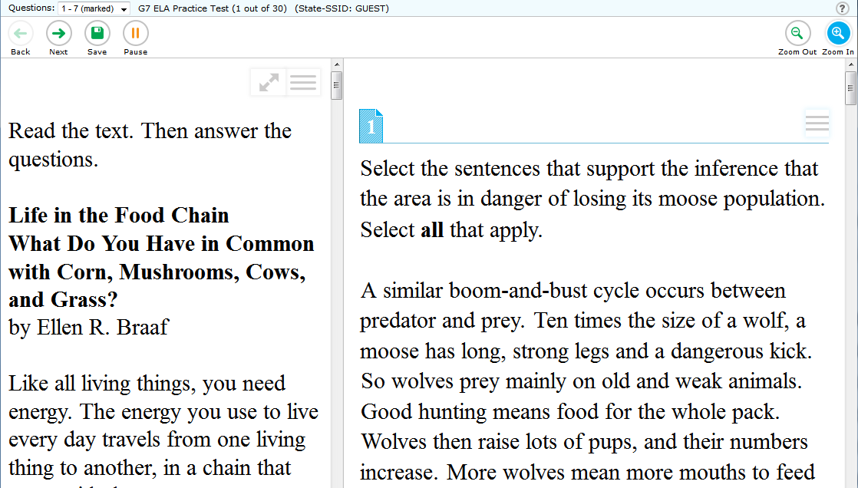
Notes:
To make the words and pictures look bigger, you will click on the [Zoom In] button at the top right of the toolbar.

Slide 48
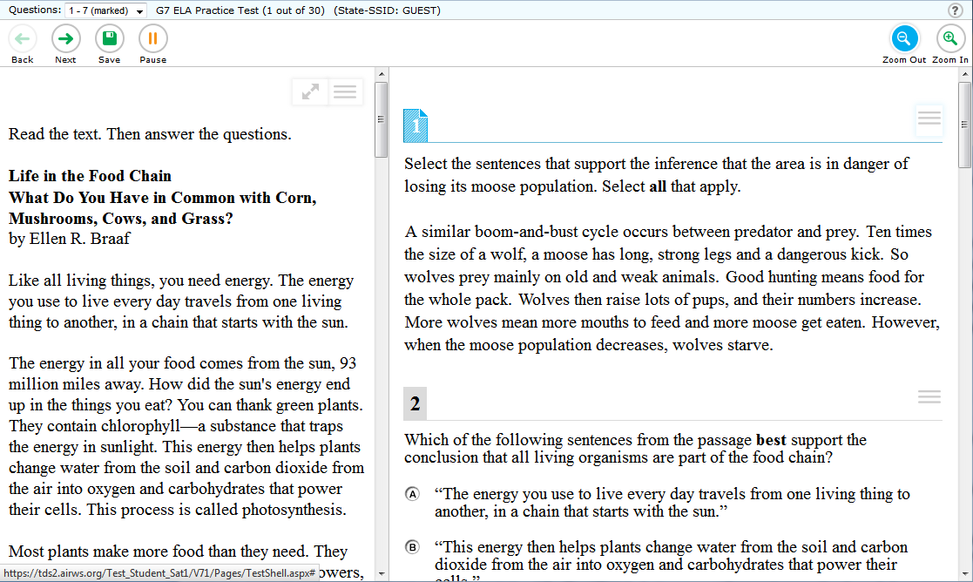
Notes:
To make the words and pictures look smaller, click the [Zoom Out] button.

Slide 49
Let’s talk about the embedded universal tool:
Expandable Passages
Notes:
Next, let’s talk about the embedded universal tool - Expandable Passages.

Slide 50
Notes:
If you wish to expand or make the space bigger for the reading area of a passage or stimulus, you can click on the [Passage/Stimulus Expansion] button.
This is a box above the passage with a double-arrow symbol.

Slide 51
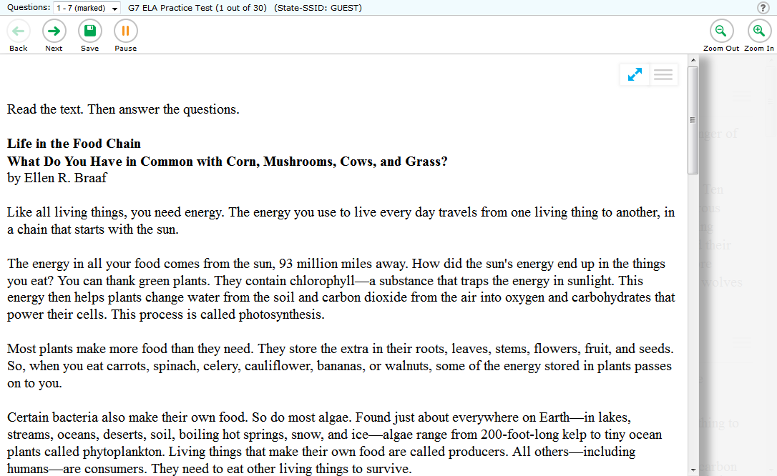
Notes:
The Expandable Passages embedded universal tool expands the width of the passage window to make it easier to read the passage or stimulus.

Slide 52
Notes:
To collapse the passage or stimulus area and return to the regular view, click the double-arrow button again.

Slide 53
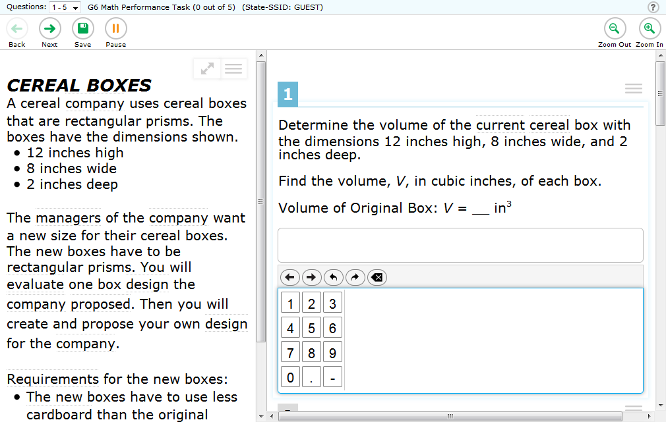
Let’s talk about the embedded universal tool:
Calculator
Notes:
The calculator is an embedded universal tool that is available to students in grades 6-8 and 11 on mathematics questions where a calculator is allowed.

Slide 54
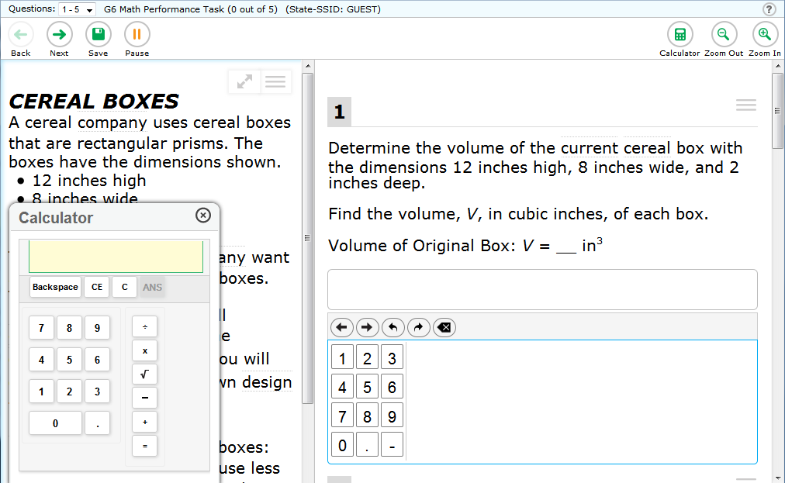
Notes:
When the calculator is allowed, it is displayed as a button on the toolbar on the right side near the Zoom buttons. If the question does not allow a calculator, the [Calculator] button will not appear on the tool bar.
You’re probably familiar with using a calculator. Click on the [Calculator] button to access the calculator. Once clicked, the appropriate calculator will appear for your use.

Slide 55
Notes:
To close the calculator, click the [X] in the top right-hand corner of the calculator.

Slide 56
Let’s talk about the embedded universal tool:
Dictionary and Thesaurus
Notes:
The Dictionary and Thesaurus is an embedded universal tool that is available for the full-write portion (the 2nd part) of the ELA performance task. With this embedded universal tool, you can access a dictionary or thesaurus to view more information about a word.

Slide 57
Notes:
To access this embedded universal tool, simply click on the [Dictionary] button in the upper right-hand corner.

Slide 58
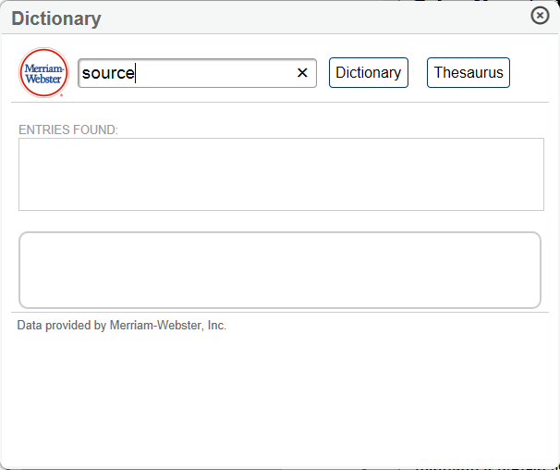
Notes:
A pop-up will appear that gives you access to both a dictionary and a thesaurus.
Type the word you want to use in the blank space and then click either [Dictionary] or [Thesaurus].

Slide 59
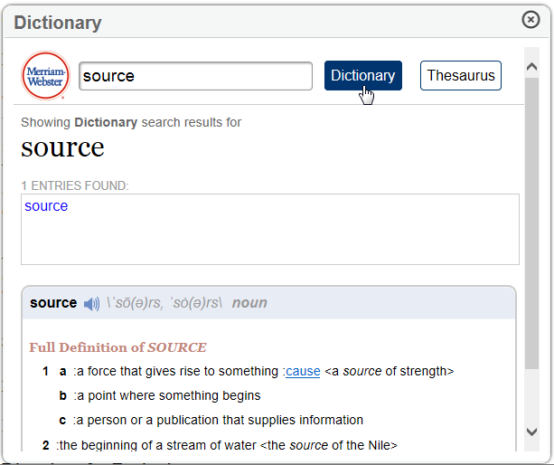
Notes:
The definition for the word will appear if you selected [Dictionary], or the synonym will appear if you selected [Thesaurus].

Slide 60
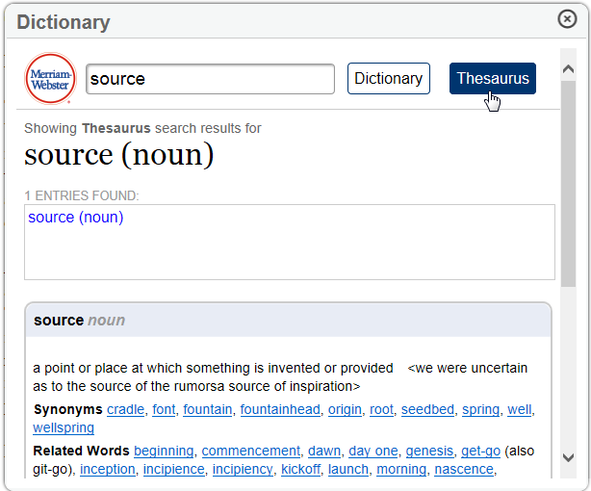
Notes:
You can switch between the [Dictionary] and [Thesaurus] for the same word by simply selecting the button that corresponds to each.

Slide 61
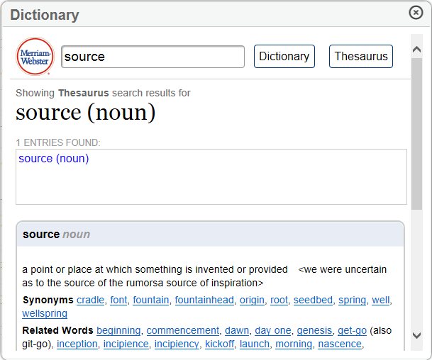
Notes:
To close the [Dictionary] or [Thesaurus], click the [X] in the upper right-hand corner.

Slide 62
Let’s talk about the embedded universal tool:
English Glossary
Notes:
Sometimes you may be unfamiliar with how a word is used in a particular sentence. In those cases, the test provides an English Glossary as an embedded universal tool to give you some additional help to understand that word better.

Slide 63
Notes:
When you see a word surrounded top and bottom by a dotted line, this means there is a definition available for that particular word. You will notice this embedded universal tool is not available for all words.

Slide 64
Notes:
When available, simply place your mouse over the word, and it will become blue.

Slide 65
Notes:
Click on the word, and a pop-up window will appear with a definition.

Slide 66

Notes:
To close the glossary window, click the [X] in the upper right-hand corner.

Slide 67
Let’s talk about the embedded universal tool:
Writing Tools
Notes:
The online test comes with the embedded universal tool called Writing Tools, which is similar to many common word processing program functions.

Slide 68
Notes:
For example: bold, italics, underlining, bullets, undo, and redo.

Slide 69
Notes:
Spell-check is included where allowed. Writing tools may be available for both mathematics and ELA items where you need to write a response.

Slide 70
Let’s review the embedded universal tools we have discussed.
Notes:
Before moving on to online features, let’s review what you have learned so far by quickly looking at the embedded universal tools we have discussed.

Slide 71
Highlighter
Notes:
Highlighter

Slide 72
Strikethrough
Notes:
Strikethrough

Slide 73
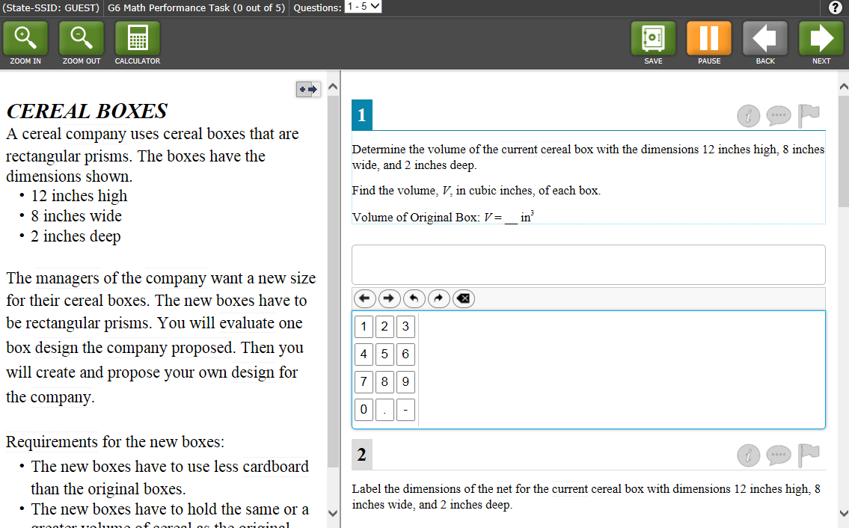
Type your notes here….
Digital Notepad
Notes:
Digital Notepad

Slide 74
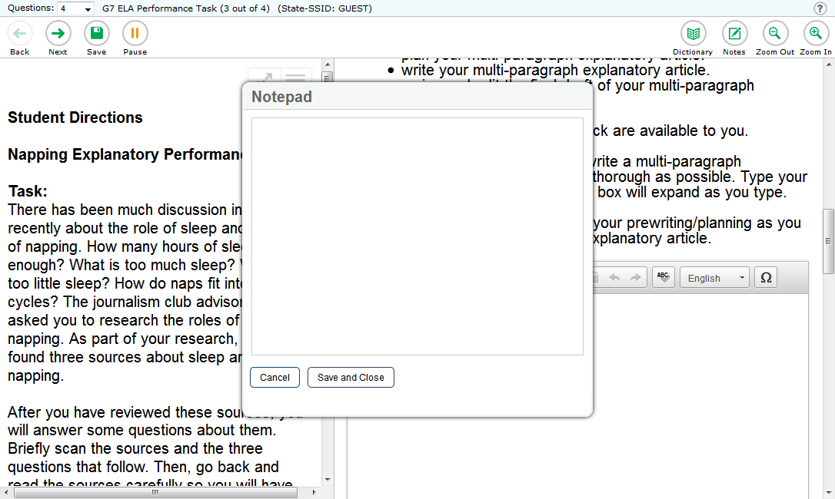
Global Notes for ELA Performance Task
Type your notes here….
Global Notes for ELA Performance Task
Notes:
Global Notes for the ELA Performance Task

Slide 75
Mark for Review
Notes:
Mark for Review

Slide 76
Zoom
Notes:
Zoom to enlarge or reduce the text size

Slide 77
Expandable Passages
Notes:
Expandable Passages

Slide 78
Calculator
Notes:
Calculator, which is available for this mathematics item, but is not available for all mathematics items.

Slide 79
Dictionary and Thesaurus
Notes:
Dictionary and Thesaurus

Slide 80
English Glossary
Notes:
English Glossary

Slide 81
Writing Tools
Notes:
Writing Tools: bold, italics, underlining, bullets, undo/redo, and spell-check where allowed.

Slide 82
Online Features Overview
Notes:
Online Features Overview

Slide 83

Let’s look at online features next.
Notes:
In addition to the embedded universal tools, there are online features that you should also know about.
Let’s look at the online features on these sample screens. These online features will help you navigate through the test, give you more information, and work in conjunction with the universal tools.

Slide 84
Question mark/
Help Guide
Notes:
The first online feature is the question mark icon. You can click on the [question mark] icon to view the Help Guide.

Slide 85
Question drop down list
Notes:
An online feature that can be used in conjunction with the embedded universal tool, Mark for Review, is the question drop down list.
This online feature allows you to go back and forth between questions within a segment on a test and shows you questions you’ve already answered.
When you click the drop-down list, questions marked for review will show “Marked” next to the question number.
This will allow you to easily make changes to previously answered questions by taking you directly to the pages containing the marked questions.

Slide 86
Save button
Notes:
The [Save] button—this online feature will appear only for certain item types.
For longer responses, make sure to save your answer or writing frequently.

Slide 87
Pause button
Notes:
The [Pause] button - this online feature can be used to pause your test for a short break.
When you pause your test, a pop-up message will appear asking you to confirm that you want to pause the test. You will be logged out when your test is paused. Some rules apply, so be sure to talk with your Test Administrator before using the [Pause] button.

Slide 88
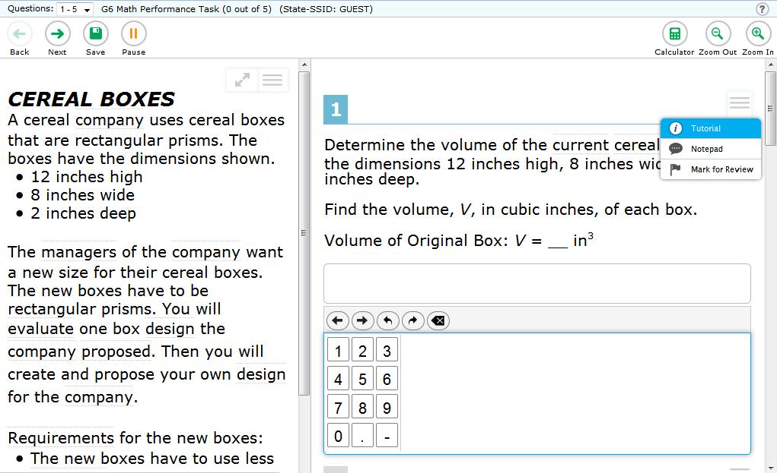
Item Tutorial
Notes:
The Item Tutorial online feature gives you more direction on what you are to do for a particular item type. Open the context menu for a question and select the [Tutorial] option.

Slide 89
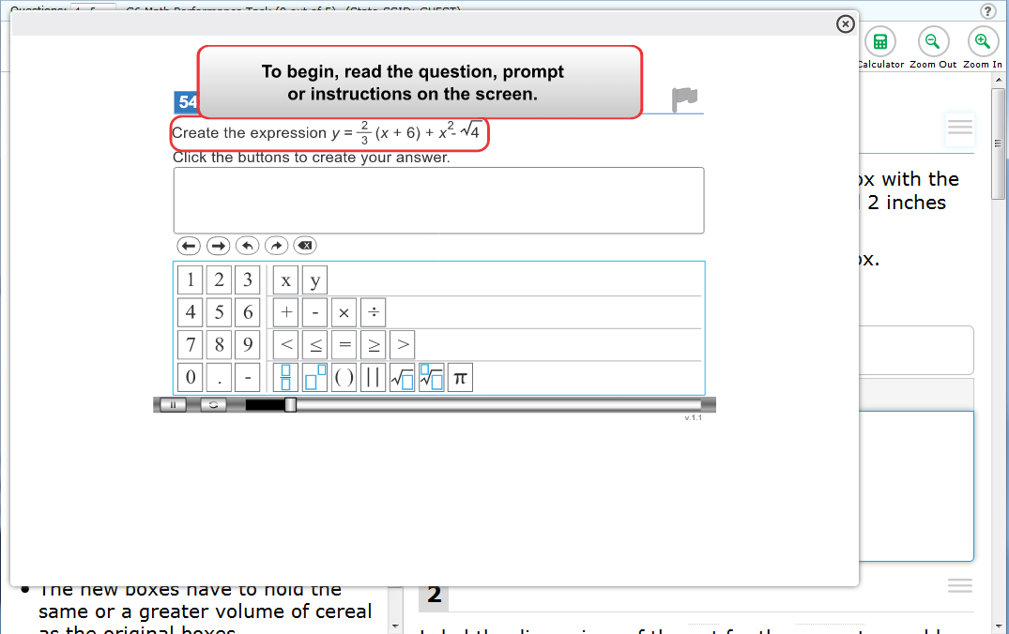
Notes:
Clicking the [Tutorial] online feature will tell you how a particular type of question works.
For example, it may inform you how to select an answer, drag and drop answers, or type an answer in a student response answer space.

Slide 90
Back and Next
Notes:
[Back] and [Next]- this online feature allows you to click these buttons to move between pages.

Slide 91
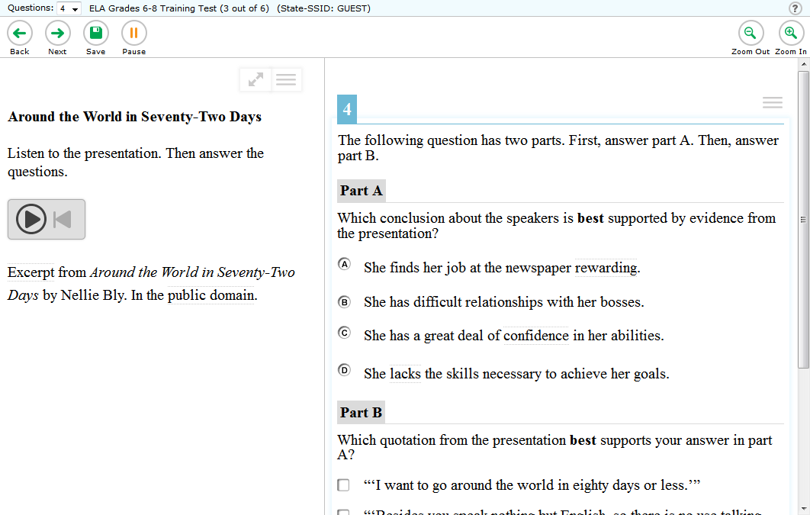
Listening Item buttons
Notes:
Lastly, you may have some items that require you to listen to audio - the listening item online feature helps with that.

Slide 92
Notes:
To play the audio, click the circle with the right arrow in it.

Slide 93
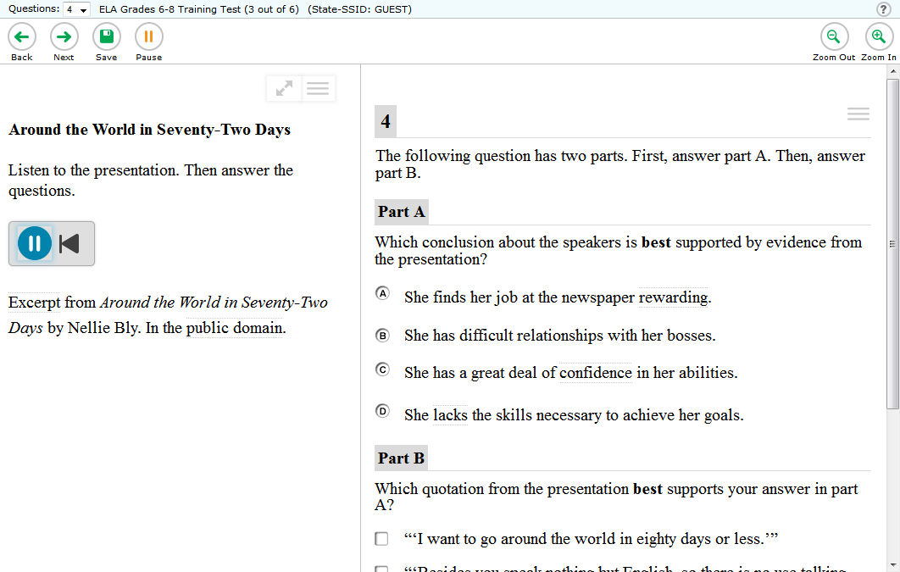
Notes:
To pause the audio, click the circle with the two vertical lines that appears once the audio clip has started playing.

Slide 94
Notes:
To stop or start the audio clip over, click the left arrow with the line to the left of it.

Slide 95
Embedded Universal Tools and
Online Features
Review
Notes:
Embedded universal tools and online features review

Slide 96
Embedded Universal Tools and Online Features Review:
Familiarize yourself with all of the embedded universal tools and online features.
Plan on using the ones with which you are most comfortable.
Use tools that make the most sense for a particular question.
Notes:
These are the embedded universal tools and online features available on the test.
You should familiarize yourself with all the embedded universal tools and online features, but plan on using only the ones with which you are most comfortable or that make the most sense for a particular question.
Remember, these embedded universal tools and online features are here to help you answer test questions only.

Slide 97
Embedded Universal Tools and Online Features Resources:
Practice using the tools in the Practice Test or Training Test.
Visit the Smarter Balanced website for more information.
Notes:
Now that you know about the embedded universal tools and online features available on the online test, you can practice using many of them on the Practice Test or Training Test. Ask your teacher how to access these tests.
These embedded universal tools and online features have been included in the online assessments to help you do your very best.

Slide 98
For more information
please visit:
www.smarterbalanced.org
Notes:
For more information please visit:
www.smarterbalanced.org

